Slide 1
Philosophy of Education
Zuzana Svobodova

Slide 2
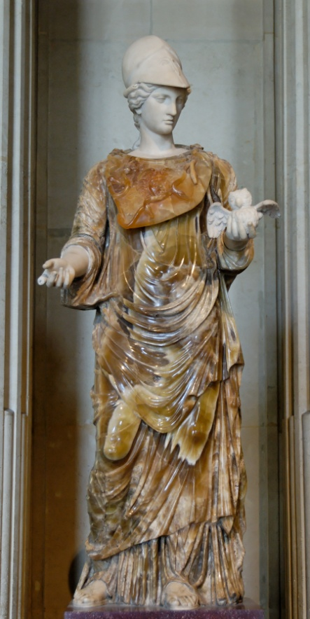
philosophia love of wisdom from Greek philein (to love) + sophia (wisdom) philosophers: lovers of wisdom
Notes:
synonyms: thinking, reasoning, thought, wisdom, knowledge
Middle English: from Old French philosophie, via Latin from Greek
Statue of Liberty (not of freedom!)

Slide 3
Philosophy philosophia literally means the love of wisdom from Greek philein (to love) + sophia (wisdom) → philosophers: lovers of wisdom
the study of general and fundamental problems –
liberal arts (latin: artes liberales)
Notes:
synonyms: thinking, reasoning, thought, wisdom, knowledge
Middle English: from Old French philosophie, via Latin from Greek
Statue of Liberty (not of freedom!)
Philosophy, (from Greek, by way of Latin, philosophia, “love of wisdom”) the critical examination of the grounds for fundamental beliefs and an analysis of the basic concepts employed in the expression of such beliefs. Philosophical inquiry is a central element in the intellectual history of many historical civilizations.
Philosophy. (2015). In Encyclopædia Britannica. Retrieved from http://www.britannica.com/EBchecked/topic/456811/philosophy
liberal arts: academic subjects such as literature, philosophy, mathematics as distinct from professional sciences; the term generally refers to matters not relating to the professional, vocational, or technical curricula („vocational training“). Education is divided nowadays, all too neatly, between liberal arts and the sciences. But according to Encyclopaedia Britannica: „In the medieval European university the seven liberal arts were grammar, rhetoric, and logic (the trivium) and geometry, arithmetic, music, and astronomy (the quadrivium). In modern colleges and universities the liberal arts include the study of literature, languages, philosophy, history, mathematics, and science as the basis of a general, or liberal, education. Sometimes the liberal-arts curriculum is described as comprehending study of three main branches of knowledge: the humanities (literature, language, philosophy, the fine arts, and history), the physical and biological sciences and mathematics, and the social sciences.“ (liberal arts. (2015). In Encyclopædia Britannica. Retrieved from http://www.britannica.com/EBchecked/topic/339020/liberal-arts)
Social sciences: economics, political science, sociology, history.
Fine arts: Historically, the five main fine arts were painting, sculpture, architecture, music and poetry, with performing arts including theater and dance. Today, the fine arts commonly include additional forms, such as film, photography, conceptual art, and printmaking. This definition originally excluded the applied or decorative arts, and the products of what were regarded as crafts.
The liberal arts (Latin: artes liberales) are those subjects or skills that in classical antiquity were considered essential for a free person (Latin: liberal, "worthy of a free person“) to know in order to take an active part in civic life, something that (for Ancient Greece) included participating in public debate, defending oneself in court, serving on juries, and most importantly, military service. Grammar, rhetoric, and logic were the core liberal arts, while arithmetic, geometry, the theory of music, and astronomy also played a (somewhat lesser) part in education.
(http://en.wikipedia.org/wiki/Liberal_arts_education)
Paideia, (Greek: “education,” or “learning”), system of education and training in classical Greek and Hellenistic (Greco-Roman) cultures that included such subjects as gymnastics, grammar, rhetoric, music, mathematics, geography, natural history, and philosophy. In the early Christian era the Greek paideia, called humanitas in Latin, served as a model for Christian institutions of higher learning, such as the Christian school of Alexandria in Egypt, which offered theology as the culminating science of their curricula. The term was combined with enkyklios (“complete system,” or “circle”) to identify a large compendium of general education, hence “encyclopaedia.”
Paideia. (2015). In Encyclopædia Britannica. Retrieved from http://www.britannica.com/EBchecked/topic/438425/paideia
Humanities, those branches of knowledge that concern themselves with human beings and their culture or with analytic and critical methods of inquiry derived from an appreciation of human values and of the unique ability of the human spirit to express itself. As a group of educational disciplines, the humanities are distinguished in content and method from the physical and biological sciences and, somewhat less decisively, from the social sciences. The humanities include the study of all languages and literatures, the arts, history, and philosophy. The humanities are sometimes organized as a school or administrative division in many colleges and universities in the United States.
The modern conception of the humanities has its origin in the Classical Greek paideia, a course of general education dating from the sophists in the mid-5th century bce, which prepared young men for active citizenship in the polis, or city-state; and in Cicero’s humanitas (literally, “human nature”), a program of training proper for orators, first set forth in De Oratore (Of the Orator) in 55 bce. In the early Middle Ages the Church Fathers, including St. Augustine, himself a rhetorician, adapted paideia and humanitas—or the bonae (“good”), or liberales (“liberal”), arts, as they were also called—to a program of basic Christian education; mathematics, linguistic and philological studies, and some history, philosophy, and science were included.
The word humanitas, although not the substance of its component disciplines, dropped out of common use in the later Middle Ages but underwent a flowering and a transformation in the Renaissance. The term studia humanitatis (“studies of humanity”) was used by 15th-century Italian humanists to denote secular literary and scholarly activities (in grammar, rhetoric, poetry, history, moral philosophy, and ancient Greek and Latin studies) that the humanists thought to be essentially humane and Classical studies rather than divine ones. In the 18th century, Denis Diderot and the French Encyclopédistes censured studia humanitatis for what they claimed had by then become its dry, exclusive concentration on Latin and Greek texts and language. By the 19th century, when the purview of the humanities expanded, the humanities had begun to take their identity not so much from their separation from the realm of the divine as from their exclusion of the material and methods of the maturing physical sciences, which tended to examine the world and its phenomena objectively, without reference to human meaning and purpose.
Contemporary conceptions of the humanities resemble earlier conceptions in that they propose a complete educational program based on the propagation of a self-sufficient system of human values. But they differ in that they also propose to distinguish the humanities from the social sciences as well as from the physical sciences, and in that they dispute among themselves as to whether an emphasis on the subject matter or on the methods of the humanities is most effectual in accomplishing this distinction. In the late 19th century the German philosopher Wilhelm Dilthey called the humanities “the spiritual sciences” and “the human sciences” and described them, simply, as those areas of knowledge that lay outside of, and beyond, the subject matter of the physical sciences. On the other hand, Heinrich Rickert, a turn-of-the-century Neo-Kantian, argued that it is not subject matter but method of investigation that best characterizes the humanities; Rickert contended that whereas the physical sciences aim to move from particular instances to general laws, the human sciences are “idiographic”—they are devoted to the unique value of the particular within its cultural and human contexts and do not seek general laws.
Humanities. (2015). In Encyclopædia Britannica. Retrieved from http://www.britannica.com/EBchecked/topic/276026/humanities

Slide 4
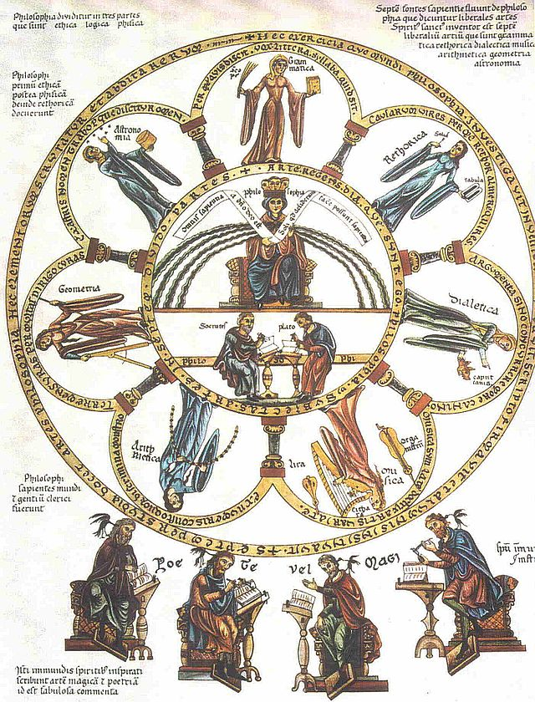
Notes:
„Septem-artes-liberales Herrad-von-Landsberg Hortus-deliciarum 1180“ od Herrad von Landsberg – Hortus Deliciarum. Licencováno pod Volné dílo via Wikimedia Commons - http://commons.wikimedia.org/wiki/File:Septem-artes-liberales_Herrad-von-Landsberg_Hortus-deliciarum_1180.jpg#mediaviewer/File:Septem-artes-liberales_Herrad-von-Landsberg_Hortus-deliciarum_1180.jpg

Slide 5
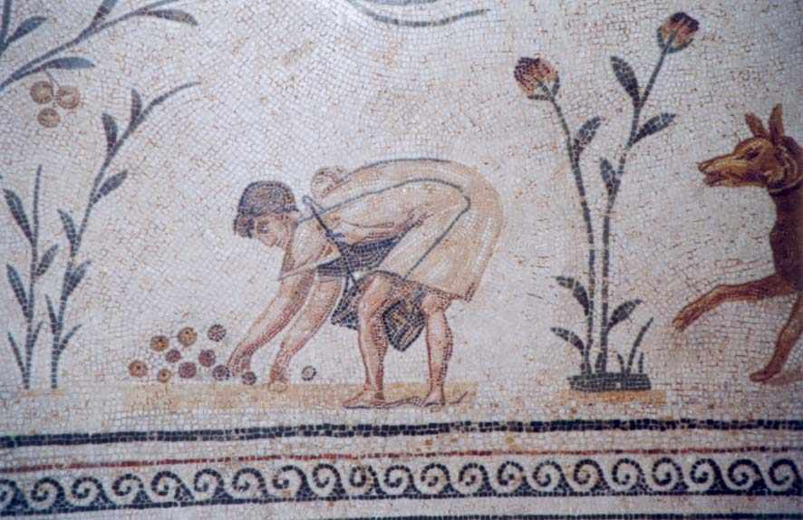
„Le cultivateur“

Slide 6
Paideia in classical antiquity
Ancient Greeks associated the education process with the term paideia; only later was this term also used to refer to the contents of education (education in the sense of gaining knowledge, skills and attitudes), exactly as the German term Bildung or the Latin word cultura with the same meaning have objectivised.

Slide 7
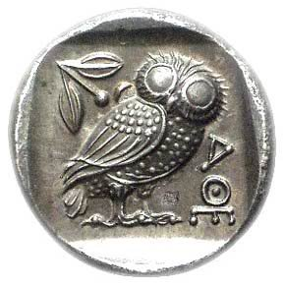
Philosophy
philosophy is about your attitude towards knowledge/being/life more than about studying a body of knowledge/being/life (in this way, philosophy differs from all other disciplines (-logy: for example, bio-logy – the study of life)
In this course, you should think about your own regards (relationships, respect).

Slide 8
Where does philosophy (ethics) come from?
? reflection (thought) ?
! shame (blush) !
! anxiety (fear, distress, worry) !
? shake out (from evidence; loss of confidence) ?

Slide 9
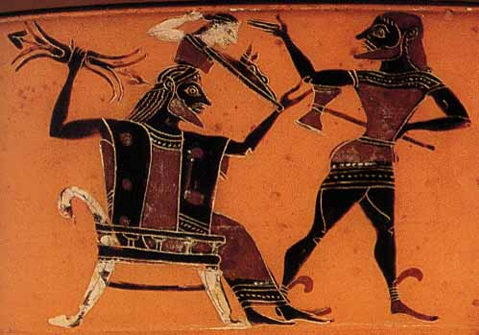
The birth of Athena „Source“ of wisdom: strength, experience
Notes:
Hephaestus (strength, experience) assisting Zeus in the birth of Athena. Vase painting, ca. 570 B.C.

Slide 10
The birth of Athena
„Source“ of wisdom: innocence/purity, beauty
Notes:
Eileithyia (innocence, purity) and Hera (beauty) assisting Zeus in the birth of Athena. Vase painting, ca. 500 B.C. (Louvre CA616; photograph by Maria Daniels)

Slide 11
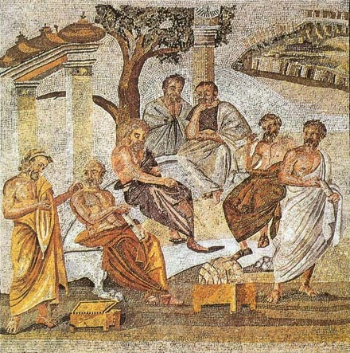
The School of Athens
Source: LOGOS

Slide 12
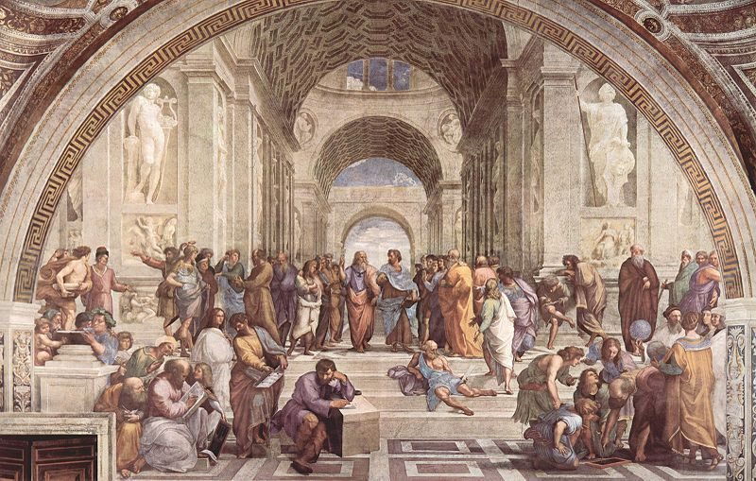
The School of Athens Sources: Ideas or Sense or Sensibility or …?
Antisthenes
Plotinus
Socrates
Plato
Aristotle
Parmenides
Epicurus
Diogenes
Pythagoras
Heraclitus
Notes:
Fresco by Raphael (in Musei Vaticani). In the middle Plato (left) and Aristotle (right): Aristotle gestures to the earth, representing his belief in knowledge through empirical observation and experience, while holding a copy of his Nicomachean Ethics in his hand, whilst Plato gestures to the heavens, representing his belief in The Forms, holding a copy of his Timaios.

Slide 13
Reflection about differences
mythos kai logos ('story' and 'meaning')
fysis kai techné ('nature' and 'art' )
praxis kai theoria ('action' and 'view')
epistémé kai fronésis ('science' and 'wisdom')
Notes:
gr. mythos – word, story, narration
gr. logos – word, reason, issue, argument, meaning, idea, concept
gr. fysis – natural, organic
gr. techné – art, method (technology)
gr. praxis – act, action, work, doing
gr. theoria – procession, view, spectacle, theory
gr. epistémé – science, knowledge, understanding
gr. fronésis – (practical) wisdom
Metaph. 981a6-981b6

Slide 14
„Metanoeite!“ (meta-noésis)
Change your mind!
by
reflection shame anxiety
shake out
…

Slide 15
PAIDEIA
Allegedly, the first time the word paideia appears in Aeschylus’ work Seven Against Thebes (467 B.C.); its meaning is similar to trofé (nurture, nourishment, behaviour, educating; trofeion – educational, nurturing; trofeus, trofos – educator, foster parent).

Slide 16
PAIDEIA
From the very beginning, the word paideia has also been close to areté, as it was already in Homer in his Iliad and Odyssey. In the 5th century B.C. we also often find the word paideia in the ‘lower’ sense, i.e., approximately in the sense of nurture, care (of a child). When Aristophanes uses the expression ‘old paideia’ in his satire entitled Clouds (418 B.C.), he means the Athenian education approximately in early 5th century B.C., which was also special beginning in the mid-6th century B.C. – typical of its newly non-military character.

Slide 17
PAIDEIA
From the 4th century B.C., a ‘new paideia’ was known, as it was born from a crisis and fall and therefore clinged to the heights; now it is about education level in the sense of striving for nobility, integrity. New paideia expresses its essence in the phrase ‘care of the soul’, which will later be called cultura animi and philosophia by Cicero or humanita by Cicero and Varro, i.e., striving for humanity, a culture itself.
Therefore, Werner Jaeger can write that the history of Greek paideia is the history of Greek literature, expressing the very essence of Greek history, the process of shaping of the Greek character. Those who participate in Greek paideia, not necessarily those who share Greek nationality, are the real Greeks, as Isocrates reminds us.

Slide 18
PAIDEIA
The polysemy of what is referred to as paideia is manifested quite soon. The view of the dual paideia is particularly famous in this polysemy: one paideia which is later described by Dio Chrysostom as divine education (daimonios, theia), which is great, strong and easy, and the other human paideia (anthrópiné), which is small, weak, long, and involves many risks.

Slide 19
PAIDEIA
It is not necessary to demonstrate extensively how Plato’s paideia is connected with godliness. The true godliness is a manifestation of the true paideia. God is the educator of the whole world. Therefore, later many Christian thinkers could accept much of Plato without major corrections.

Slide 20
PAIDEIA
According to Jaeger’s research, the norms of human and social behaviour in Greek paideia have always been derived from sacred norms of the world which were called physis – natural (natura). It is also the fundamental and characteristic manifestation of the entire Greek philosophy, that all breathes together (panta sympnei), all shares the common spirit (pneuma, spiritus) or soul (psyché, anima) which brings everything to life – the thought of one spirit spreading through the whole organism comes from Greek medicine from which it made it to stoic philosophy.

Slide 21
PAIDEIA
Jan Patočka, when interpreting Plato’s role in history, speaks about Plato’s transformation of the myth into religion, i.e., transformation from the passive fantasy (which does not know that it is fantasy, which is substantially practical) into a reality which requires personal activity, personal interest and faith. Patočka calls it the first purely moral religion.
Therefore Plato’s care of the soul, breaking free from the sphere of apeiron (from the sphere of indulging in desires which are capable of growing without limits, from the principle of multiplicity and uncertainty), to a higher, graduated, concentrated, definite and formed up being that does not dissolve but is. It is the essence of probably the most famous story wherein the essence and structure of paideia is shown: the story by Plato about the difference between the educated and uneducated soul.

Slide 22
PAIDEIA
‘Paideia is above all periagógé, conversion of the soul. ... Paideia as movement aims at shaping up the soul...’. Paideia is therefore a movement to find the form, direction and purpose of the soul; therefore, it is possible to refer to paideia as religion (Plato describes a soul which sees the essence of existence as circling in the traces of the gods).
A soul that does not pursue paideia is not idle but is in motion – if it is a soul, it is always in motion – but this is an aperatic loss of appearance, a form of blurring in an uncertain illusion where the soul is diffused in diverse desires up to superficial oscillation in multiplicity. It is therefore possible to call this state a passive fantasy, which is the opposite of a definite religion or spirituality.

Slide 23
PAIDEIA
Paideia as an essential, deliberate and oriented care of the soul establishes a new concept of a citizen’s task. The ruler in his Constitution is the most excellent result of education, and his task is to be the greatest educator.
He who cares the most about the education of the soul (psychés paideusis) is the one who really loves.

Slide 24
PAIDEIA
The objective in Plato is also ‘conversion’ – in the sense of turning to the light of the true Being. If Plato speaks about god in this context, there is a great difference from the traditional Olympic gods; therefore, for his followers the philosophical system of the Hellenist period was a way of ‘spiritual refuge’.

Slide 25
PAIDEIA
For Plato, god is the world’s educator, god is the measure of everything (as opposed to Protagoras’ understanding that man is the measure of existence of all things).
The objective of the true education is true justice. The true education corresponds with the process of building the state. Therefore, Henri Irene Marrou can speak in his work Histoire de l´education dans l´antiquité, about the paideia civilization which he sees between the civilizations polis and theópolis.

Slide 26
PAIDEIA
Plato. Resp. 514-520: ‘tén hémeteran fysin paideias te peri kai apaideusias

Slide 27
PAIDEIA
When Aristotle, knowing Homer, searches for the term to describe the essence of education, the focus of his efforts, he finds an example in an old term describing the noble morality, in areté in its highest meaning.
In Politics Aristotle mostly deals with education in connection with the antique ideal of an educated, versed and mature man: kalokagathos.

Slide 28
PAIDEIA
Aristotle considered all of ethics to be a part of political science because for him, man was directly defined by the definiteness of his life for life in a community (then, of course, ethics was also a matter of the community).
The community precedes an individual, just as the whole precedes the part. Also, according to Nicomachean Ethics, man is intended for life in a community (in the sense of purpose).

Slide 29
PAIDEIA
Aristotle. Politics. 1278 b 19: ‘estin anthrópos zóon politikon’. Cf. Aristotle. Politics. 1253a 2. 9: ‘ho anthrópos fysei politikon zóon’, ‘politikon ho anthrópos zóon’.
Aristotle. Ethica Nic. 1097b 11: ‘fysei polikon ho anthrópos’.

Slide 30
PAIDEIA
When Alexander the Great initiated the establishment of a cosmopolitan city bearing his name, Alexandria, its citizens also included Diaspora Jews, who were granted as a reward for the alliance the same rights as the Hellenists.

Slide 31
PAIDEIA
Jews in Alexandria spoke Greek and at some point starting in the 3rd century B.C. they started using the Greek translation of the Law (Torah) – Pentateuch, subsequently followed by translations of other books of the Old Testament.
Thus, gradually until the 1st century B.C. the Greek set of Jewish writings called Septuagint was written. This text also contains the concept of paideia. In most places, the word is used in the sense of ‘rebuke’, ‘punishment’, ‘teaching’ and ‘instruction’, but paideia is used also with the sovereign meaning – the ‘Lord’s paideia’ – which plays a fundamental role in the relationship of man and his capacity to live from and in connection with God.

Slide 32
PAIDEIA
With Philo of Alexandria, who addresses his writings to educated Hellenized Jews, the concept of paideia summarizes the contents of Jewish tradition.
We can therefore read in his work, for example: ‘the light of the soul is paideia’, or he uses also the phrase ‘enkyklios paideia’ (general education). Hellenized Jews use the word paideia to approach Greek culture, education level, and their own tradition of divine revelation as well.

Slide 33
PAIDEIA
The later Christian acceptance of the high value of paideia was also facilitated by the Septuagint text (early Christians used the Old Testament in the version of the Septuagint). This is especially the case when it speaks of paideia in the sovereign sense. Despite the fact that this term was important in Greek thinking, it is used in the Septuagint not in the sense of Greek philosophy, but according to the usage of the common Hellenic language and, in this broad sense, as the fruit of Hellenic culture.
Philo, Legum allegoriae III, 58 – fós de psychés esti paideia;

Slide 34
Paideia in Christianity
Although many Christians in the patristic period will perceive adoption of the essence of Greek culture as ‘blinding by Hellenic paideia’, in the New Testament the word paideia is only encountered six times, of which four occur in the Book of Hebrews.

Slide 35
Paideia in Christianity
It is possible to state several reasons for this. The most frequent reason would probably be a reference to Paul’s rejection of the worldly wisdom and the path to the discovery of the soul through internal thought view. Yet the most important change in the Christian view of the soul is the rejection of the essence of the soul in looking at the truth in favour of the concept of a soul which is exposed to the truth of its own source, the truth associated with eternal responsibility. This opening up to the immenseness of divinity and humanity causes such intensification of the soul that Jan Patočka considers Christianity the greatest and insurmountable leap forward.
However, it cannot be thought through entirely and it empowers man in his fight against decadence. It is a drama in which the life of the soul is decided, where the soul can choose, and (perhaps) arrive at the purpose, i.e., its cause, through this assumption of responsibility in facing death, in anxiety and hope through choice.

Slide 36
Paideia in Christianity
For example, contrary to a different expression for the content and process of teaching – didaché: teaching, study; instruction, tutoring – which is encountered thirty times in the New Testament.

Slide 37
Paideia in Christianity
The apocryphal narrative of the Acts of Philip describes the performance of the apostle Philip in Athens (in front of the same audience and with the same questions as the canonical book of Acts describes Paul’s acts) who says: ‘I came to Athens to reveal Christ’s paideia to you.’
If Christianity is called Christ’s paideia here, it emphasizes the intention to show Christianity in continuity with the classical Greek paideia (and Greek paideia has become the tool of the author of this apocryphal narrative).

Slide 38
Paideia in Christianity
In the canonical Letter to the Ephesians, written sometime after 75 A. D., we find the phrase ‘paideia kai nouthesia kyriou’ (6:4).
In the First letter of the Clement of Rome to Corinth, which is dated approximately 96 A.D., the term paideia is used often (in particular in section 56) in the sense of rebuke, punishment, but it also contains the phrase ‘paideia tou theou’ (62,3), where paideia is already in the sovereign sense.

Slide 39
Paideia in Christianity
Clement of Alexandria and Origen are considered founders of Christian philosophy. Both build upon the sovereign concept of paideia in Plato. In the fight against the proliferating teachings of the Gnostics, they have promoted the concept of Christianity as the true gnosis.
Christian Platonians were convinced that they can confront different mystifications like Plato with their more scientific approach, in which the view and exoteric approach was emphasized with focus on the concept of alétheia as opposed to the more mythical approach where the focus was impression – doxa – and esoteric approach. Clement of Alexandria dedicated his work Protreptikos pros Hellénas (Exhortation to the Greeks) to the Greeks, but soon in his work Paidagógos aimed directly at the centre of Greek culture, at the Hellenic paideia, because Christ is called the true paidagógos.

Slide 40
Paideia in Christianity
It is not rejection of the previous great Greek tradition but rather a conviction that in Christ all paideia finds its intensification. At this point Christianity aspires to realize the entire Christian civilization to which all previous great cultures were propaideia, but Christian religion is the true paideia – Christianity in its theological form, as Christian gnosis, which also implies that Christianity is the divine paideia. In Origen, the concept of paideia had always anagogic (uplifting, educational, noble, festive) character, i.e., in the sense of theia paideia.
Christianity has now become a new paideia as opposed to the Greek idea of uniform culture in the Hellenic paideia, whose source is the divine Logos, the Word which creates the world. Christian paideia, unlike other concepts of paideia with human teachers, differs particularly in the concept of Jesus as the embodied divine Word – Logos.

Slide 41
Paideia in Christianity
The later times will assign a task to the Christian paideia to show a formative strength of its intellectual work – in particular in the intellectual and artistic domain. Only Cappadocian Fathers – Basil of Caesarea, Gregory of Nazianzus and Gregory of Nyssa – created a new culture for which they used both the art of rhetoric as well as philosophy.

Slide 42
Paideia in Christianity
In his work Life of Moses Gregory of Nyssa focuses on the narration of Moses’ life as an example of virtuous life or also spiritual life through which Gregory answers the question what comprises perfect life, thus providing an interpretation of Christian spirituality using an example of a man whom also Philo of Alexandria shows as a role model of perfection and greatness. It is in Life of Moses where we encounter Gregory’s thought about eternity as a measure of virtue.
God alone is the perfect virtue. A man is called to search for the good: ‘Human perfection is probably characterized as desire to have ever fuller good.’

Slide 43
Paideia in Christianity
According to Gregory, every man is called to choose an image which he will model (although from the point of view of the Biblical story of creation, man is made in God’s image). In this sense, everybody is a father to himself.
Wise parents (i.e., true view of the image, ‘foresighted thought’) will of course equip a newborn child for the journey through the stream of the world with a basket made of various sticks, i.e., with education (paideusis) in various disciplines’. This is the way Gregory allegorically interprets the Biblical story of little Moses being put in a basket and allowed to float on the Nile.
Also, the writing On Perfection includes a warning against stopping on the journey of increasing in virtue: ‘Because the true perfection means never stopping in the growth toward the ever greater and never limiting perfection with any boundary.’ Gregory of Nyssa contributes to the concept of paideia here in particular by his emphasis on the eternal process of education – maturing as a journey to virtue and perfection – and Plato’s idea of education as a movement toward perfection, to the highest virtue, to good, is also apparent here. If, however, virtue is eternal, then this way of paideia is also never ending and its purpose lies in searching, in periagógé, conversion, in the very movement of the soul.

Slide 44
Paideia in Christianity
The concept of paideia has therefore acquired a broad semantic field in the way from Aeschylus to Gregory of Nyssa, in which the most important element for the practice of education which would want to draw on this concept is perhaps the reference to the orientation to the essence of life. This may be called, according to different concepts, generally virtue or, more specifically, goodness, or God.
At any rate, paideia is thus associated with that which represents the highest value for the given system.

Slide 45
Paideia in Christianity
The second important characteristic of paideia is dynamism, continuity, variability and fundamental incompleteness.
Education retains this characteristic also in the thinking of other great figures of the philosophy of education, such as Saint Augustine, John Amos Comenius and, most recently the Czech philosopher Jan Patočka. For them, humanity is not a hereditary reality but rather a reality assigned to us as a task to be realized, therefore humanity is acquired as an option.

Slide 46
Methods of philosophy
methodos
epimeleia peri tés psychés (Cicero: cultura animi)
logos → dia-logos
questioning, search
thinking, speculation, hermeneutics, exegesis
care of the soul
Method of science? Description (measure, weath, proportion, extent …), analysis, synthesis, comparison…

Slide 47
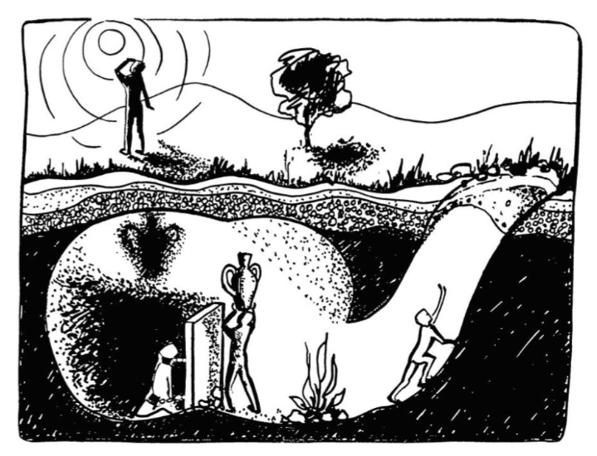
Plato (428/7-348/7 BC) The Allegory of the Cave (The Constitution/Republic, VII)

Slide 48
Plato (428/7-348/7 BC) The Allegory of the Cave (The Constitution/Republic, VII)
„a figure how far our nature is enlightened or unenlightened“
„the uneducated and uninformed of the truth“

Slide 49
„And if they were in the habit of conferring honours among themselves on those who were quickest to observe the passing shadows and to remark which of them went before, and which followed after, and which were together; and who were therefore best able to draw conclusions as to the future, do you think that he would care for such honours and glories, or envy the possessors of them? Would he not say with Homer, Better to be the poor servant of a poor master, and to endure anything, rather than think as they do and live after their manner? Yes, he said, I think that he would rather suffer anything than entertain these false notions and live in this miserable manner.“

Slide 50
„…the prison-house is the world of sight, the light of the fire is the sun, and you will not misapprehend me if you interpret the journey upwards to be the ascent of the soul into the intellectual world according to my poor belief, which, at your desire, I have expressed whether rightly or wrongly God knows. But, whether true or false, my opinion is that in the world of knowledge the idea of good appears last of all, and is seen only with an effort; and, when seen, is also inferred to be the universal author of all things beautiful and right, parent of light and of the lord of light in this visible world, and the immediate source of reason and truth in the intellectual; and that this is the power upon which he who would act rationally, either in public or private life must have his eye fixed.“

Slide 51
„But then, if I am right, certain professors of education must be wrong when they say that they can put a knowledge into the soul which was not there before, like sight into blind eyes. … Whereas, our argument shows that the power and capacity of learning exists in the soul already; and that just as the eye was unable to turn from darkness to light without the whole body, so too the instrument of knowledge can only by the movement of the whole soul be turned from the world of becoming into that of being, and learn by degrees to endure the sight of being, and of the brightest and best of being, or in other words, of the good. … And must there not be some art which will effect conversion in the easiest and quickest manner; not implanting the faculty of sight, for that exists already, but has been turned in the wrong direction, and is looking away from the truth?“

Slide 52
„…the intention of the legislator, who did not aim at making any one class in the State happy above the rest; the happiness was to be in the whole State, and he held the citizens together by persuasion and necessity, making them benefactors of the State, and therefore benefactors of one another; to this end he created them, not to please themselves, but to be his instruments in binding up the State. True, he said, I had forgotten. Observe, Glaucon, that there will be no injustice in compelling our philosophers to have a care and providence of others;“

Slide 53
From Letter to Menoeceus By Epicurus (341-270 BC)
„Let no one be slow to seek wisdom when he is young nor weary in the search thereof when he is grown old. For no age is too early or too late for the health of the soul. And to say that the season for studying philosophy has not yet come, or that it is past and gone, is like saying that the season for happiness is not yet or that it is now no more. Therefore, both old and young ought to seek wisdom, the former in order that, as age comes over him, he may be young in good things because of the grace of what has been, and the latter in order that, while he is young, he may at the same time be old, because he has no fear of the things which are to come. So we must exercise ourselves in the things which bring happiness, since, if that be present, we have everything, and, if that be absent, all our actions are directed toward attaining it.“
Notes:
http://classics.mit.edu/Epicurus/menoec.html

Slide 54
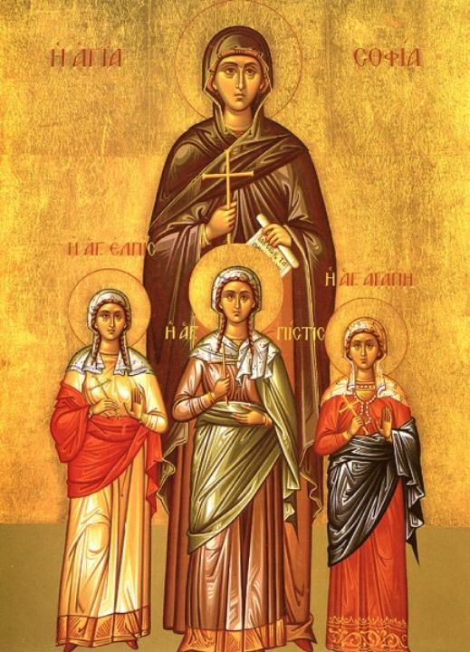
Mother Sophia – Wisdom;
daughters (from left :) Hope, Faith, Love
→ Christian virtues as a source of morality
Notes:
Saint Sophia the Martyr (died 137 AD) is venerated in the Eastern Orthodox Church on September 17. Born in Italy, Sophia had three daughters: Faith, Hope and Love, who were named after virtues mentioned by Saint Paul in 1 Corinthians 13.
The daughters are said to have been martyred during the reign of Hadrian (117–138). The guards took Sophia's daughters one by one, from the oldest to the youngest and beat and tortured them to death. Sophia buried her daughters' bodies and remained by their graves for three days until she died herself.

Slide 55
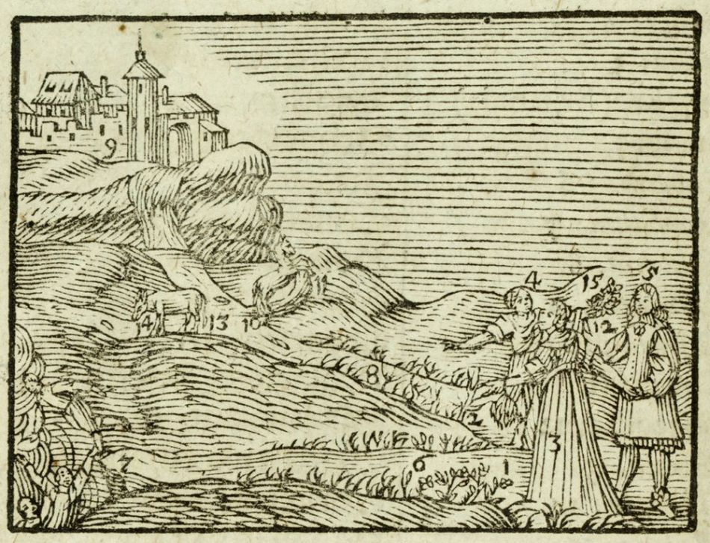

Slide 56
Joh. Amos Comenii Orbis Sensualium Pictus: HOC EST Omnium principalium in Mundo Rerum, & in Vita Actionum, Pictura & Nomenclatura.
Joh. Amos Comenius’s VISIBLE WORLD: OR, A Nomenclature, and Pictures OF ALL THE Chief Things that are in the World, and of Mens Employments therein; In above 150 Copper Cuts. WRITTEN By the Author in Latin and High Dutch, being one of his last Essays; and the most suitable to Childrens Capacity of any he hath hitherto made.
Translated into English By Charles Hoole, M.A. For the Use of Young Latin Scholars.
The Eleventh Edition Corrected, and the English made to answer Word for Word to the Latin.
Nihil est in intellectu, quod non prius fuit in sensu. Arist.
London; Printed for, and sold by John and Benj. Sprint, at the Bell in Little Britain, 1728.

Slide 57
John Amos Comenius: The Orbis Pictus (1728) CIX. Moral Philosophy. Ethica
This Life is a way, or a place divided into two ways, like Pythagoras’s Letter Y. broad, 1 on the left hand track; narrow, 2 on the right; that belongs to Vice, 3 this to Vertue, 4 Mind, Young Man, 5 imitate Hercules: leave the left hand way, turn from Vice; the Entrance, 6 is fair, but the End, 7 is ugly and steep down. | Vita hæc est via, sive Bivium, simile Litteræ Pithagoricæ Y. latum, 1 sinistro tramite angustum, 2 dextro; ille Vitii, 3 est his Virtutis, 4 Adverte juvenis, 5 imitare Herculem; linque sinistram, aversare Vitium; Aditus speciosus, 6 sed Exitus, 7 turpis & præceps. | Go on the right hand, though it be thorny, 8 no way is unpassible to vertue; follow whither vertue leadeth through narrow places to stately palaces, to the Tower of honour, 9 Keep the middle and streight path, and thou shalt go very safe. Take heed thou do not go too much on the right hand, 10 Bridle in, 12 the wild Horse, 11 of Affection, lest thou fall down headlong. See thou dost not go amiss on the left hand, 13 in an ass-like sluggishness, 14 but go onwards constantly, persevere to the end, and thou shalt be crown’d, 15 | Dextera ingredere, utut spinosa, 8 nulla via invia virtuti; sequere quâ viâ ducit virtus per angusta, ad augusta, ad Arcem honoris, 9 Tene medium & rectum tramitem; ibis tutissimus. Cave excedas ad dextram, 10 Compesce freno, 12 equum ferocem, 11 Affectûs ne præceps fias. Cave deficias ad sinistram, 13 segnitie asininâ, 14 sed progredere constanter pertende ad finem, & coronaberis, 15
Notes:
Source: http://www.gutenberg.org/files/28299/28299-h/28299-h.htm

Slide 58
This Life is a way, or a place divided into two ways, like Pythagoras’s Letter Y. broad, 1 on the left hand track; narrow, 2 on the right; that belongs to Vice 3 (bad habit),
this to Virtue, 4.
Mind, Young Man, 5 imitate Hercules: leave the left hand way,turn from Vice; the Entrance, 6 is fair, but the End, 7 is ugly and steep down.
Go on the right hand, though it be thorny, 8 no way is impossible to virtue; follow whither virtue leadeth through narrow places to stately palaces, to the Tower of honour, 9 Keep the middle and straight path, and you should go very safe.
Take heed you do not go too much on the right hand, 10 Bridle in, 12 the wild Horse, 11 of Affection, lest you fall down headlong. See you dost not go amiss on the left hand, 13 in an ass-like sluggishness (laziness), 14 but go onwards constantly, persevere to the end, and you should be crown’d 15

Slide 59
Who am I ? Who are we ?
homo legulus
homo movens – homo viator – homo spiritualis
homo viator (Comenius, G. Marcel) → homo turisticus
homo loquens
homo faber (H. Bergson, Max Frisch – man and technology)
homo economicus
homo sociologicus (German, 1958)
homo ludens (Johan Huizinga)
homo aesteticus
homo politicus
homo insipiens (x sapiens)
...
Notes:
Max Frisch "Homo faber" : www.youtube.com: http://www.youtube.com/watch?v=H1bF56W-
http://www.csfd.cz/film/8102-homo-faber/?text=724
homo insipiens: http://www.cts.org.au/1999/homoinsipiens.htm

Slide 60
Liberales – serviles
artes liberales: to life, to freedom
artes serviles / artes mechanicae
revaluation work comes from laziness (lat. acedia): " I do not want to participate in my mission", fear of being a person
nowadays : freelancers x employee
creatio continua → man participates in the creation
man as action (Blondel), opérer (Mounier)

Slide 61
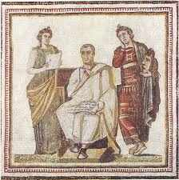
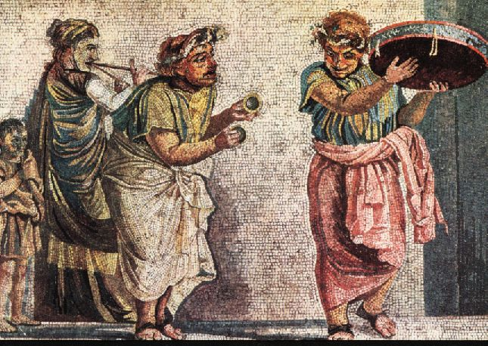

Slide 62
The viewer x actor. Thinking and acting
theatai (viewers, spectators) → theory, theoretical (contemplative), absence (gr. schein) – the price of spectatorship that understands the meaning (logos) of the game
actor: engaged (not autonomous), hunter of the glory (doxa), his fame comes from the viewer's mind (he is not his master), he plays the part from the whole play.
The Old Greeks were convinced that only a spectator, not an actor, was able to understand what offers itself as a play. Thus, the life of spectators, contemplative life, life of the audience, was regarded as superior that of the actors.

Slide 63
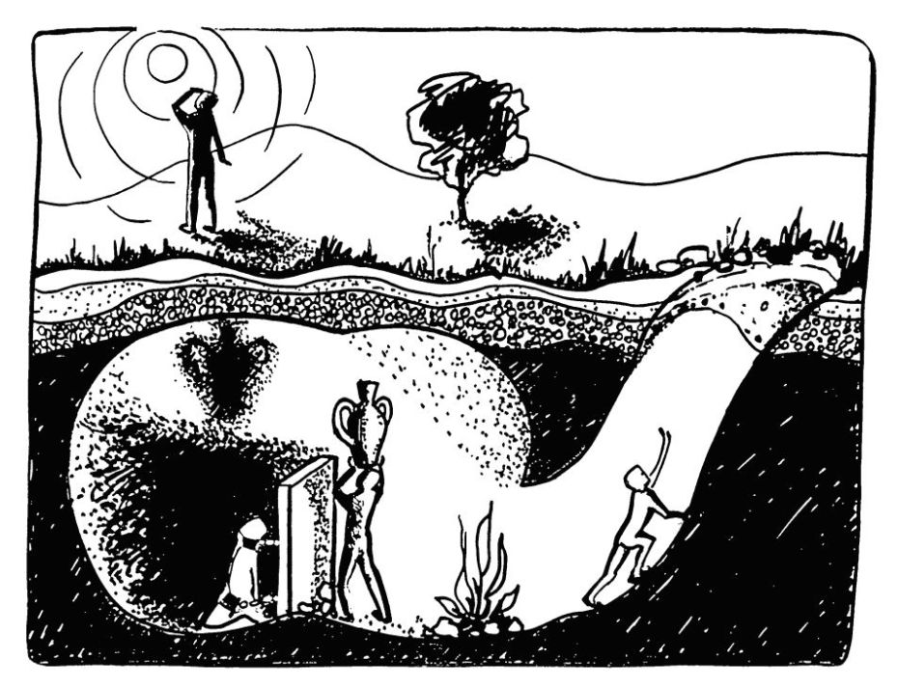
Man according to Plato

Slide 64
Man according to Plato
prisoner in a cave (busy – ascholia)
envoy (challenge to scholé, care – epimeleia peri tés psychés)
guest abroad (leisure – scholé, education, exploring the meaning of life / orientation)
Republic; Laws

Slide 65
Man according to Aristotle
zoon logon echon – animal having speech
and therefore
zoon politikon – a political animal

Slide 66
From these things therefore it is clear that the city-state is a natural growth, and that man is by nature a political animal (ὁ ἄνθρωπος φύσει πολιτικὸν ζῷον), and a man that is by nature and not merely by fortune citiless is either low in the scale of humanity or above it … And why man is a political animal in a greater measure than any bee or any gregarious animal is clear. For nature, as we declare, does nothing without purpose; and man alone of the animals possesses speech (οὐθὲν …μάτην ἡ φύσις ποιεῖ: λόγον δὲ μόνον ἄνθρωπος ἔχει τῶν ζῴων). The mere voice, it is true, can indicate pain and pleasure, and therefore is possessed by the other animals as well (for their nature has been developed so far as to have sensations of what is painful and pleasant and to indicate those sensations to one another), but speech is designed to indicate the advantageous and the harmful, and therefore also the right and the wrong; for it is the special property of man in distinction from the other animals that he alone has perception of good and bad and right and wrong and the other moral qualities, and it is partnership in these things that makes a household and a city-state.
Notes:
Aristotle. Politics 1253a. Aristotle in 23 Volumes, Vol. 21, translated by H. Rackham. Cambridge, MA, Harvard University Press; London, William Heinemann Ltd. 1944. Available at: http://data.perseus.org/citations/urn:cts:greekLit:tlg0086.tlg035.perseus-eng1:1.1253a

Slide 67
Man according to Augustine „Quid ergo sum..., quae natura mea?“
Man is alone in the world, one homeless person wandering and looking in vain for itself in the depths of his own soul.
Man as a grande profundum: „what is man that thou art mindful of him, and the son of man that thou dost care for him?“ Psalm 8,4
Dubito ergo sum.
Notes:
Dubito ergo sum: I doubt, therefore I am.

Slide 68
I think, therefore I am
Cogito |  | I think
Dubito |  | I doubt
Sentio | ergo sum | I feel | therefore I am
Video |  | I see
Promitto |  | I promise
Si enim fallor | sum | If I'm wrong | I am

Slide 69
Shall I believe I am nothing? Shall I believe I am God?
All the excesses, all the violence, and all the vanity of great men, come from the fact that they know not what they are…
What part of us feels pleasure? Is it our hand, our arm, our flesh, or our blood? It must obviously be something immaterial.
(Pascal, Pensées)

Slide 70
Knowledge about man
has never been as wide and diverse as it is today
But, at the same time,
it has never been known less
of what a man actually is, than it is known today.
(Martin Heidegger)
Notes:
Heidegger, Martin. Kant a problém metafyziky (In Buber, Martin. Problém člověka. Praha: Kalich, 1997, s. 115)

Slide 71
What is a man?→ Who is a man?
Thinking about man in a holistic way (meléte to pan) – are people capable of it?

Slide 72
Qu´est ce qu´un homme dans l´infini?
Nous sommes quelque chose, et ne sommes pas tout.
(Blaise Pascal 1623-62)

Slide 73
Thinking reed
(Pascal, Pensées):
L'homme n'est qu'un roseau, le plus faible de la nature; mais c'est un roseau pensant. … une vapeur, une goutte d’eau suffit pour le tuer. Mais ... parce qu’il sait qu’il meurt, et l’avantage que l’univers a sur lui, l’univers n’en sait rien. Ainsi toute notre dignité consiste dans la pensée. C'est de là qu'il faut nous relever, non de l'espace et de la durée. Travaillons donc à bien penser. voilà le principe de la morale.
Man is but a reed, the most feeble thing in nature; but he is a thinking reed. … A vapour, a drop of water suffices to kill him. But, …man would still be more noble than that which killed him, because he knows that he dies and the advantage which the universe has over him; the universe knows nothing of this. All our dignity consists, then, in thought. By it we must elevate ourselves, and not by space and time which we cannot fill. Let us endeavour, then, to think well; this is the principle of morality. (347)
Notes:
Pascal, Pensées, ed. Ch. M des Granges, Garnier, Paris, 1964.

Slide 74
Thinking man – loving being
Le silence éternel de ces espaces infinis m´effraie. The eternal silence of these infinite spaces terrifies me. (206)
La vraie morale se moque de la morale. True morality makes fun of morality. (4)
Man is obviously made to think. It is his whole dignity and his whole merit; and his whole duty is to think as he ought. Now, the order of thought is to begin with self, and with its Author and its end. Now, of what does the world think? Never of this, but of dancing, playing the lute, singing, making verses, running at the ring, etc., fighting, making oneself king, without thinking what it is to be a king and what to be a man. (146)
I cannot imagine a man without thought; he would be a stone or an animal. (339)
Le cœur a ses raisons, que la raison ne connaît point. The heart has its reasons, which reason does not know. (227)

Slide 75
Baruch Spinoza (1632-77)
Man is a being in whom God loves itself. World and man are united.
J. W. Goethe (1749-1832)
Man is "the first conversation of nature to God”

Slide 76
Kant's four questions that indicate the scope of philosophy in sensu cosmico
What can I know? → Metaphysics
What should I do? → Morals, Ethics
In what may I hope? → Religion
What is a man? → Anthropology (transferred to other questions: What is this creature, which can know, which should do and which may hope?)

Slide 77
G. W. F. Hegel (1770-1831)
Phänomenologie des Geistes, 1807 - The title can be translated as either The Phenomenology of Spirit or The Phenomenology of Mind, because the German word Geist has both meanings. The book's working title, which also appeared in the first edition, was Science of the Experience of Consciousness.
The whole is mental because it is mind that can comprehend all of these phases and sub-parts as steps in its own process of comprehension. It is rational because the same, underlying, logical, developmental order underlies every domain of reality and is ultimately the order of self-conscious rational thought, although only in the later stages of development does it come to full self-consciousness. The rational, self-conscious whole is not a thing or being that lies outside of other existing things or minds. Rather, it comes to completion only in the philosophical comprehension of individual existing human minds who, through their own understanding, bring this developmental process to an understanding of itself.
Man is a principle – logos, nous
Notes:
citace: Buber, Problém člověka, s. 41.

Slide 78
Three great anthropological systems
Aristotle: cosmological (home to ancient humans, the world of things, human is a thing among things)
Thomas Aquinas: theological (home to the man of the Christian Middle Ages)
Hegel: logological (never became a real home for the modern man)

Slide 79
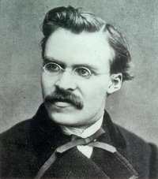
Man as a problematic being
Friedrich Nietzsche (1844-1900)
"How can a man know himself?" - „He is a thing dark and veiled…" (1)
He is "yet indeterminate animal", an eccentric animal species.
As a result of "forcible separation from the animal past" man suffers himself, the problem of its purpose. This is the beginning, the transition, in fact, a person is "almost human embryo of the future" - the first of the genus of man. "Man is something fluid and pliable – it can do what it wants." Life is the "will to power" (Schopenhauer: the will to live), not austerity.
Was sagt dein Gewissen? — 'Du sollst der werden, der du bist.
What does your conscience say? — "You shall become the person you are.“(2)
Notes:
(1) “Schopenhauer as educator,” § 3.1
(2) Nietzsche, according to Pindar, merely re-used by Nietzsche. In: The Gay Science (Die fröhliche Wissenschaft, 1882). Sec. 270.

Slide 80
Man is a disease of the eart. The overman is the meaning of the earth.
Nietzsche:
Man is an animal that may promise – is connected with the future, something guarantees.
„We derive a man not of spirit“, we have placed him back among the animals." Man is a disease of the world.
„I teach you the overman. Man is something that shall be overcome. … The overman is the meaning of the earth. Let your will say: the overman shall be the meaning of the earth... Man is a rope, tied between beast and overman — a rope over an abyss ... What is great in man is that he is a bridge and not an end.“ (1)
Man is a road, great promise.
Man does not promise the fulfillment of obligations to the other, but to himself the fulfillment of human.
Notes:
Thus Spoke Zarathustra (Prologue, 3–4)

Slide 81
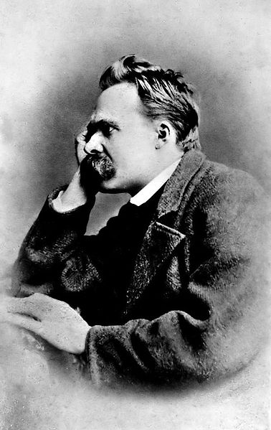
It is true: we love life
not because we are used to living,
but because we are used to loving.
Notes:
Also sprach Zarathustra ; Thus Spake Zarathustra . Part I, Chapter 7, "Vom Lesen und Schreiben"/"On Reading and Writing".

Slide 82
Humanity struggling to understand oneself
Edmund Husserl (1859, Prostějov, Moravia – 1938, Freiburg, Germany): The Crisis of European Sciences and Transcendental Philosophy (1936):
the greatest historical phenomenon is humanity struggling to understand oneself
„Humanity in the universal concept is inherently human being in generative and socially connected humanity.“
The being of man can not be found in isolated individuals.

Slide 83
Martin Buber
„together with human finitude and we must also recognize participation in the same man at infinity, not as two properties next to each other, but as a double process ...“ (1)
What can it be experience only for human being: the struggle with destiny, rebellion, reconciliation – and sometimes: what is secretly going on in the other. (2)
Notes:
Problém člověka, s. 14
Tamtéž, 17.

Slide 84
Man according to Albert Camus
L'Étranger
Le Mythe de Sisyphe
L'Homme révolté
If the world were clear, art would not exist.
The realization that life is absurd cannot be an end, but only a beginning.
I rebel — therefore we exist.
Man is the only creature who refuses to be what he is.
Art, at least, teaches us that man cannot be explained by history alone and that he also finds a reason for his existence in the order of nature.

Slide 85
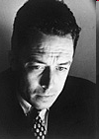
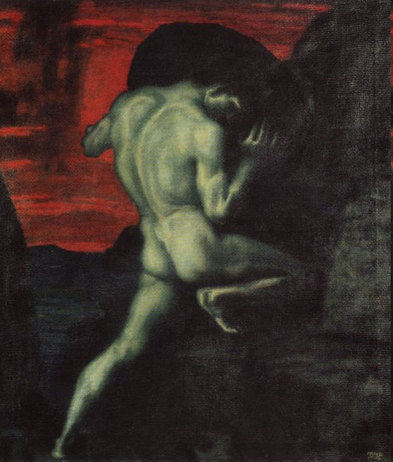
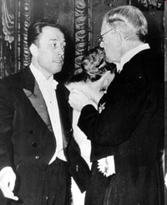
Video from receiving the Nobel Prize

Slide 86
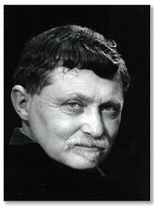
Man according to Gabriel Marcel
Being and Having
Mystery of Being
Man Against Mass Society
Homo Viator: Introduction to a Metaphysic of Hope
The Existential Background of Human Dignity

Slide 87
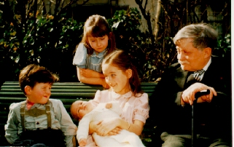
Philosophie concrète by Gabriel Marcel (†1973)
aimer un être, c’est dire: toi, tu ne mourras pas
to love another being, that is to say: you shall not die
Thou Shall Not Die (2009)

Slide 88
Who is man?
object → naturalism
subject → idealism

Slide 89
Person
Def.: „singularity of spiritual order“
Boethius: „Persona est naturae rationabilis individua substantia.“
Person is an individual substance of a rational nature.
"Substance" is used to exclude accidents: "We see that accidents cannot constitute person”
Notes:
Boethius. De persona et duabus naturis 2, 3; PL 64, 1342 sqq.

Slide 90
Discover the person being
by theory?
by experience?
by logic?
by phenomenology?
by hermeneutics?
by dialog?

Slide 91
Personalism: The structure of a personal relationship
Person being:
indestructibility of the person
it can not be manipulate
creativity of personal being

Slide 92
When a person is objectified
Two basic negative attitudes to the person, when a person is objectified:
Conflict: violence, hatred, aggression, ...
Indifference: the other as a customer, client, number, case, ... - not as a personal being

Slide 93
Theory of stages of moral development Lawrence Kohlberg
Level 1 Pre-Conventional
Obedience and punishment orientation (How can I avoid punishment?)
Self-interest orientation (What's in it for me?)
Paying for a benefit
Level 2 Conventional
3. Interpersonal accord and conformity (Social norms) (The good boy/girl attitude)
4. Authority and social-order maintaining orientation
Law and order morality
Level 3 Post-Conventional
5. Social contract orientation
6. Universal ethical principles
7. Transcendental Morality, or Morality of Cosmic Orientation — which linked religion with moral reasoning
Principled conscience

Slide 94
Heinz's dilemma
A woman was near death from a special kind of cancer. There was one drug that the doctors thought might save her. It was a form of radium that a druggist in the same town had recently discovered. The drug was expensive to make, but the druggist was charging ten times what the drug cost him to produce. He paid $200 for the radium and charged $2,000 for a small dose of the drug. The sick woman's husband, Heinz, went to everyone he knew to borrow the money, but he could only get together about $1,000 which is half of what it cost. He told the druggist that his wife was dying and asked him to sell it cheaper or let him pay later. But the druggist said: “No, I discovered the drug and I'm going to make money from it.” So Heinz got desperate and broke into the man's laboratory to steal the drug for his wife. Should Heinz have broken into the laboratory to steal the drug for his wife? Why or why not?
From a theoretical point of view, it is not important what the participant thinks that Heinz should do. Kohlberg's theory holds that the justification the participant offers is what is significant, the form of their response. Below are some of many examples of possible arguments:

Slide 95
Heinz's dilemma
Stage one (obedience): Heinz should not steal the medicine because he will consequently be put in prison which will mean he is a bad person.
Or: Heinz should steal the medicine because it is only worth $200 and not how much the druggist wanted for it; Heinz had even offered to pay for it and was not stealing anything else.
Stage two (self-interest): Heinz should steal the medicine because he will be much happier if he saves his wife, even if he will have to serve a prison sentence.
Or: Heinz should not steal the medicine because prison is an awful place, and he would more likely languish in a jail cell than over his wife's death.
Stage three (conformity): Heinz should steal the medicine because his wife expects it; he wants to be a good husband.
Or: Heinz should not steal the drug because stealing is bad and he is not a criminal; he has tried to do everything he can without breaking the law, you cannot blame him.

Slide 96
Heinz's dilemma
Stage four (law-and-order): Heinz should not steal the medicine because the law prohibits stealing, making it illegal.
Or: Heinz should steal the drug for his wife but also take the prescribed punishment for the crime as well as paying the druggist what he is owed. Criminals cannot just run around without regard for the law; actions have consequences.
Stage five (human rights): Heinz should steal the medicine because everyone has a right to choose life, regardless of the law.
Or: Heinz should not steal the medicine because the scientist has a right to fair compensation. Even if his wife is sick, it does not make his actions right.
Stage six (universal human ethics): Heinz should steal the medicine, because saving a human life is a more fundamental value than the property rights of another person (universal justice orientation).
Or: Heinz should not steal the medicine, because others may need the medicine just as badly, and their lives are equally significant.
Stage seven (cosmic perspective, natural law perspective, agape, metaphoric): Heinz should (or not) steal the medicine, because it is the natural law, the Divine Will, responsible love or agape.

Slide 97
Care (epimeleia)
The virtue involving a persistent disposition to be concerned about others.
Sometimes used as a synonym for a cluster of virtues or even for virtue theory itself. (melete to pan, epimeleia peri tés psychés)
Sometimes considered an „orientation“ to others, one that focuses on the relationship between persons.

Slide 98
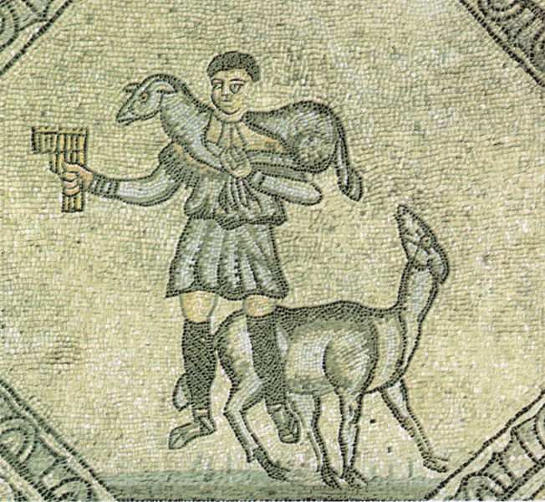
Notes:
Mosaics of Jesus Christ as the Good Shepherd (Pan with flute → Good Shepherd → Jesus Christ as the Good Shepherd)
Ancient Roman mosaics in Aquileia, Italy
4th-century
Basilica Patriarcale (Aquileia) - Naves paleochristian mosaics

Slide 99
Ethics of care
care ethics or EoC
Carol Gilligan and In a Different Voice
Four ethical elements of care:
Attentiveness
Responsibility
Competence
Responsiveness

Slide 100
Man as a being living in relationships
relationships – openness
V. Ivanov, M. Buber, G. Marcel, E. Lévinas
The truth about the man shows in his openness to the O/other
Man as a being able to listen, respond, reach out, care, not being only for oneself ...

Slide 101
„Ethical turn“
Emmanuel Levinas the ethics of the Other or, in Lévinas's terms, "ethics as first philosophy". Jewish existentialism. Ethics of responsibility.
1930. La théorie de l'intuition dans la phénoménologie de Husserl
1935. De l'évasion
1935. L'actualité de Maimonide
1947. De l'Existence à l'Existent. (Existence and Existents)
1948. Le Temps et l'Autre. (Time and the Other)
1961. Totalité et Infini: essai sur l'extériorité. (Totality and Infinity)
1963 & 1976. Difficult Freedom: Essays on Judaism
1972. Humanisme de l'autre homme (Humanism of the Other)
1974. Autrement qu'être ou au-delà de l'essence (Otherwise than Being or Beyond Essence)
1982. Of God Who Comes to Mind
1982. Ethique et infini (Ethics and Infinity: Dialogues of Emmanuel Levinas and Philippe Nemo)
1995. Altérité et transcendence (Alterity and Transcendence)

Slide 102
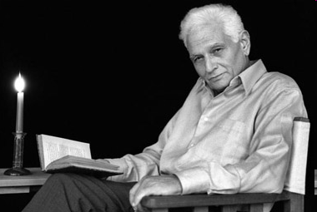
Jacques Derrida
Man is that which is in relation to his end, in the fundamentally equivocal sense of the word. Since always.
The end of man (as a factual anthropological limit) is announced to thought from the vantage of the end of man (as a determined opening or the infinity of a telos).
Notes:
"The Ends of Man," Margins of Philosophy, tr. w/ notes by Alan Bass. The University of Chicago Press. Chicago, 1982. (Original French published in Paris, 1972, as Marges de la philosophie.) - p. 123

Slide 103
Cultural Conflict or Dialog? Critiques.
Martin Luther King Jr. embraced many traditional Western moral views while at the same time criticizing the West for not honoring traditions. – ideals of brotherly love, ideals of community
Mahatma Gandhi (from Hindu tradition) used a similar strategy (What do you think of Western civilization? – I think it would be a good idea.) – ahimsa – the lives of your enemies „as sacred as those of our own dear ones“
Both Ghandi and King jr. adopted nonviolence and in so doing appealed to both Western and non-Western ideas.
(re)gain the sens of respect

Slide 104
Cultural Conflict – or Dialog?
Do we have a deal in common as humans?
Do we have similar needs, desires, abilities?
Do we face similar challenges?
discover important shared commitment (e.g. not harming persons)
understand the other´s point of view – be patient and respectful in trying to come to an understanding about another person´s position on a moral issue
decide what is negotiable and what is not
consider what is at stake

Slide 105
Bibliography
SVOBODOVÁ, Z. Paideia as Care of the Soul – the Potentials of Contemporary School. In Stępkowski, Dariusz, ed. a Murzyn, Andrzej, ed. Religion long forgotten: the importance of religion in education towards civil society. Cracow: Impuls, 2014. ISBN 978-83-7850-682-9. Pp. 191-206.
SVOBODOVÁ, Zuzana. At the Beginning of Everything is the Word. In František Štěch, Bert Roebben (eds.) When East and West Meet. Svitavy: Trinitas, 2019, s. 87–95. ISBN 978-80-86885-46-9.
SVOBODOVÁ, Zuzana. Overcoming Despair: Open Soul, Hope in Dialogue. Caritas et veritas, Č. Budějovice: Jihočeská univerzita, Teologická fakulta, 2020, roč. 10, č. 1. ISSN 1805-0948, s. 176–183. Available at: <http://www.caritasetveritas.cz/index.php?action=openfile&pkey=323>.
SVOBODOVÁ, Zuzana, 2018. Natural Law and Integral Humanism by J. Maritain: Teaching Challenges. Caritas et veritas 2018 (2): 21–30. <http://www.caritasetveritas.cz/index.php?action=openfile&pkey=277>.

Slide 106
Bibliography
SVOBODOVÁ, Zuzana. Forms and Movements of Life: Existential and Metaphysical Responsibility in the work of Jan Patočka. Forum Philosophicum 25, no. 1 (2020): 37–52. doi:10.35765/forphil.2020.2501.3.
SVOBODOVÁ, Zuzana. The Life of the Shaken. Forum Pedagogiczne, [S.l.], n. 1, May 2019, 213–223. ISSN 2083-6325. Available at: <https://czasopisma.uksw.edu.pl/index.php/fp/article/view/3516>. doi: <http://dx.doi.org/10.21697/fp.2019.1.15>.

