Slide 1
Reward systems
Remuneration in relation to employee satisfaction. Corporate climate.

Slide 2
Remuneration and employee satisfaction
The employer should not pursue only performance, but also take care of the satisfaction of the employees. A satisfied employee puts on a far higher performance than a dissatisfied employee.

Slide 3
Remuneration and employee satisfaction
Employee satisfaction surveys
Why it is good to notice employee satisfaction:
employee satisfaction is a significant motivational factor (they will work long hours and put on higher performances)
It increases the capability of the organisation to retain quality employees
It reduces the risks of a crisis and hence also the crisis management costs

Slide 4
Remuneration and employee satisfaction
The following areas are usually monitored:
Remuneration - wage conditions, payroll system
Activities - whether the job content and work conditions are suitable
Relations - at the workplace, how communication runs, collaboration
Sense - possibility of development and self-realisation

Slide 5
Remuneration and employee satisfaction
Satisfaction survey methods
use of structural questionnaires - cheap, large number of respondents, the results can be compared
use of an interview - expensive, time intensive, difficult to analyse
combination of the questionnaire and interview - analysis of the questionnaire results
use of discussion groups - representative sample (credible and focused on a specific topic)

Slide 6
Remuneration and employee satisfaction
Methods for determination of employee satisfaction:
the company does it itself (cheaper, lower quality)
outsourcing - orders the service from another company (more expensive, higher quality)

Slide 7
Remuneration and employee satisfaction
Use of surveys:
informative functions - ascertaining of employment attitudes
predictive functions - forecasts a crisis in the company
control functions - fulfilment of plans, obligations, expectations
initiation functions - on the basis of evaluation, implement the remedy, new methods, procedures, standards

Slide 8
Remuneration and employee satisfaction
Employee satisfaction surveys:
comprehensive satisfaction surveys:
basis - surveys are focused on getting the overall picture of the company situation
survey target - get the opinions of the individual departments, determine the areas to which attention must be devoted, follow satisfaction from the long-term perspective
methodology - anonymous questionnaire survey with organisational division of the respondents, periodical (2 - 3 years), comparison of the results

Slide 9
Remuneration and employee satisfaction
Employee satisfaction surveys:
AD-HOC surveys
Basis - getting information about certain areas, activities in the enterprise, problematic department
Target - determination of the basic problems and formulation of the basis
methodology - combination of standardised interviews and a questionnaire survey
One-off actions specifically targeted at

Slide 10
Remuneration and employee satisfaction
Employee satisfaction surveys:
360 – feedback
basis - each employee is evaluated from all angles of view
target: ascertain the level of the capability, knowledge and skills of the employee, his strong and weak points, satisfaction
methodology - questionnaire survey; measurement of satisfaction, capabilities, etc. from all perspectives.
It is a difficult method, which has its advantages and disadvantages. The advantages include its complexity and objectivity. Its disadvantages include time-consuming nature and costliness.

Slide 11
Remuneration and employee satisfaction
360 Degree Feedback

Slide 12
Remuneration and employee satisfaction
Evaluation of satisfaction - phases
preparatory phase
agreement on the tool structure and parameters
creation of the design of the standard questionnaire
Pilot project - incorporation of the comments and creation of the final questionnaire version
definition of the time schedule

Slide 13
Remuneration and employee satisfaction
implementation phase
communication strategy - informativeness of the interested parties
organisation of the distribution and collection of questionnaires to all territories
statistical processing and evaluation of the questionnaires
creation of the summary evaluation report

Slide 14
Remuneration and employee satisfaction
Results evaluation phase
Presentation of the results to the managers, HR centres and job candidates
analysis of the results and formulation of specific real recommendations - correspondence with the real needs of the company (so that they make sense)

Slide 15
Corporate climate
For the employees, the business climate is the working atmosphere in enterprise.
The business climate influences:
The internal enterprise environment (team, physical working environment, type of personnel management)
External enterprise environment (laws, situation in unemployment rates)

Slide 16
Corporate climate
For the employees, the business climate is the working atmosphere in enterprise.
The business climate influences:
The internal enterprise environment (team, physical working environment, type of personnel management)
External enterprise environment (laws, situation in unemployment rates)

Slide 17
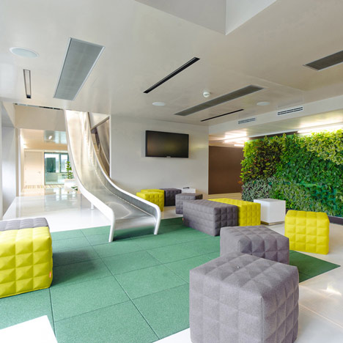

Slide 18
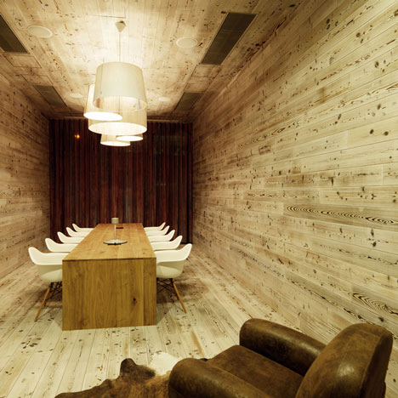

Slide 19
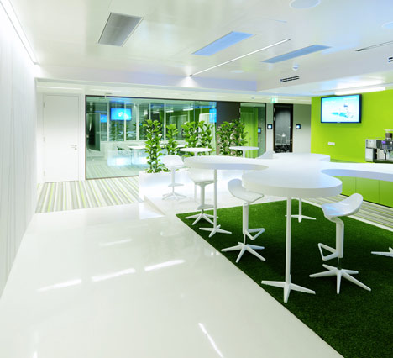

Slide 20
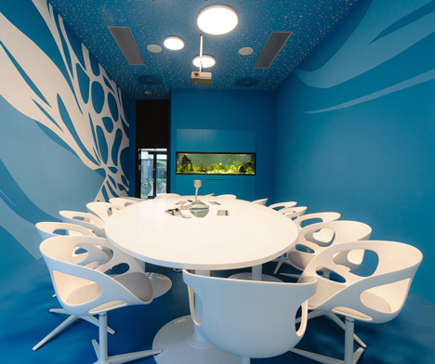

Slide 22
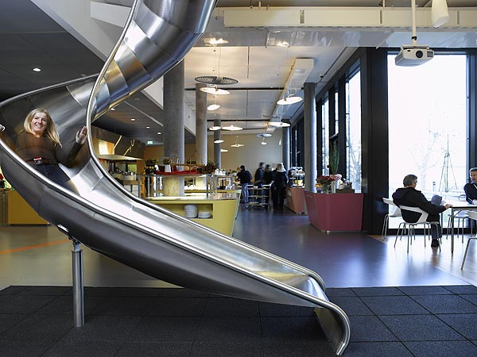

Slide 23
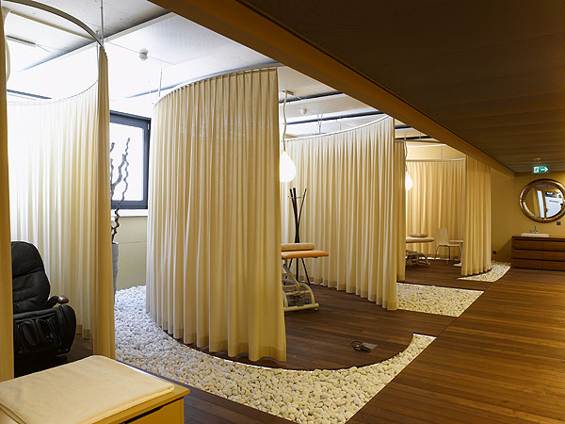

Slide 24
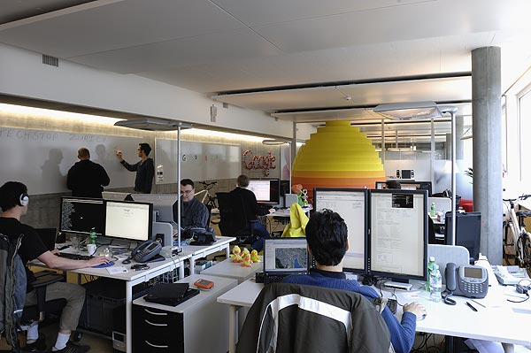

Slide 27
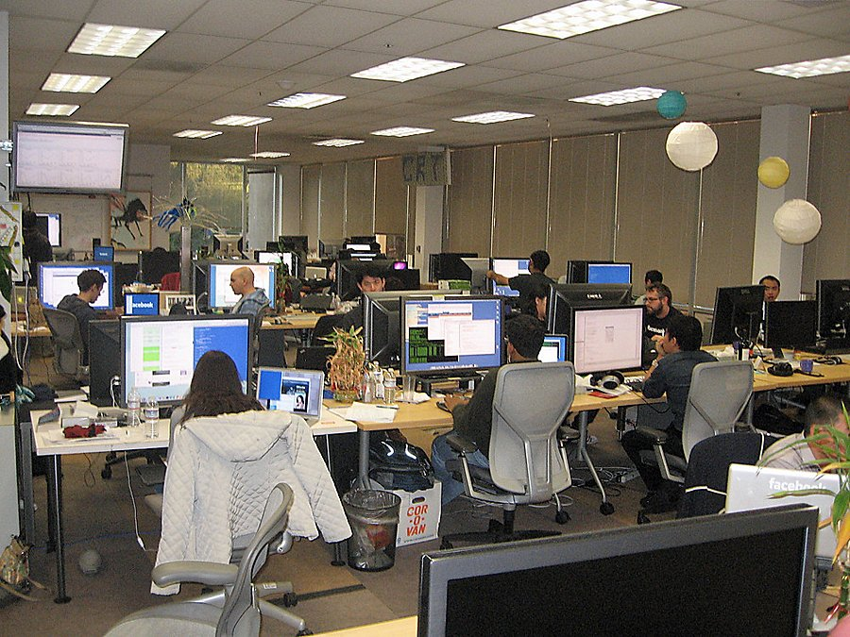

Slide 28
Corporate climate
Assessment of the climate in the organisation
It makes an attempt to evaluate the organisation according to the indicators that describe the perception of the climate
The following indicators are evaluated: Cohesion, confidence, resources, support, recognition, decency and fairness, innovation. Bad business climate results in conflicts.

Slide 29
Thank you for your attention
Have a nice day

