Slide 1
Selected Educational Aspects of Leisure
Zuzana Svobodová

Slide 2
Course objectives
The philosophical background of the leisure-time theory
The philosophical background of the research on leisure time
Reflections on the structure of human existence
Reflections on the current position of man in the world and society
The leisure time phenomenon

Slide 3
Requirements on student
Presentation or essay: 8–10 slides (with presentation in class) or 3–5 pages.
Theme: one topic of the “Content” below, with a clear conclusion.
It must be sent to the teacher’s email (svobodz@tf.jcu.cz) minimum 15 working days before you want to leave the Czech Republic (or before the end of semester).

Slide 4
Content
Main topics
Conditions of leisure time
Activity and passivity
Choice
Man as a free being, the importance of freedom
Responsibility. Man as a person
The importance of leisure time
Religion and leisure time
Celebrations and feasts/holidays
Games, rules, order, beauty
Art and Liberal Arts. Creativity
Studies. Vita contemplativa, the intellectual life
Work and culture of “total work”
Recuperation, recreation

Slide 5
“Be at leisure - and know that I am God. ”
Psalm 46:11
“But the Gods, taking pity on human beings – a race born to labor – gave them regularly recurring divine festivals, as a means of refreshment from their fatigue; they gave them the Muses, and Apollo and Dionysus as
the leaders of the Muses, to the end that, after refreshing themselves in the company of the Gods, they might return to an upright posture.”
Plato, Laws 653d

Slide 6
Conditions of leisure time
freedom
choice
participation (active or passive)
Kelly, John (1996). Leisure, 3rd edition. Boston and London: Allyn and Bacon. pp. 17–27. ISBN 978-0-13-110561-4: “It is done for "its own sake", for the quality of experience and involvement.”
Note: “Recreation differs from leisure in that it is a purposeful activity that includes the experience of leisure in activity contexts.” (https://en.wikipedia.org/wiki/Leisure#cite_ref-Kelly_1996_17%E2%80%9327_1-1)

Slide 7
Leisure time
freedom, schole
“a need for philosophy in an older meaning of the word – the need for new authority to express insight and wisdom”
(T. S. Eliot: Introduction. In: Pieper, Josef. Leisure, the Basis of Culture. St. Augustine's Press, Inc., 1998, p. 7)

Slide 8
Leisure – schole
freedom, leisure in Greek: schole
“For, when we consider the foundations of Western European culture…, one of these foundations is leisure. We can read it in the first chapter of Aristotle’s Metaphysics. And the very history of the meaning of the word bears a similar message. The Greek word for leisure (schole) is the origin of Latin scola, German Schule, English school. The name for the institutions of education and learning means "leisure".”
Pieper, Josef. Leisure, the Basis of Culture. St. Augustine's Press, Inc., 1998, p. 25-26.

Slide 9
Choice
choice
Luke 10:38-42: “Now it happened as they went that He entered a certain village; and a certain woman named Martha received Him into her house. And she had a sister called Mary, who also sat at Jesus' feet and heard His Word. But Martha was distracted with much serving, and she came to Him and said, Lord, do You not care that my sister has left me to serve alone? Therefore tell her to help me. And Jesus answered and said to her, Martha, Martha, you are anxious and troubled about many things. But one thing is needed, and Mary has chosen that good part, which will not be taken away from her.”:
see later on this presentation: → choose for yourself that better part, which will not be taken away from you!

Slide 10
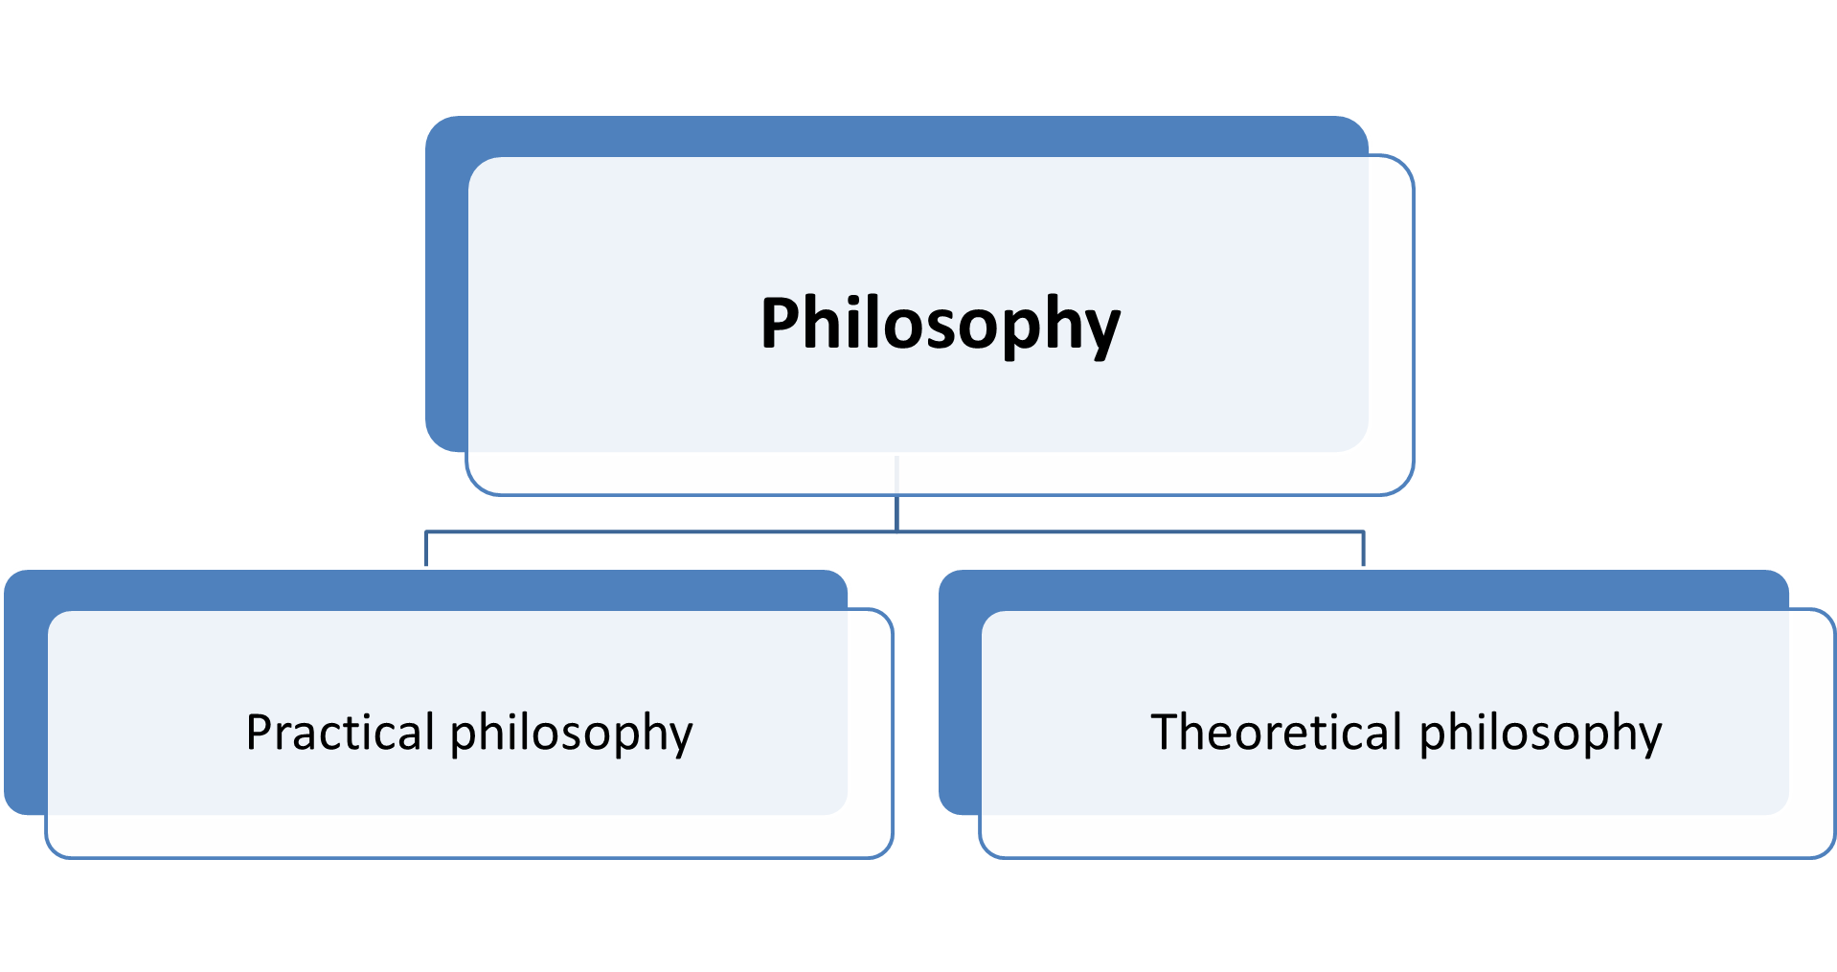
Activity and passivity
participation (active or passive)
DIANOIA ratio thought manyness manipulation knowledge ascholia, work fronesis, practical wisdom mastercraft polis | NOESIS intellectus intellection oneness participation theoria, theory schole, leisure sophia, theoretical wisdom gazing cosmos

Slide 11
Activity
participation (active or passive?)
Kant wrote about Plato, as about the "Father of all raving enthusiasm in Philosophy," while "Aristotle's philosophy is truly work.“ (theoretical wisdom vs practical wisdom) “In Kant's view, then, human knowing consists essentially in the act of investigating, articulating, joining, comparing, distinguishing, abstracting, deducing, proving – all of which are so many types and methods of active mental effort. According to Kant, knowing (intellectual knowing, that is, by the human being) is activity, and nothing but activity.”
Pieper, Josef. Leisure, the Basis of Culture. St. Augustine's Press, Inc., 1998, p. 31.

Slide 12
Passivity
participation (active or passive?)
Imagination, gazing, receiving: “What happens when our eye sees a rose? What do we do when that happens? Our mind does something, to be sure, in the mere fact of taking in the object, grasping its color, its shape, and so on. We have to be awake and active. But all the same, it is a “relaxed“ looking, so long as we are merely looking at it and not observing or studying it, counting or measuring its various features. Such observation would not be a "relaxed" action: it would be what Ernst Jünger termed an "act of aggression." But simply looking at something, gazing at it, "taking it in," is merely to open our eyes to receive the things that present themselves to us, that come to us without any need for "effort" on our part to "possess" them.”
Pieper, Josef. Leisure, the Basis of Culture. St. Augustine's Press, Inc., 1998, p. 30.

Slide 13
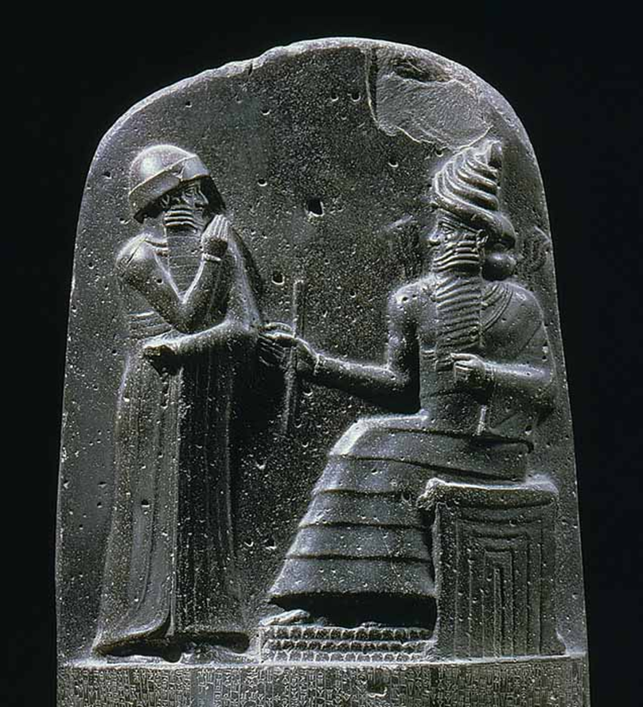
Reception
participation (active or passive?)
Imagination, gazing, receiving
The Code of Hammurabi, 1754 BC, Hammurabi standing in front of the sun god Shamash, god of justice

Slide 14
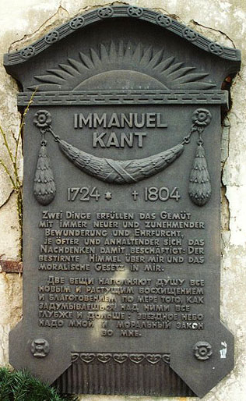
Wonder and awe – also by Immanuel Kant
Two things
fill the mind (das Gemüt)
with ever-increasing (immer neuer und zunehmender) wonder and awe, the more often and the more intensely the mind of thought (das Nachdenken) is drawn to them:
the starry heavens above me
and the moral law within me.

Slide 15
Man as a free being, person
Universal Declaration of Human Rights
“Article 1
All human beings are born free and equal in dignity and rights. They are endowed with reason and conscience and should act towards one another in a spirit of brotherhood.
Article 2
Everyone is entitled to all the rights and freedoms set forth in this Declaration, without distinction of any kind, such as race, colour, sex, language, religion, political or other opinion, national or social origin, property, birth or other status.
Furthermore, no distinction shall be made on the basis of the political, jurisdictional or international status of the country or territory to which a person belongs, whether it be independent, trust, non-self-governing or under any other limitation of sovereignty.
Article 3
Everyone has the right to life, liberty and the security of person.
Article 4
No one shall be held in slavery or servitude; slavery and the slave trade shall be prohibited in all their forms.”
Source: https://www.ohchr.org/EN/UDHR/Pages/Language.aspx?LangID=eng

Slide 16
Responsibility. Man as a person
Responsibility (from Latin: re-spondeo)
Emmanuel Levinas: Ethics of responsibility, the ethics of the Other or, in Lévinas's terms, "ethics as first philosophy". Jewish existentialism:
“our construction of the Other is not the Other; the Other can never become one with our "same": it continually transcends our poor attempt to know it”
“The ego involved in responsibility is me and no one else,
me with whom one would have liked to pair up a sister soul,
from whom one would have substitution and sacrifice.”

Slide 17
Freedom – Responsibility – Love – Thinking
The aim of art, the aim of a life can only be to increase the sum of freedom and responsibility to be found in every man and in the world.
It takes time to live. Like any work of art, life needs to be thought about.
The opposite of an idealist is too often a man without love.
(Albert Camus)

Slide 18
Man of today. Work and culture of “total work”
“Of course, the original meaning of the concept of "leisure" has
practically been forgotten in today's leisure-less culture of "total work": in order to win our way to a real understanding of leisure, we must confront the contradiction that rises from our overemphasis on the world of work. … It is difficult for us to see how in fact it turns the order of things upside-down.”
Pieper, Josef. Leisure, the Basis of Culture, p. 26.

Slide 19
Man of today. Work
Nikolaus Ludwig von Zinzendorf: “One does not only work in order to live, but one lives for the sake of one's work“.
People “no longer have time for any otium”.
Cf. Nietzsche, Friedrich. The Gay Science, § 329; Nietzsche, Friedrich. Human, All Too Human, I, Preface, § 8.

Slide 20
Work and culture of “total work”
„Their taverns and wine bars, their pleasant entertainment, their parties, their churches: all this is so mediocre, because it neither consumes, nor therefore requires, any spirit of energy. – Otium! But this is the idleness (Müssiggang) of those who still have all their energy.“
Nietzsche, Friedrich. Frammenti postumi, 1881-1882, 11 [294], in: Scholari, Paolo. Near things: leisure time and rest. Phenomenology of idleness in Friedrich Nietzsche, Voluntas, Santa Maria, v. 12, n. 1, jan./abril, 2021, p. 8.

Slide 21
Work and culture of “total work”
German: Müssiggang: inactivity, lainess, wrong idleness, Italian: dolce far niente, banausia – from: banausos (from baunos / oven, auó / ignite) “Oven keeper”
versus
German: Musse: otium, schole, good/true idleness
Even in these moments of freedom, “one is tired and wants not only to ‘let oneself go’ but also to lay oneself down and stretch oneself out unceremoniously to one’s full length and breadth”.
Nietzsche, Friedrich. The Gay Science, § 329

Slide 22
The importance of freedom and leisure time
"We are not-at-leisure in order to be-at-leisure.“
Aristotle. Nicomachean Ethics X, 7 (1177b4-6)
cf. Aristotle. Politics VII, 3 (1337b33)
Greek: ascholia Latin: neg-otium English: not-leisure | Greek: schole Latin: otium English: leisure

Slide 23
Religion and leisure time
“…the Christian concept of the "contemplative life" (the vita contemplativa) was built on the Aristotelian concept of leisure. Further, the distinction between the "Liberal Arts" and the "Servile Arts" has its origin precisely here.”
Pieper, Josef. Leisure, the Basis of Culture, p. 27.

Slide 24
Celebrations and feasts/holidays
the "holy rest" of the Sabbath
Sundays
Holidays
“But the Gods, taking pity on human beings – a race born to labor – gave them regularly recurring divine festivals, as a means of refreshment from their fatigue; they gave them the Muses, and Apollo and Dionysus as the leaders of the Muses, to the end that, after refreshing themselves in the company of the Gods, they might return to an upright posture.”
Plato, Laws 653d

Slide 25
Games, plays, rules, order
“We try to think of the total motion of the cosmos, for instance, in terms of celestial orbits, of the sun’s course, or otherwise in the image of a great “growth,” a natura naturans, or, like the early materialists, as a shower of atoms, or as a deliberate rule of the gods or a divine world-architect, or as the creatio continua of a creator god—or perhaps also as a game. If the world’s movement is to be grasped as play, the play of the world cannot be understood and interpreted simply without tension according to the image of the innerworldly play of human beings. To be sure, the human being is an innerworldly thing of a special sort, insofar as he comports himself in his very Being to the cosmos, stands forth with understanding into the whole of the world. But nevertheless it is in no way already certain that the whole has a structural constitution like the intraworldly thing, which is stamped by an ecstatic openness to the whole. The “play of the world” is a speculative formula that does not express phenomenal results but rather points out a way of thinking. Human play, in contrast, is a tangible phenomenon with which everyone is acquainted, that is universally familiar, and of which each has an intimate knowledge from the testimony of his own lived experience. We are conversant with a manifold of individual features, are familiar with a wealth of examples of forms of play, rules of the game, and customs of every kind, and we are able, without further ado, to cite specific structures of play-comportment.”
FINK, Eugen. Play as a Symbol of the World, p. 82

Slide 26
Games, plays, rules, order
Why?
Are we as human beings in order?
Is the world in order?
Is the human essence “play”?
Is the essence of the world “play”?
Are rules all around us? If yes, who is the ruler? Who should be the ruler?

Slide 27
Vita contemplativa and Liberal Arts
must be repeated: “…the Christian concept of the "contemplative life" (the vita contemplativa) was built on the Aristotelian concept of leisure. Further, the distinction between the "Liberal Arts" and the "Servile Arts" has its origin precisely here.”
Pieper, Josef. Leisure, the Basis of Culture, p. 27.

Slide 28
Art. Liberal Arts. Creativity
Septem artes liberales
“Seated outside and below the larger circle are four men—poets or magicians—said to be producing fictional tales, poetry, or perhaps even magic spells. In Herrad’s opinion, such things lie outside the higher philosophical and theological goals of the Liberal Arts and must therefore be inspired by impure spirits (symbolized by the black birds perched on the shoulders of each man).”
“The Hortus deliciarum (Garden of Delights) is an illuminated encyclopedia compiled during the later 12th century by Herrad von Landsberg, abbess of the Hohenburg Abbey in Alsace. A compendium of medieval knowledge designed to instruct novices, Herrad’s Hortus includes an image of the seven Liberal Arts dispersed gracefully in a “rose window” pattern around the allegorical figure of Lady Philosophy, beneath whom are two of her most famous practitioners (Socrates and Plato). The three heads embedded in her crown represent ethics, logic, and physics, the three main branches of philosophical study at the time. The strong medieval connection between philosophy and theology is made clear in the banner Philosophy holds, which reads: “All wisdom comes from God; only the wise can achieve what they desire.”
Seven streams flow from the inner circle to the outer ring of the illustration where the seven Liberal Arts reside, each with a characteristic attribute and a descriptive phrase in the arc over her image: Grammar (book & whip/“Through me all can learn what are the words, the syllables, and the letters”); Rhetoric (tablet and stylus/“Thanks to me, proud speaker, your speeches will be able to take strength”); Dialectic (dog’s head & hooked hand/“My arguments are followed with speed, just like the dog’s barking”); Music (harp, kithara, & harmonium/“I teach my art using a variety of instruments”); Arithmetic (beaded cord for counting/“I base myself on the numbers and show the proportions between them); Geometry (compass & staff/“It is with exactness that I survey the ground”); Astronomy (stars & magnifying tool/“I hold the names of the celestial bodies and predict the future”).”
Source: https://www2.naz.edu/dept/philosophy/liberal-arts-resources/classical-images-gallery/

Slide 29
Art. Liberal Arts. Creativity
Septem artes liberales
“The seven Liberal Arts appear in this beautifully illustrated late medieval German medical/astrological manuscript, demonstrating the link between the seven “liberating” paths of wisdom and a healthy, happy life. The sympathetic connection existing between humanity and the stars was a commonplace of Renaissance culture, and so it is no surprise that the seven Liberal Arts are seen here paired with the traditional seven planets, their associated metals, and corresponding days of the week. Left to right: Geometry (Saturn/lead/Saturday); Logic (Jupiter/tin/Thursday); Arithmetic (Mars/iron/Tuesday); Grammar (Sun/gold/Sunday); Music (Venus/copper/Friday); Astronomy (Mercury/quicksilver/Wednesday); Rhetoric (Moon/silver/Monday).”
Source:
https://www2.naz.edu/dept/philosophy/liberal-arts-resources/classical-images-gallery/

Slide 30
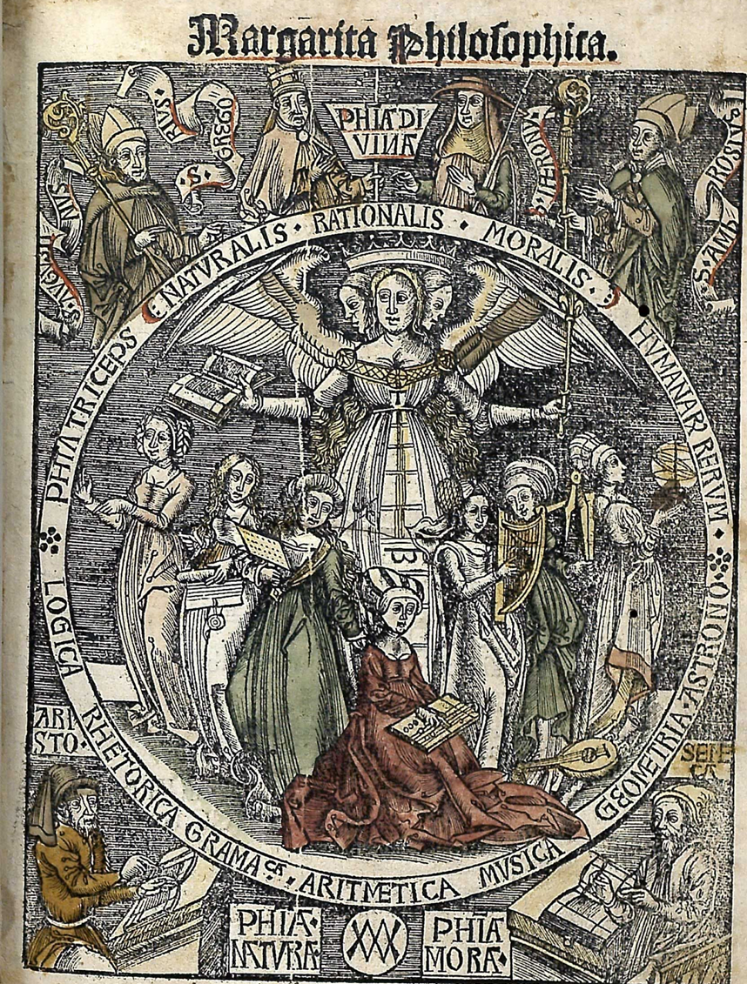
Art. Liberal Arts. Creativity
“Outside the circle are historical figures who exemplify the three types of Wisdom. On the lower left of the page is Aristotle, famous for his knowledge of natural philosophy (i.e., observation of the natural world, or “science”). On the right is Seneca, associated with moral philosophy (i.e., observation of human motivations and behavior, or “ethics”). Above the circle are the four fathers of the Church (St. Augustine, St. Gregory, St. Jerome, and St. Ambros), representing divine/rational philosophy (i.e., contemplation of the divine, or “theology”).”
Septem artes liberales
“The seven Liberal Arts grace the title page of Gregor Reisch’s Margarita philosophica (Pearls of Wisdom), a popular university textbook from the early 16th century. This illustration emphasizes the Liberal Arts as the way to mastering the “triple philosophy of human affairs.” Within the circle are the seven allegorical Arts with their attributes, watched over by the winged, triple-headed figure of Wisdom. Her open book and scepter suggest the relationship between knowledge and power in earthy matters. The panel on the front of her dress depicts a ladder rising up out of the seven Liberal Arts. The Greek letter Pi at the bottom of the ladder represents practical philosophy (secular knowledge) and the Greek letter Theta at the top represents theoretical philosophy (divine knowledge).”
Source:
https://www2.naz.edu/dept/philosophy/liberal-arts-resources/classical-images-gallery/

Slide 31
Art. Liberal Arts. Creativity
Septem artes liberales
“The seven Liberal Arts in this manuscript are depicted without attributes and are dressed in decidedly humble attire. They are seen here moving a heavy cart uphill, in which is seated the crowned and more elegantly attired allegorical figure of “Sacra Theologia” (Holy Theology), who holds an image of Christ. The steep hill symbolizes the difficulty of acquiring the seven paths to wisdom. The privileged position of Sacra Theologia indicates that for this artist, mastery of the Liberal Arts was little more than the means to a loftier end; that is, the study of theology. The Arts of the quadrivium (Music, Astronomy, Geometry, & Arithmetic) each turn a wheel of the cart, while the Arts of the trivium (Grammar, Rhetoric, & Logic) are yolked to the vehicle like oxen. The figure behind the cart, compelling the seven Liberal Arts forward with a whip, is identified as the medieval scholastic theologian Peter Lombard.”
Source:
https://www2.naz.edu/dept/philosophy/liberal-arts-resources/classical-images-gallery/

Slide 32
Studies, work, recuperation, recreation
Luke 10:41-42: “…you are anxious and troubled about many things. But one thing is needed…” (Vulgata: “sollicita es et turbaris erga plurima porro unum est necessarium”)
→ choose for yourself that better part, which will not be taken away from you!

Slide 33
Studies, work, recuperation, recreation
St. Augustine:
“And how can we imagine that Martha was condemned for her hospitality - she who received the Lord himself with welcome? How can she be rebuked when she rejoices in such a Guest? If this be so, let men scorn what they minister to the needy; they choose for themselves the better part, which shall not be taken away from them. Let them busy themselves with the Word, be open-mouthed for the doctrine of sweetness, be occupied with the knowledge of salvation: let them care nothing who is a stranger in the place, who lacks bread or clothing, who should be visited, who should be set free, who buried; let the works of mercy cease, that one may seek knowledge alone. If it is the better part, why do we not all lay hold of it, since we have the Lord as an Advocate? We need not fear to offend his justice, when we have his express judgment as an advocate. …

Slide 34
Studies, work, recuperation, recreation
One should be preferred to many: for one does not spring from many, but many from one. Many are the things which are made; one is he who makes them. …
The Lord does not, … condemn the work but he makes a distinction in the reward. …
busy-ness about many things passes and the charity of oneness remains. …
In that house which received the Lord there remained, therefore, in the two women two lives: both blameless, both praiseworthy: one laborious, the other leisured: neither sinful, neither slothful. … neither sinful, which is the danger of the laborious life: neither slothful, the tendency of the leisured life. … Be at rest and see [cf. Ps 46:11]…”
MARTHA AND MARY: THE TWO LIVES. By Saint Augustine. / De Martha et María significantibus duas vitas. Tractatus inediti. XXIX. Ed. Dom Morin. Translated by E. J. B. Fry

Slide 35
Studies, work, recuperation, recreation
John Amos Comenius: Unum necessarium (Amsterdam, 1668) / The One Thing Necessary:
“a remarkable philosophical and theological testament. Here he [Comenius] summarised his life and wandering through various labyrinths / educational, religious, and political ones. The rays of the truth and of the good had always directed him towards Christ.”
Zemek, Petr (2018). Comenius Known and Unknown. Muzeum Jana Amose Komenského v Uherském Brodě. ISBN 978-80-907125-1-5, p. 68

Slide 36
Philosophy
Practical philosophy
Theoretical philosophy
Notes:
Acc. to Aristotle
„The classic epistemic question was posed by René Descartes: How do I know that I am not now dreaming? “ (Joel Marks: „Real Epistemology, or On Being Your Own Scientist“ in: Philosophy Now 2006 Feb. 50/1: https://philosophynow.org/issues/54/Real_Epistemology_or_On_Being_Your_Own_Scientist)

Slide 37
Philosophy
Theoretical philosophy
Aristotle: Maths, Physics, Theology (Metaph. 1026a)
Ontology
Metaphysics
Epistemology – Noology - Noethics
Logic…
Practical philosophy
Politics
Ethics
Aesthetics
Decision theory
Value theory
Reflective practice
…
Notes:
Acc. to Aristotle
„The classic epistemic question was posed by René Descartes: How do I know that I am not now dreaming? “ (Joel Marks: „Real Epistemology, or On Being Your Own Scientist“ in: Philosophy Now 2006 Feb. 50/1: https://philosophynow.org/issues/54/Real_Epistemology_or_On_Being_Your_Own_Scientist)

Slide 38
dianoia
noesis
ratio
thought
manyness
manipulation
knowledge
ascholia, work
fronesis, practical wisdom
mastercraft
polis
intellectus
intellection
oneness
participation
theoria, theory
schole, leisure
sophia, theoretical wisdom
gazing
cosmos

Slide 39
Bibliography
Kelly, John (1996). Leisure, 3rd edition. Boston and London: Allyn and Bacon. ISBN 978-0-13-110561-4.
Zemek, Petr (2018). Comenius Known and Unknown. Muzeum Jana Amose Komenského v Uherském Brodě. ISBN 978-80-907125-1-5.
Augustine Saint. Martha and Mary: The Two Lives. / De Martha et María significantibus duas vitas. Tractatus inediti. XXIX. Translated by E. J. B. Fry. Ed. Dom Morin.

