Slide 1
Reward systems
Criteria of evaluation employees

Slide 2
Criteria of evaluation employees
Employee assessment and remuneration
This is a personnel activity whose objective is comprehensive assessment of the worker - behaviour, attitude of the worker to work and his results with subsequent reflection of the results in the employee’s remuneration.
The evaluation objective is to ascertain the motivation of employees, determine the potential of the employee, assess feedback and search for reserves for the purpose of higher performance.

Slide 3
Criteria of evaluation employees
The evaluation of employees is to ascertain the motivation of employees, determine the potential of the employee, assess feedback and search for reserves for the purpose of higher performance.

Slide 4
Criteria of evaluation employees
Employee assessment principles
1. Individual critical values should be differentiated. The objective that the employee should achieve must be predefined prior to assessment.
2. Written records - written assessment must always be discussed with the employee and it also necessary to ascertain whether he considers it to be fair
3. assessment should be continuously linked to remuneration and focused on performance, not the employee himself, without prejudice or subjective influences.

Slide 5
Criteria of evaluation employees
4. Employee assessment should be balanced, i.e. it should include positive and negative things
5. the direct superior is responsible for assessment of the employees

Slide 6
Criteria of evaluation employees
The employees’ assessment process consists of 3 time periods:
1) Preparatory period
Preparation of all background documents, definition of the assessment methodology (criteria, method)
2) Period for acquisition of information and documents
The activities in this period consist in acquisition of information about the working performance of the individual

Slide 7
Criteria of evaluation employees
3) Period for evaluation of working performance information
It concerns the evaluation of acquired information and creation of written documents that are subsequently discussed with the evaluated person. During the interview, the results are not only imparted, but improvement options are also discussed.

Slide 8
Criteria of evaluation employees
Basic assessment rule:
The employee can be assessed and remunerated only according to the criteria (results), which he can influence himself.

Slide 9
Criteria of evaluation employees.
Job evaluation
Evaluation of employees work is of great importance in the creation of the wage system. Work evaluation is a systematic process of determining the relative value of work in an enterprise to determine internal wage relations

Slide 10
Criteria of evaluation employees
Employee satisfaction surveys
Why it is good to notice employee satisfaction:
employee satisfaction is a significant motivational factor (they will work long hours and put on higher performances)
It increases the capability of the organisation to retain quality employees
It reduces the risks of a crisis and hence also the crisis management costs

Slide 11
Criteria of evaluation employees
Evaluation methods
MBO
BSC (Balanced Scorecard)
20-70-10
Check-list
BARS
Evaluation based on compliance with standards

Slide 12
Criteria of evaluation employees
MBO (Management by Objectives)
It is a very widespread mode of remuneration mainly for reason of ease of implementation. It is a method based on the determination and mutual reconciliation of objectives and evaluation of the successfulness of their achievement. The remuneration method based on MBO, i.e. according to the objectives, can be applied practically anywhere. The basis of the method comprises well-defined objectives that must be SMART (Specific, Measurable, Achievable, Realistic, Time Specific).

Slide 13
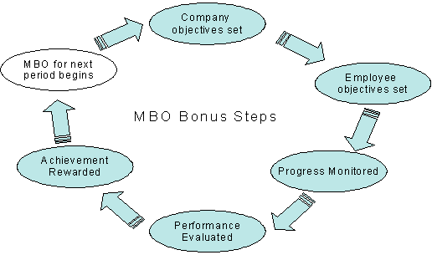
Criteria of evaluation employees

Slide 14
Criteria of evaluation employees
Balanced Scorecard (BSC)
System of the balanced indicators of company performance.The basic idea is that the target of the enterprise is to satisfy not only its shareholders, but also other interest groups, such as employees, suppliers, distributors, customers and others.
The enterprise on the basis of four perspectives:
1. Financial
2. Customer
3. Internal business processes
4. Learning and growth

Slide 15
Criteria of evaluation employees

Slide 16
Criteria of evaluation employees
Evaluation based on compliance with standards
This method consists in comparison of a worker’s performance with defined standards. It is most frequently used for blue collar professions.
Check-list
The check-list is actually a questionnaire, which presents certain formulations related to working behaviour and the assessor indicates whether a given type of behaviour is present in the worker’s performance or not (usually, he only marks ‘yes’ or ‘no’).

Slide 17
Criteria of evaluation employees
BARS Method (Behaviourally Anchored Rating Scale)
The method is not focused on the working effect, but approach to the work, observance of a certain working procedure and working behaviour. The method assumes that the desired working behaviour contributes to the efficient performance of the work.

Slide 18
Criteria of evaluation employees
Method 20-70-10
The vitality model of former General Electric chairman and CEO Jack Welch has been described as a "20-70-10" system. The "top 20" percent of the workforce is most productive, and 70% (the "vital 70") work adequately. The other 10% ("bottom 10") are nonproducers and should be fired.

Slide 19
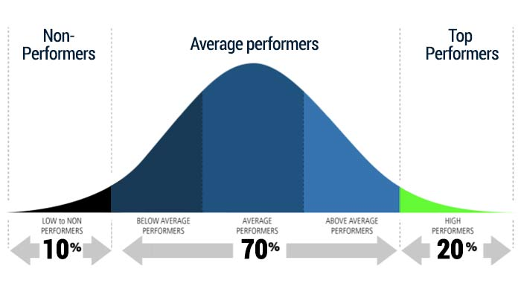
Criteria of evaluation employees
Method 20-70-10 (GE)

Slide 20
Criteria of evaluation employees
What is evaluated:
1) Output (performances)
- Performances and results, which are properly measurable
2) Process (working behaviour, attitude to work)
The connecting element between the inputs and outputs - how the worker behaves during work
3) Input (potential, competence, practice)

Slide 21
Criteria of evaluation employees.
The results of employee assessment are the basis for determination of the wage, basis for future deployment of the worker, provide information about the employee’s further education and constitute a mutual relations tool between the evaluated and the evaluator.
Circle of evaluated persons
In the case of the system of regular employee assessment, it applies to all employees. The evaluation of the individuals is done in special cases, for instance, transfer of the employee to a different working position.

Slide 22
Thank you for your attention
Have a nice day

