Slide 1
Cestovka – Situation Analysis
Business Simulator
Ing. Viktor Vojtko, Ph.D. (2019)

Slide 2
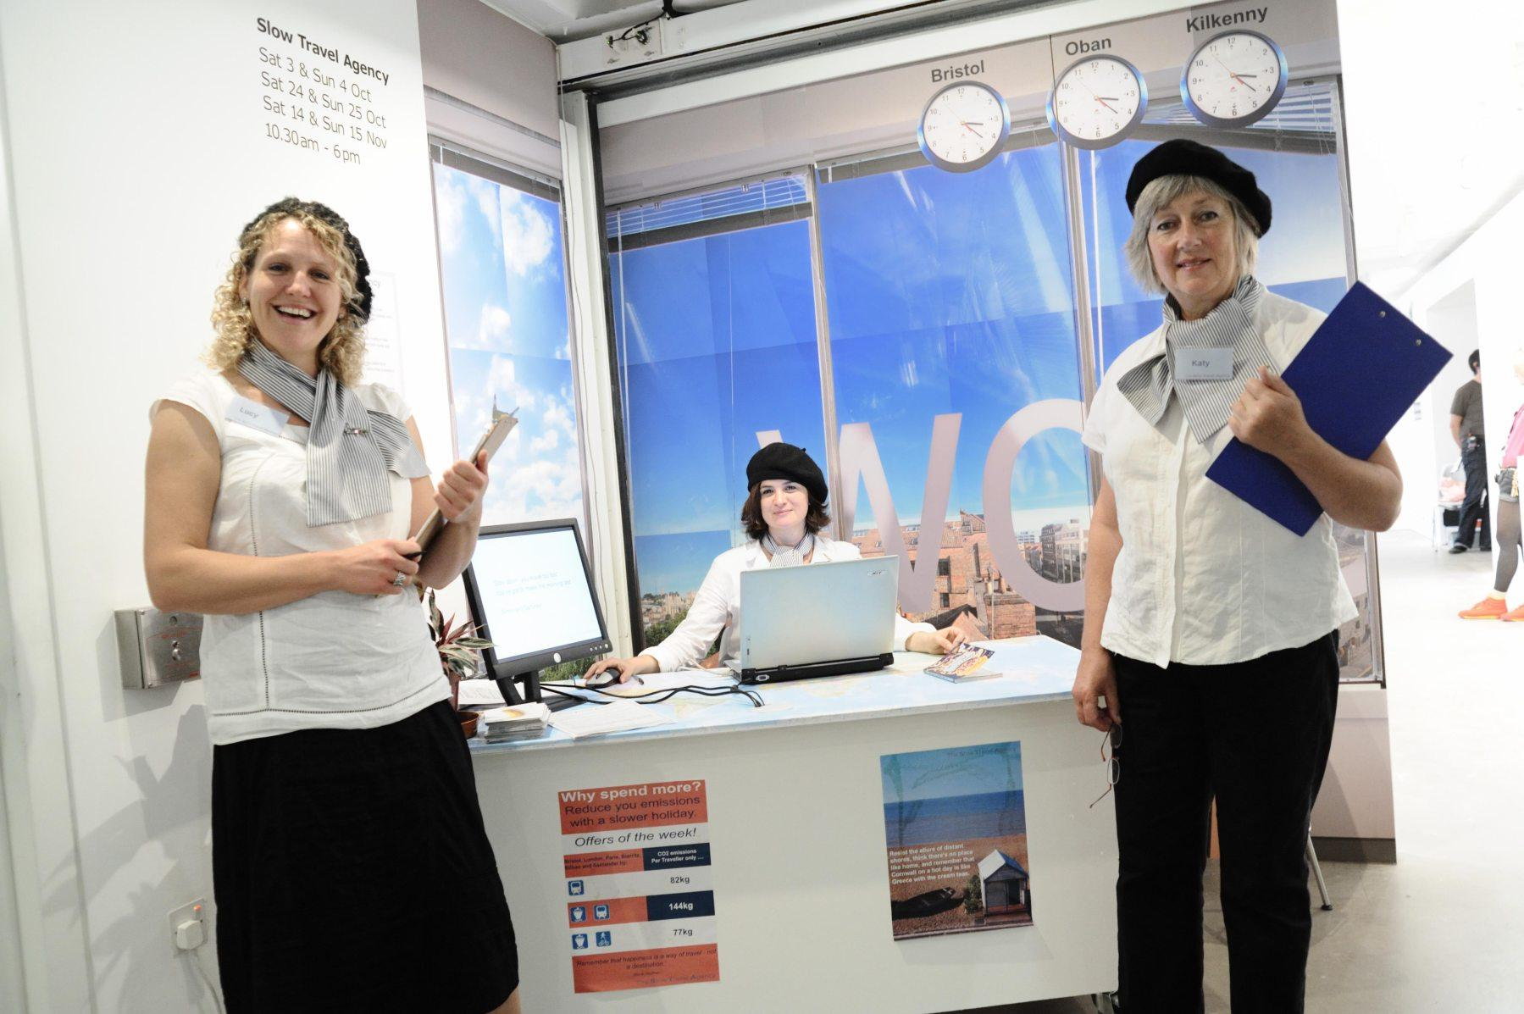
Case study and simulation description
Tour operator in the Czech Republic
One year of operation
Approximately CZK 5.4 million of sales and a loss of CZK 1.5 million after the first year
Saturated and highly competitive market
Simulation for the next 2 years of operation, decisions being made for each month
Tato fotka od autora Neznámý autor s licencí CC BY-SA

Slide 3
Operation of the simulated business

Slide 4
Situation analysis
The purpose of situation analysis is to understand how the company works and in how could it be affected by external environment factors.

Slide 5
How to perform the situation analysis?
Analysis of macro-environment
STEP analysis
Analysis of micro-environment
External analysis - Porter five forces model + complements + public + local government
Internal analysis - financial analysis, portfolio analysis, personnel, processes, capacities, resources
Analysis of relationships between various factors
SWOT analysis (strengths, weaknesses, opportunities, threats)

Slide 6
SW analysis (internal factors)
Guiding questions:
How is a company performing economically? Where is it in relation to the break even point?
Does the company have sufficient financial reserves?
How is the company interesting for investors / bankers?
Does the company have sufficient operating capacity?
Is the company sufficiently equipped for future development?
What is the position of the company with customers?
What is the company's position with suppliers?
Are the products of the company competitive?
How does the company deal with its risks?

Slide 7
OT analysis (external factors)
Guiding questions:
Can fluctuations in exchange rates be expected?
Are there any expected changes in legislation / regulation in relation to the industry?
Is it possible to expect strenghtening or weakening of competition?
Can growth / decrease in demand be expected?
Can changes in supplier prices be expected?
Is there any room on the market for getting more customers?
Are there other opportunities? For example, new technologies or funding schemes?

Slide 8
SWOT – what to watch out for?
Reliable data and resources
Provided materials
The Czech Statistical Office, the Czech National Bank, the Ministry of Industry and Trade
Everything should be done from the perspective of the company - ie what is the expected impact of different factors, changes, and trends?
Specific recommendations for the next step - ie what is the result of the company?

Slide 9
Simulation game limitations
What is not possible to change due to simulation game limitations:
Extend the number of establishments
Sell outside the defined region
Specify tours by destinations

