Slide 1
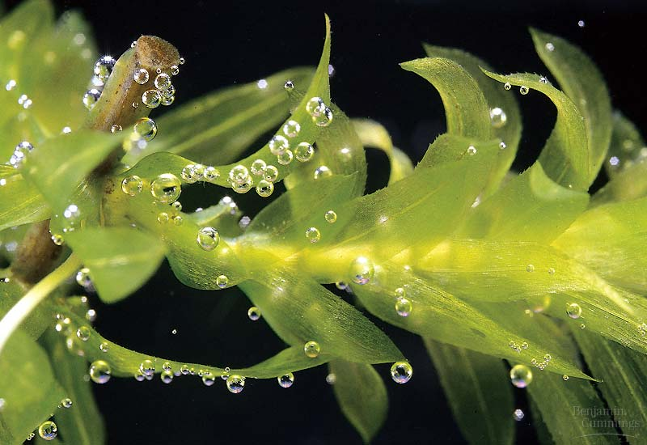
Light and chloroplast development
Roman Sobotka

Slide 2
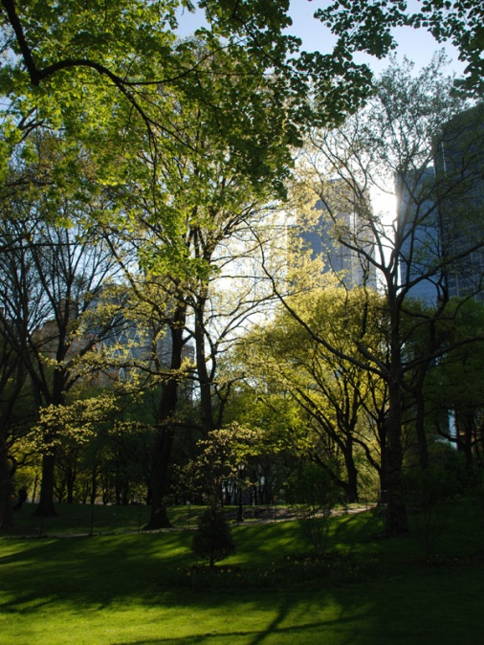
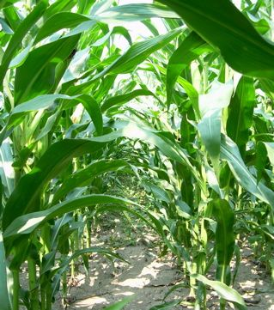
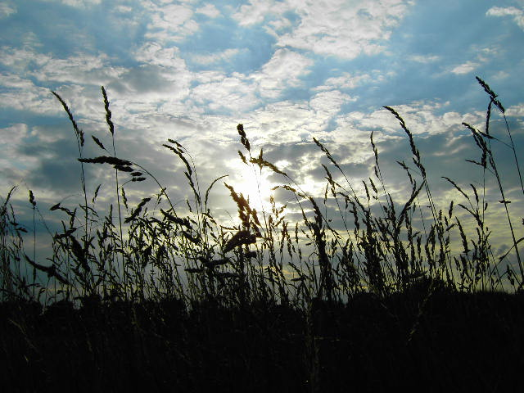
Light is alpha and omega for the ’green’ cell
The cell depends completely on light as a source of energy
and.. can be destroyed by an excess light
As light intensity is very oscillating >>> the ‘first of all‘ singnaling event for the photosynthetic cell

Slide 3
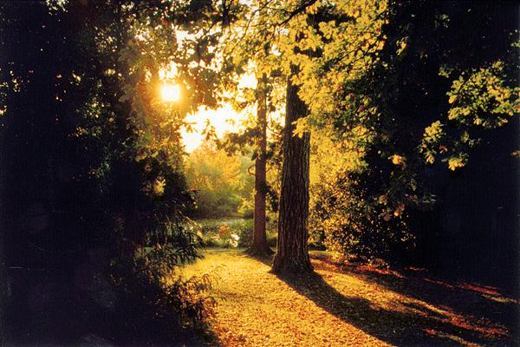
Over one-third (1/3) of the Arabidopsis genes (~8,000 of 25,000)
is coordinately regulated by light by 2-fold or more.

Slide 4
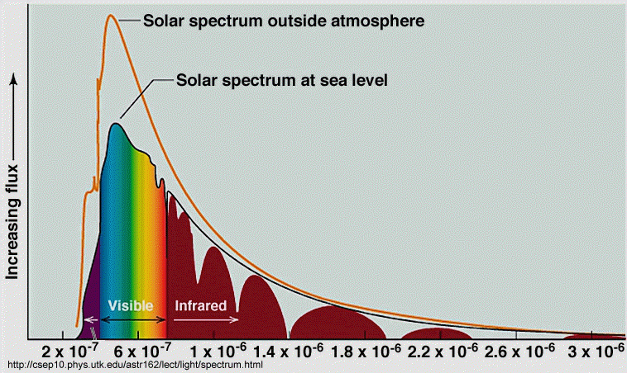
Solar energy
When the sky is clear, the photosynthetically active part of the solar spectrum accounts for about HALF of the total solar energy..

Slide 5
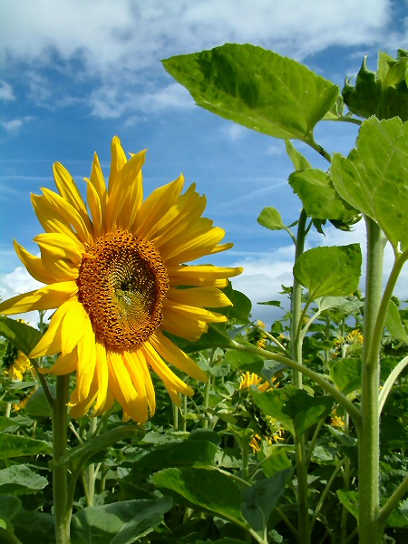
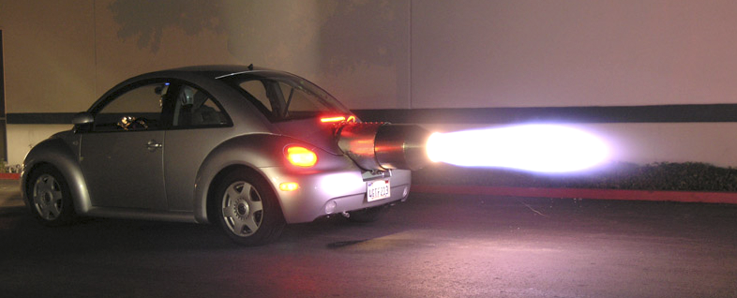
When there is too much light ..
When the sky is clear... ~1500 μmol of photons s⁻¹ m⁻²
Arabidopsis optimum is ~ 100 - 200 μmol s⁻¹ m⁻²
... more than enough

Slide 6
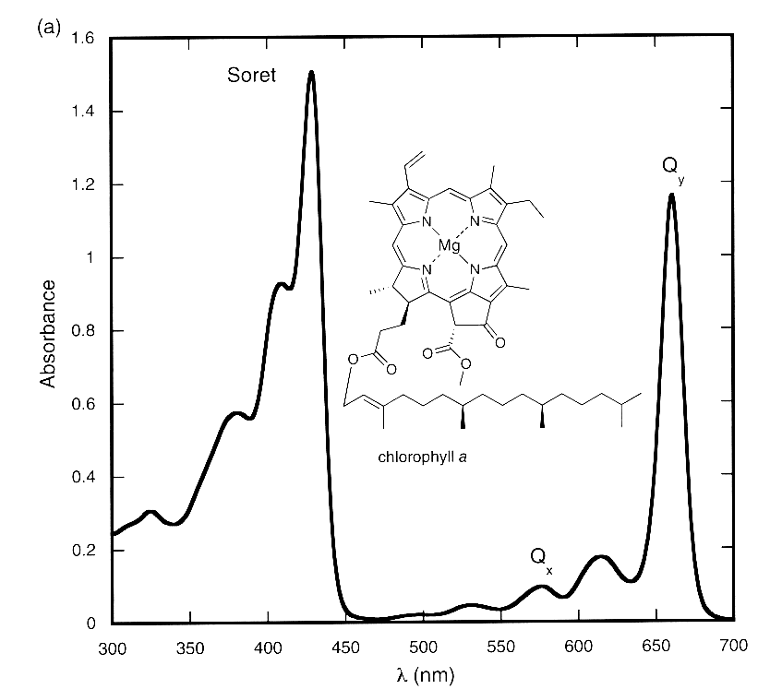
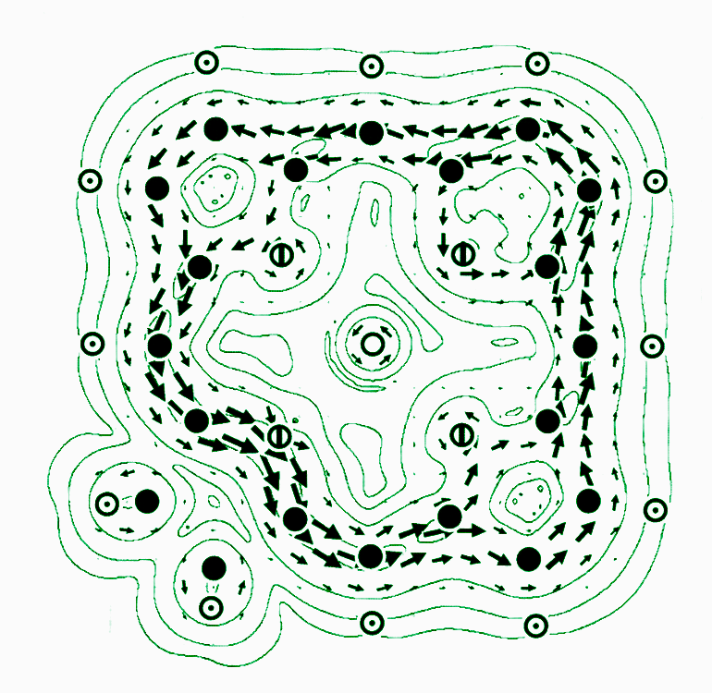
Absorption of light by chlorophyll (tetrapyrroles)
e- excitation
photon

Slide 7
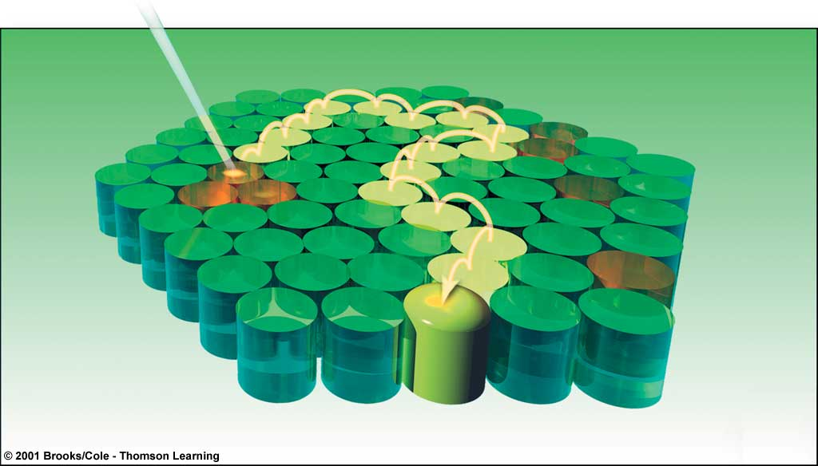
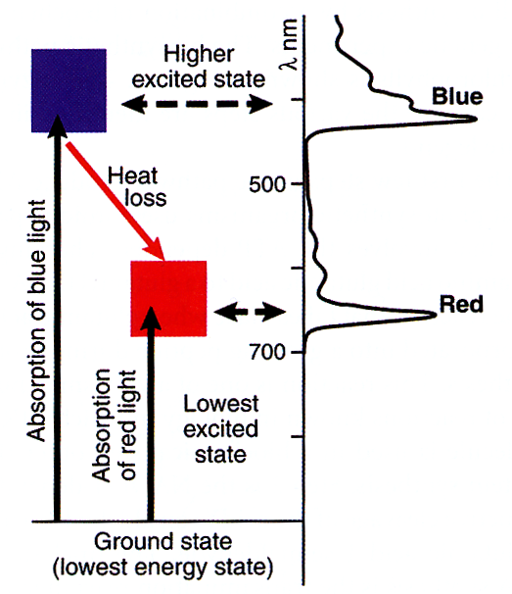
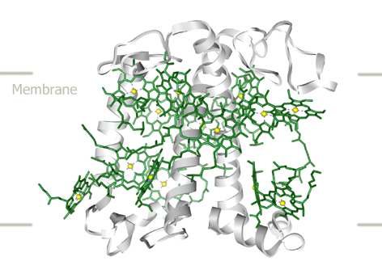
Absorption of light by chlorophyll
photon
.. what happens with the excess of energy absorbed by chlorophyll?

Slide 8
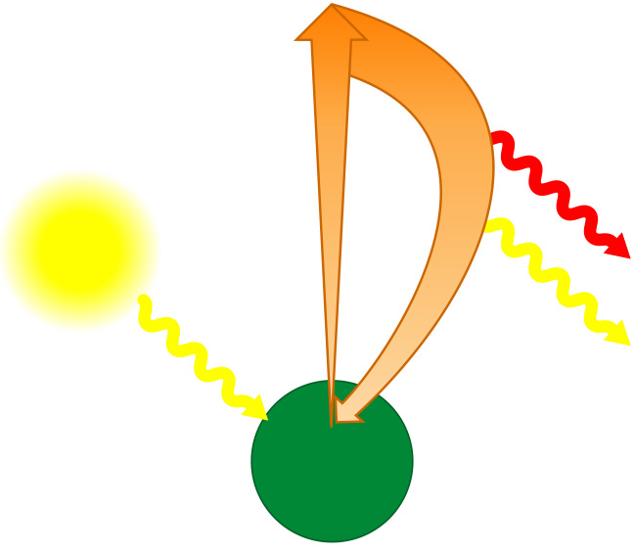
When there is too much light .. chlorophyll excitation
e⁻
Excited
state (singlet state)
e⁻
.. triplet state!
Heat
Light
Light
(fluorescence)
Photon
Ground
state
Chlorophyll
molecule
Photosynthesis
Absorption of a photon

Slide 9
When there is too much light .. triplet state
There are two ways in which the spin of two electrons can be combined in
different orbitals – singlet and triplet
In chlorophyll the energy trapped in the triplet state has only quantum mechanically
"forbidden" transitions available to return to the lowest energy state –> very slow
As a consequence, chlorophyll in the triplet state can have very long lifetime
(milliseconds ..)
Chlorophyll in the triplet can transfer energy to oxygen resulting in singlet oxygen
– reactive molecule >> converted into hydroxyl radical (.OH) >> destruction of
proteins, lipids, nucleic acid ..

Slide 10
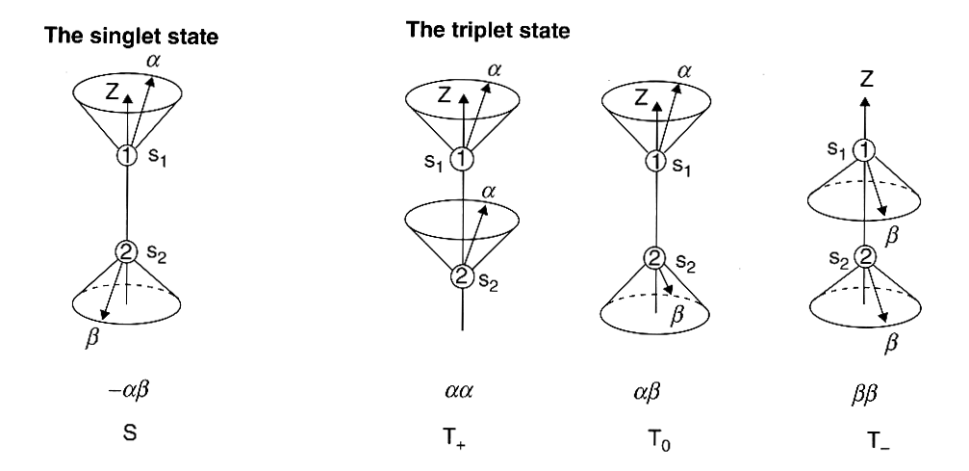
Singlet state and triplet state

Slide 11
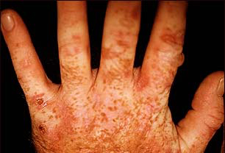
Misregulation of tetrapyrrole metabolism ...
Necrotic leaf of the ferrochelatase antisense tabacco
Porphyria - disorders of certain enzymes in the heme biosynthetic pathway

Slide 12
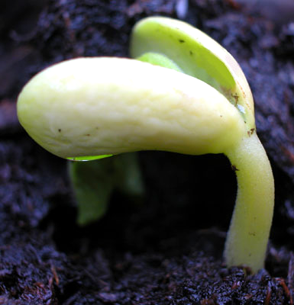
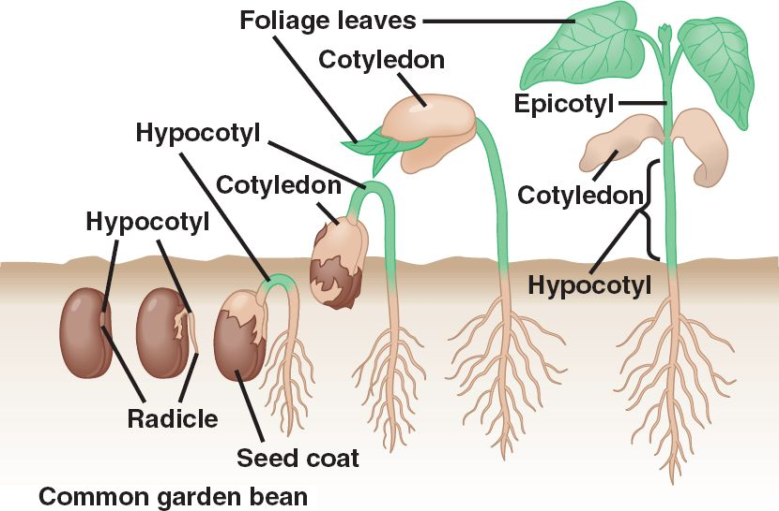
Babies have to be protected
Dark phase Autotrophic grow

Slide 13
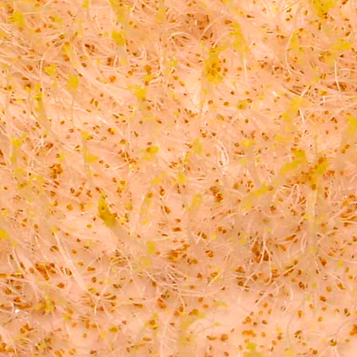
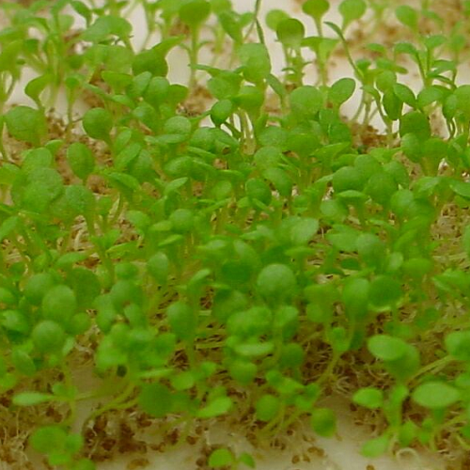
Photomorphogenesis
- light-mediated changes in plant growth and development
Skotomorphogenesis
Photoprotection of seedlings (very probable, however, problem to prove)
Save of energy? (chloroplasts ~ 50% of the total cell protein)
Shade avoidance
...

Slide 14
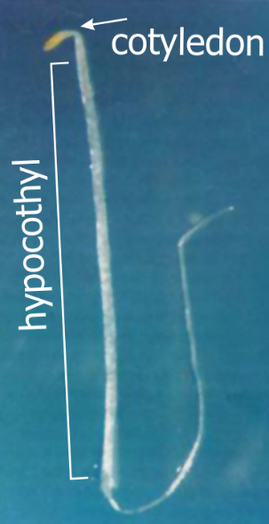
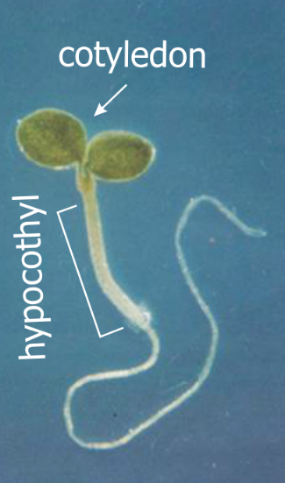
Comparison of dark-grown (etiolated) and light-grown seedlings
Etiolated
De-etiolated
Distinct "apical hook"
No leaf growth
Etioplasts, no chlorophyll
Rapid stem elongation
Limited root elongation
Limited production of lateral roots
Apical hook opens
Leaf growth promoted
Chloroplats
Stem elongation suppressed
Radial expansion of stem
Root elongation promoted
Lateral root development accelerated

Slide 15
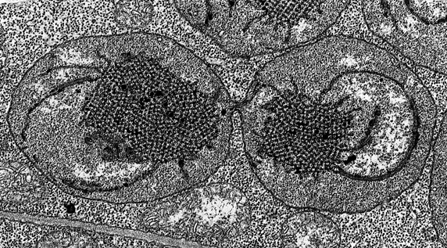
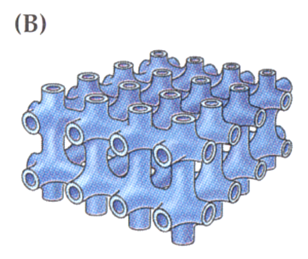
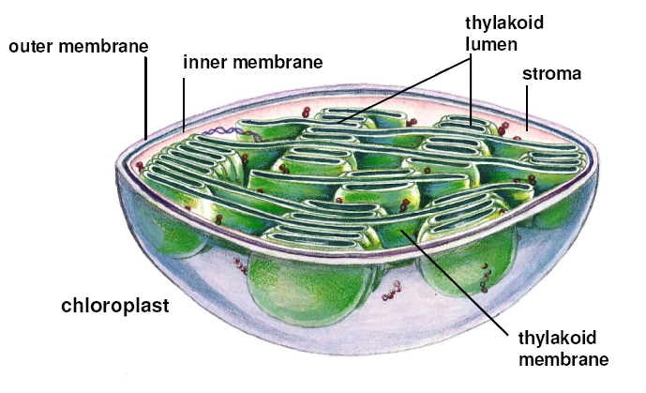
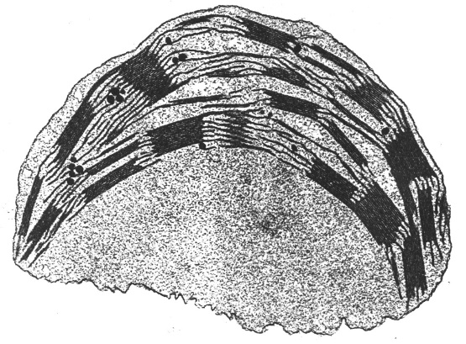
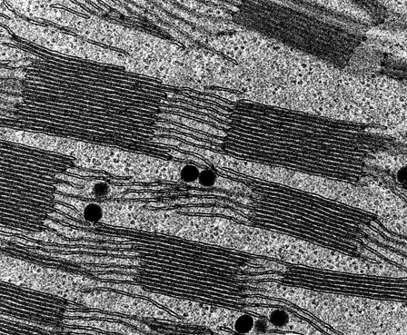
Etioplast versus chloroplast
Etioplasts lack:
majority of proteins
chlorophyll
photosynthetic capacity
chloroplast membrane structure
...
Dividing etioplast
Prolamellar body
Mature chloroplast
Thylakoid membranes

Slide 16
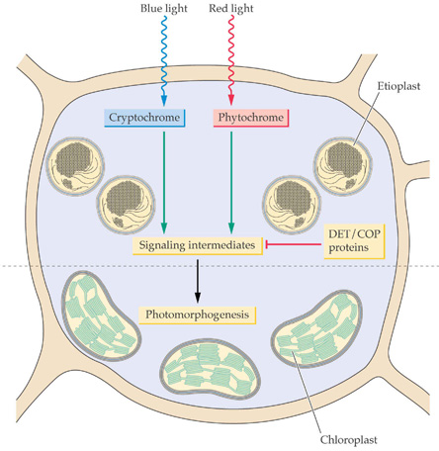
Chloroplast development -overview
Sensing of light - photoreceptors
Signal transduction – expression of genes in the nucleus, protein transport into plastids
Expression and accumulation of proteins coded by plastid DNA, chlorophyll biosynthesis

Slide 17
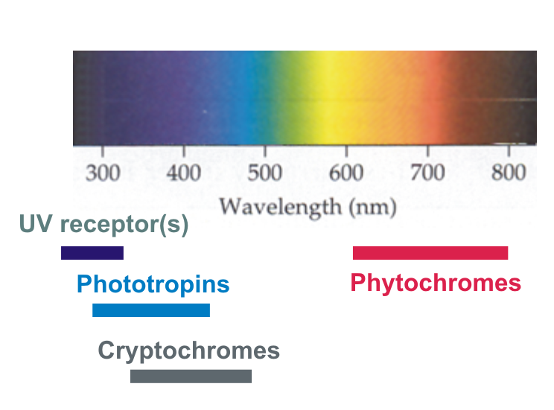
Plant photoreceptors
intensity
wavelength
direction
spectral characteristics (colour)
time of exposition
....

Slide 18
UV-B photoreceptor
UVR8 protein
Kliebenstein et al. Arabidopsis UVR8 regulates ultraviolet-B signal transduction and tolerance and contains sequence similarity to human regulator of chromatin condensation 1. Plant Physiol. 2002
isolation of a Arabidopsis mutant hypersensitive to UV light
Rizzini et al, Perception of UV-B by the Arabidopsis UVR8 protein. Science. 2011
→ UVR8 is a UV-B receptor
Christie et al, Plant UVR8 photoreceptor senses UV-B by tryptophan-mediated disruption of cross-dimer salt bridges. Science 2012
Wu et al, Structural basis of ultraviolet-B perception by UVR8. Nature 2012
→ two independent structures of UVR8

Slide 19
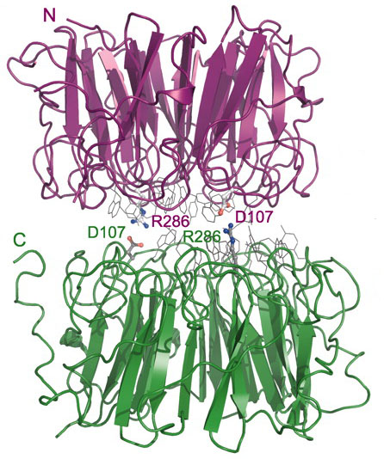
UV-B photoreceptor
The UVB8 dimer is disrupted by UV-B into monomers, UV-B is absorbed by tryptophans

Slide 20
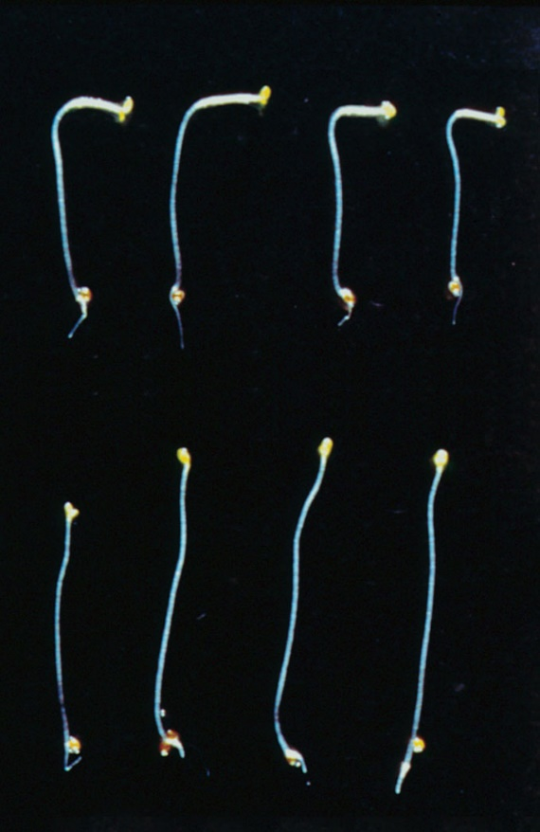
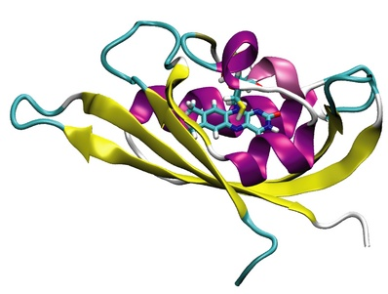
Phototropins - UV/A and blue light receptors
Phototropin mutant
Function - phototropism, growth toward or away from light
- photoperiodism (orientation in time during season)
Flavoproteins (2 FMN) Sites + Kinase domain
Arabidopsis - PHOT1 Low Light response
- PHOT2 High Light response

Slide 21
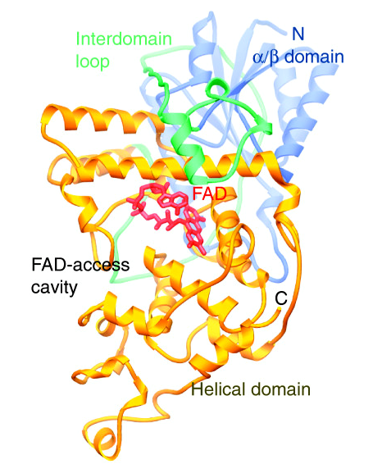
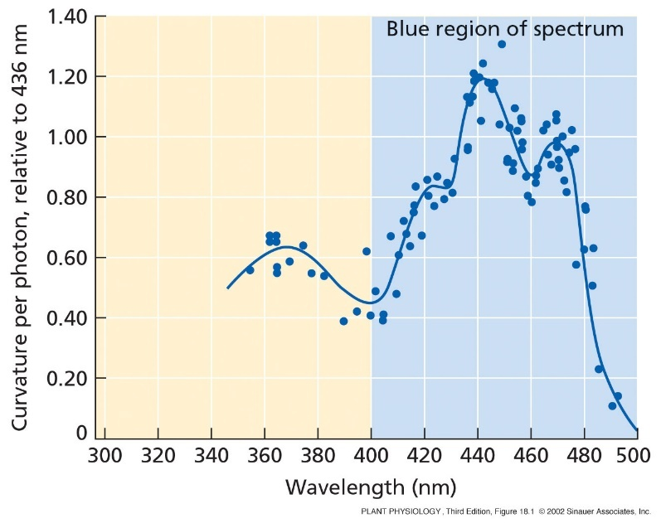
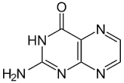
Cryptochromes - blue light receptors
Flavoproteins (Pterin + FAD site)
Arabidopsis Cry1 Hypocotyl elongation
Cry2 Flowering, circadian clock setting
Pterin
Cryptochrome action spectrum

Slide 22
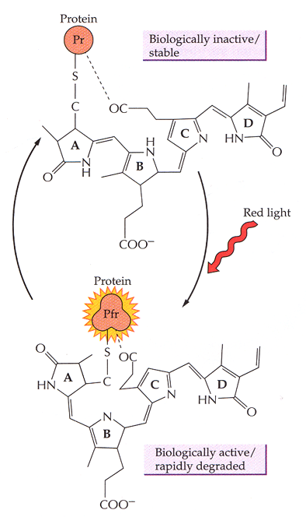
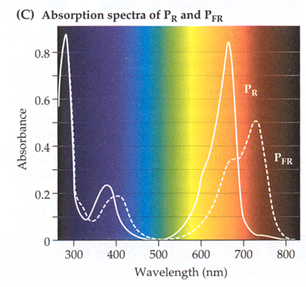
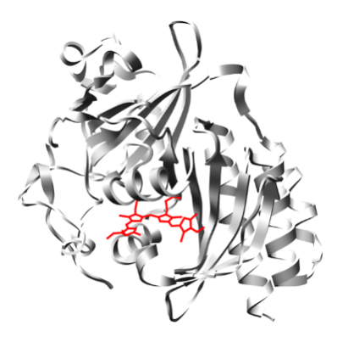
Phytochromes - activated by red light
.. and de-activated (reset) by far-red light
Chromophor - phytochromobilin, synthesized by oxidizing of heme
Serine/threonine kinase domain –> light regulated kinases
Arabidopsis has 5 phytochromes - PhyA, PhyB, PhyC, PhyD, PhyE
The different Phy control different responses
Redundancy - in the absence of one, another may take on the missing functions
PhyA – photolabile, PhyB,C,D,E - photostabile

Slide 23
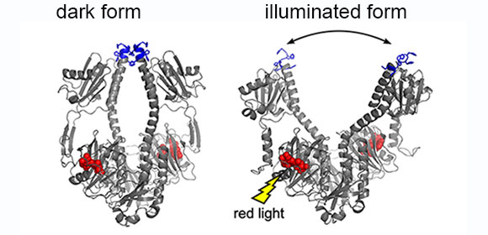
Phytochromes structure
GAF domain
Heikki Takala, et al. Nature (2014)

Slide 24
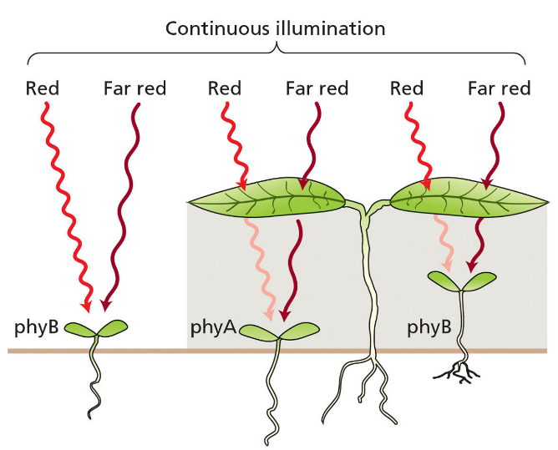
Why red/far-red receptors?
Detection of spectral characteristics of light (midday vs. sunset etc)
Longer-term light quality (e.g. good time for flowering)
Seed germination
red light induces germination
far-red inhibits germination
Shade avoidance
PhyB plays the key role in the shade avoidance
mechanism.. induces hypocotyl elongation
Red light is required for photomorphogenesis (blue is not essential)
Setting of circadian clock

Slide 25
Chloroplast development – downstream of photosensors
Sensing of light - photoreceptors
Signal transduction – expression
of genes in the nucleus; transport of proteins into plastids

Slide 26
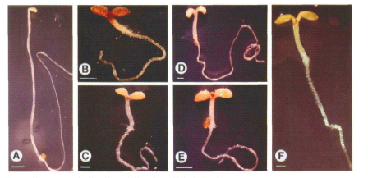
Screening for mutants with perturbed photomorphogenesis
cop - for constitutive photomorphogenic (normal function is to repress photomorphogenesis in the dark). Examples: COP1 – E3 ligase, COP9 signalosome
A - Wild type, dark
B - Cop8 mutant, dark
C - Cop9 mutant, dark
D - Cop10 mutant, dark
E - Cop11 mutant, dark
F - Wild type, light
det - for de-etiolated (like Cop genes). CDD complex (COP10 + DET1 + DDB1)
hy - named for mutants hypocotyl elongated, a dark grown character, needed for photomorphogenesis. HY1, heme oxygenase
HY5, a key transcription factor (>5000 genes)

Slide 27
Chloroplast development – what plastid can do alone?
Expression and accumulation of proteins coded by plastid DNA, chlorophyll biosynthesis

Slide 28
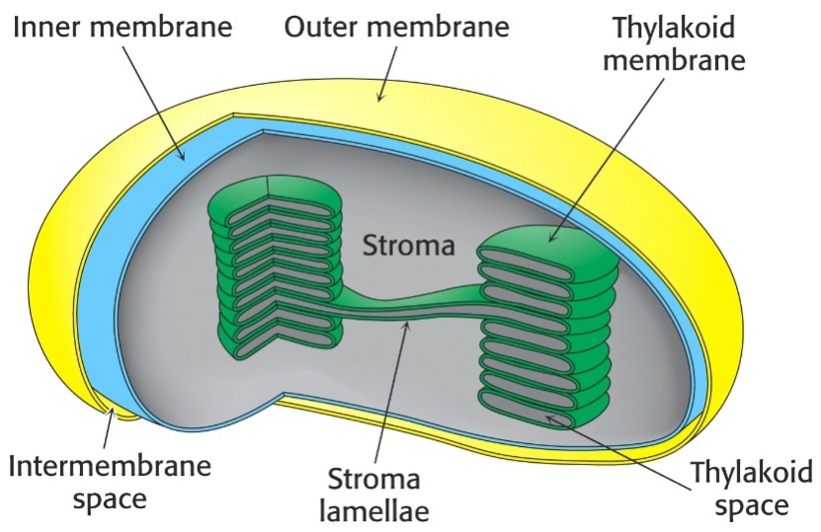
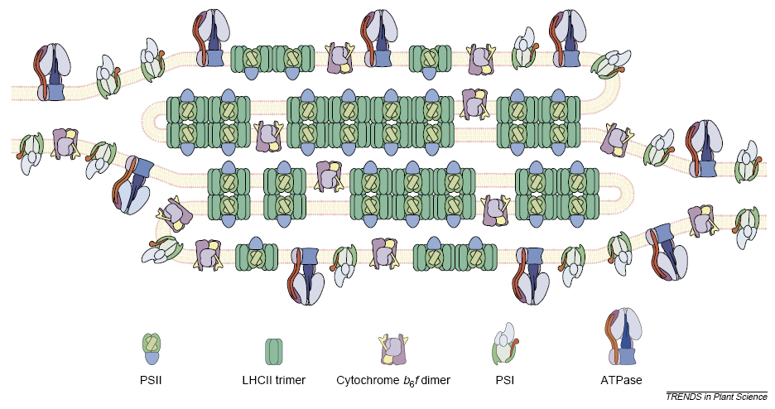
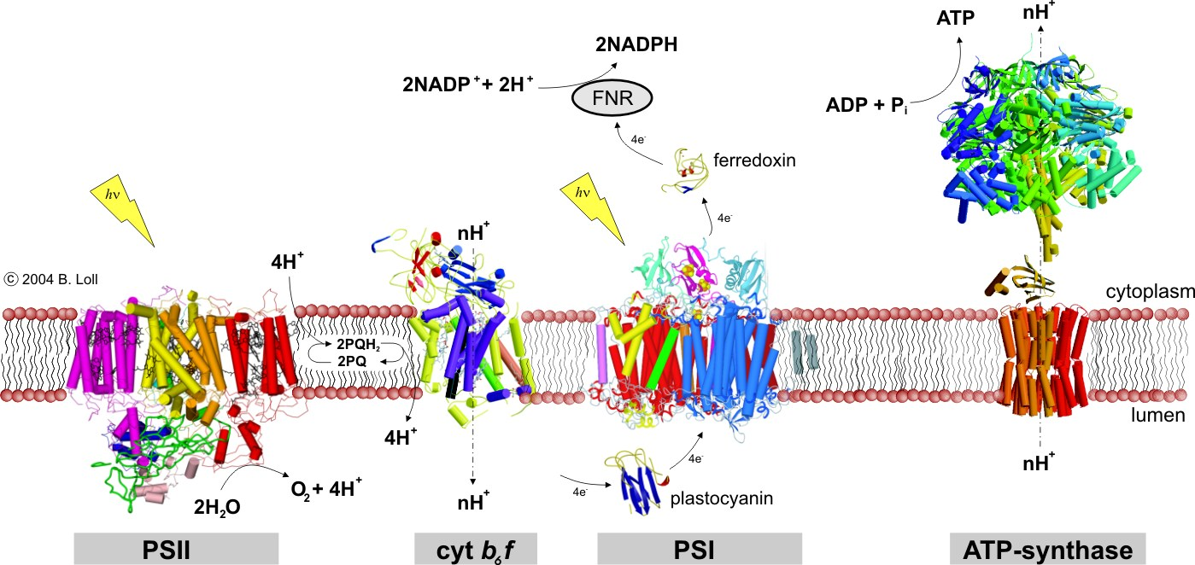
Photosynthetic complexes

Slide 29
Chloroplast - where are proteins coming from?
Chloroplast-encoded proteins (~80)
Accumulation under tight and complex control ... two different RNA polymerases in chloroplast
Nucleus encoded protein (~1800)
Transported into (developing) chloroplast
Controlled by light (phytochromes, cryptochromes), circadian clock, back-signaling from chloroplast ..

Slide 30
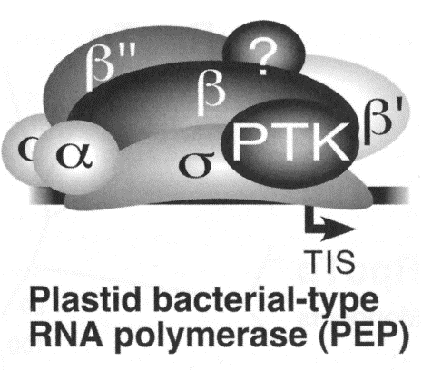
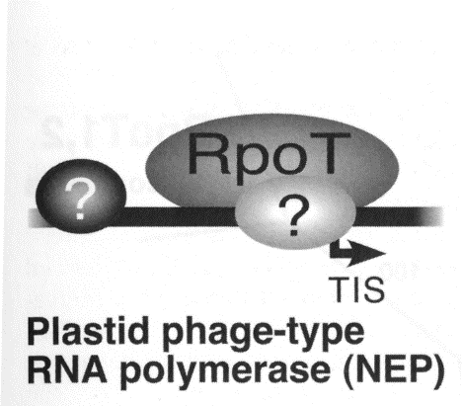
RNA polymerase in chloroplast
Plastid-encoded polymerase (PEP, bacterial) and nucleus encoded polymerase (NEP, phage type)
Nucleus encoded polymerase (NEP) is induced during photomorphogenesis
Light

Slide 31
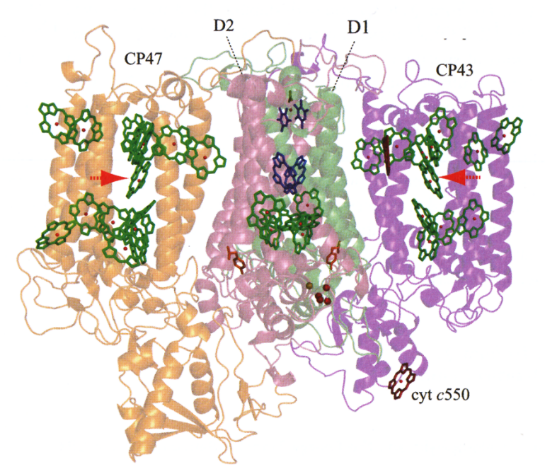
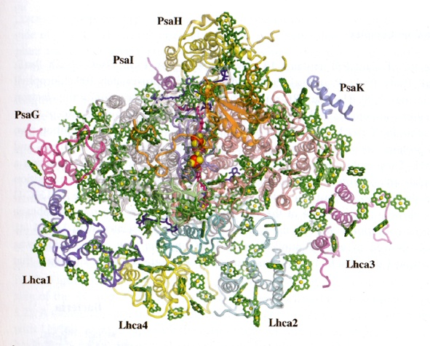
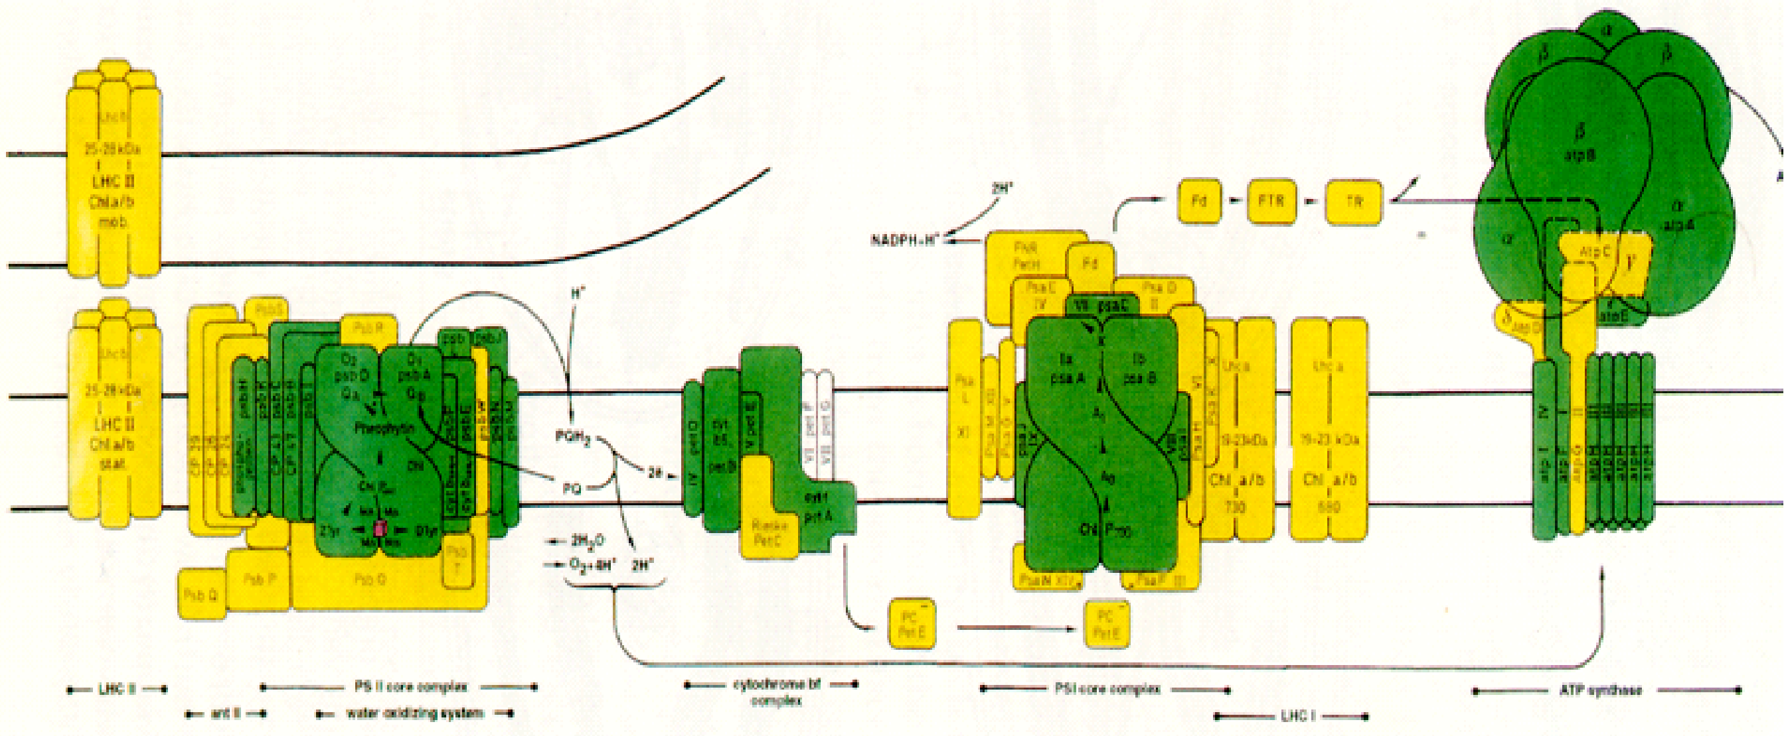
Core proteins of photosystems are encoded by plastid DNA
Green – plastid encoded
Yellow – imported from nucleus
Photosystem II, side view
Photosysten I, top view

Slide 32
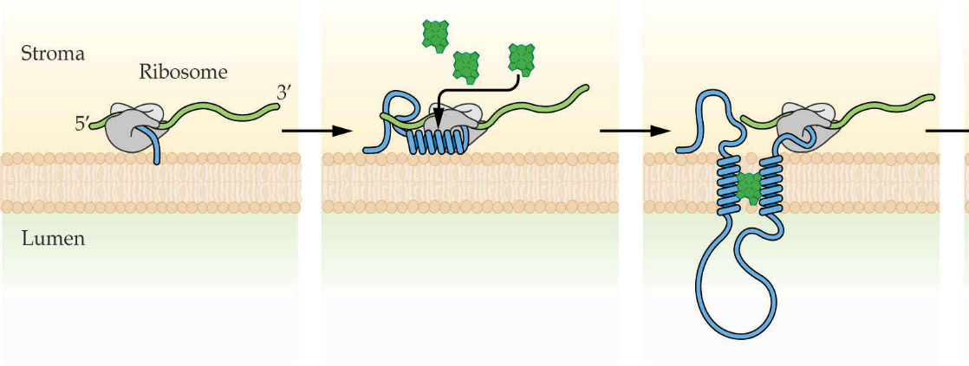
... chlorophyll is essential for chlorophyll-protein synthesis
Chlorophyll is incorporated into protein during translation ..
Chlorophyll is essential for chlorophyll-protein stability
In etioplast, chlorophyll-binding proteins are probably synthetized, however, their accumulation is triggered by chlorophyll availability

Slide 33
Chlorophyll biosynthesis
- dealing with ”danger molecules”
Chlorophyll has to be synthesized in substantial amount as safety as possible:
Pathway completely located in chloroplast, shared with heme biosynthesis
Tightly controlled by light
Finished chlorophyll is immediately bound to apoproteins
Biosynthetic pathway is very well self-controlled, precursors do not accumulate
Chlorophyll precursors implicated in regulation of nuclear and plastid gene expression

Slide 34
Light is essential for the finishing of chlorophyll synthesis
Protochlorophyllide oxidoreductase (POR) - penultimate enzymatic reaction of the chlorophyll biosynthesis depends on light

Slide 35
POR is the major component of etioplast prolamellar bodies
Etioplast is full of the POR with bound substrate – protochlorophyllide + NADPH
Level of other enzymes of chlorophyll biosynthesis is very limited in etioplast
-> imported during photomorphogenesis (after Pif degredation)

Slide 36
How it works together?
Photoreceptors
+
Transcription factors and protein complexes in nucleus
+
Activation of chlorophyll biosynthesis
Synthesis of photosynthetic complexes
Formation of thylakoid membranes

Slide 37
Mechanism of phytochrome action - actors
Protochlorophyllide oxidoreductase
Cryptochromes
Inactive phytochromes
E3 ubiquitin
ligase
Specific Prf phosphatase
bHLH group of transcription factors
bZIP type transcription factor (ubiquitinated)

Slide 38
Mechanism of phytochrome action - activation

Slide 39
Mechanism of phytochrome action – PNB formation
Nuclear body, tens of proteins..
Fine-tuning of Phr signaling
COP9 signalosome – (CNS) involved in protein degradation

Slide 40
Mechanism of phytochrome action – COP1 and Pifs degradation
Hy5 can start to accumulate..

Slide 41
Mechanism of phytochrome action – export of proteins into plastids
NEP polymerase is imported into
plastid

Slide 42
Cryptochrome and POR signaling

Slide 43
Phytochrome interacting factors (Pif) repress chloroplast development
- emerging role of Pif factors in the regulating of chlorophyll biosynthesis

Slide 44
PIF factors repress chlorophyll biosynthesis
Pif1/3 block the expression of several key enzymes of chlorophyll biosynthesis
- Pifs are degraded via the COP9 signalosome (CNS) during photomorphogenesis

Slide 45
COP9 Signalosome (CSN)
8 COP subunits have been identified to form a large complex, ‘COP9 signalosome’.
Similar to proteasome ‘lid’
19S
26S
proteasome
CNS

Slide 46
CNS
COP9 signalosome S.cerevisiae
subunits of plants Identity lid subunits
CSN1 22% Rpn7p
CSN2 21% Rpn6p
CSN3 20% Rpn3p
CSN4 19% Rpn5p
CSN5 28% Rpn11p
CSN6 22% Rpn8p
CSN7 15% Rpn9p
CSN8 18% Rpn12p

Slide 47
The COP proteins are highly conserved
COP1 =a specific E3 ligase
COP9 signalosome COP1
Budding Yeast No No
Fission Yeast Yes No
C. elegans Yes No
Drosophila Yes No
Fish Yes Yes
Mammals Yes Yes
Higher Plants Yes Yes

Slide 48
The COP9 signalosome discovery
1992, the cop9 mutant characterization was reported in Plant Cell
1994, the COP9 gene was cloned and its encoded protein was found to be part of a protein complex in Arabidopsis (Wei et al., Cell, 1994)
1996, the initial purification and characterization of the COP9 signalosome was reported (Chamovitz et al., Cell, 1996)
1998, the purification and characterization of the COP9 signalosome in human and mouse was reported (Wei et al., Cur. Biol, 1998)
Both human COP9 signalosome and COP1 shown to involve in many oncogenic processes. Human COP1 E3 targets included p53 (tumor suppressor) and c-Jun (oncogene) ...

Slide 49
COP9 (CNS) – a regulator of protein degradation
controls activity of E3 Cullin-RING (CRL) ligases by neddylation/de-neddylation --> specific targeting of a substrate into proteasome
COP10 (CDD)
COP9
E3 Cullin-RING ligase

Slide 50
COP9 (CNS) – a regulator of protein degradation
controls activity of E3 Cullin-RING (CRL) ligases by neddylation/de-neddylation --> specific targeting of a substrate into proteasom
N = Nedd8
ub = Ubiquitin
E2 = Ub conjugating enzyme
CAND1 = Cullin associated and
neddylation disociated 1
Hyper-neddylated E3 CRL ligase (COP1) is unstable ..

Slide 51
COP9 structure (and proteasome lid)
Eukaryotic proteasome lid
Nature 2014

Slide 52
E3 Cullin-RING - COP9 structure – a mechanistic view
Cavadini S, Nature 2016

Slide 53
A most current model of photomorphogenesis

Slide 54
Central position of the light signaling in signaling network
light dark

