Slide 1
Strategic change
doc. Ing. Petr Řehoř, Ph.D.

Slide 2
Learning outcomes
you will know to explain the concepts - strategy change
you will meet different strategic changes,
you will get information about it, what is strategy 2x5P,
you will learn, what the substance of strategic analysis, creation of strategy, implementation of the change,
you know, what is strategic gap.

Slide 3
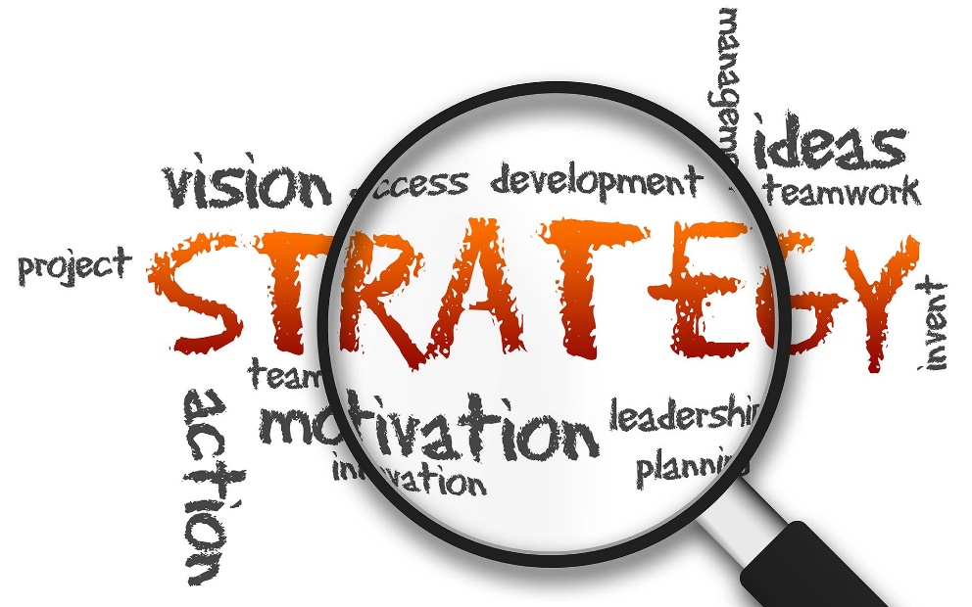
Introduction
The main tasks of the strategic management are formulations of the strategies and control of their realization.
Strategic change must come out of the concrete situation.
Implemented strategic change brings also new standards
and values.

Slide 4
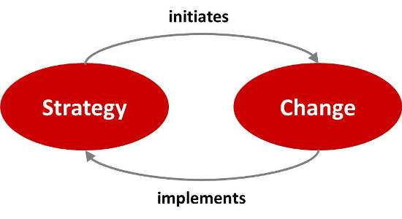
Strategic change
Process of bringing about relatively enduring alternation in the precent state of strategies to compete with the rivals and their differentiated and integrated functions in totality or partially so as to attain greater adaptability and viability in the context of the current and emerging environmental developments.

Slide 5
Types of strategic change
re-engineering - Business Process Reengineering - rethinking and radical redesign of business processes.
restructuring - improve the firm's performance.
innovation - process by whitch organisations use their skills and resources to create new technologies or goods and services

Slide 6
Types of strateic change
strategy of saving - aim is a renewal of the company efficiency.
strategy of prosperity - quick and flat decision it is also important the motivation of the employees.
strategy of re-birth - the leading employees must be changed here.

Slide 7
Types of strategic change
strategy of the blue ocean - the companies ignore competition by this strategy, they concentrate on the construction of the new sports grounds and on the definition of the new branch.
strategy of red ocean - there are market branches, there is keen and murdered competition there.The company tries to increase the performances more than their rivals and capture bigger part of existing demand.

Slide 8
Strategy 2x5P
Preparedness
Plan
Portfolio of the solution Perspective
Care
Product
Staff
Processes
Partners
Gain

Slide 9
Process of strategic change
Strategic analysis – SWOT analysis:
the current status is suitable,
the current status is satisfactory,
The current status is unsatisfactory.
Proposal of stragy
Where are we and where do we want to get to? Which variants can we use to attain our global goal of the strategy? What are the criteria for assessing variants and choosing the most suitable?

Slide 10
Process of strategic change
Implementation - participative and directive approaches
Principles: regularly identify and mitigate barriers to change, establish proactive, two way communication, ensure ongoing, adequate resourcing, seek program resilience, divide and conquer, establish scorecards/metries for success, celebrate results.

Slide 11
Process of strategic change
Barriers of the implementation:
mission and strategy are unrealizable,
goals of particular cells, teams and employees are not connected with the strategy,
mechanisms of resource allocation are not connected with the strategy,
feedback are of operating (tactical), and not strategic character

Slide 12
Process of strategic change
Prerequisites for successful implementation:
Engage all levels of your company in the strategy planning process.
Communicate the need and how decisions were made to fill that need.
Obtain buy-in by all key employees and stakeholders.
Conduct informational sessions or training to achieve a comfort level with new strategic processes and procedures.
Implement the new strategy with fanfare.

Slide 13
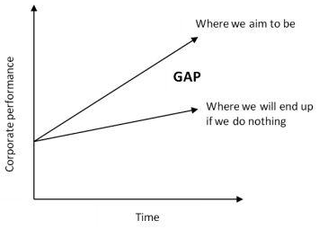
Strategy gap
Space between the expected result in future, that continuity of the existing strategy would lead to - and requested result of the new strategy.

Slide 14
Thank you for
the attenttion!!!

