Slide 1
Signal transduction pathways II:
Enzyme-linked receptors
Nuclear receptors

Slide 2
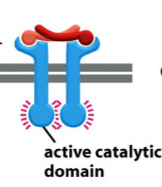
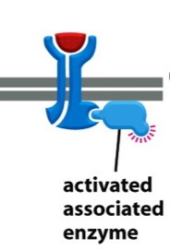
Enzyme-linked receptors
signalling through growth factors, hormones, cytokines
acting locally at very low concentrations (10⁻⁹ – 10⁻¹¹M)
response is usually slow (min-hours) and requires many intracellular steps, leading to
changes in gene expression
1. receptor tyrosin kinases (RTKs)
2. tyrosin kinases associated receptors
3. receptor serin/threonin kinases
4. histidin kinase associated receptors
5. receptor guanylyl cyclases
Notes:
Which type of kinases do we know? Tyrosin, Ser/Thr. Histidin…

Slide 3
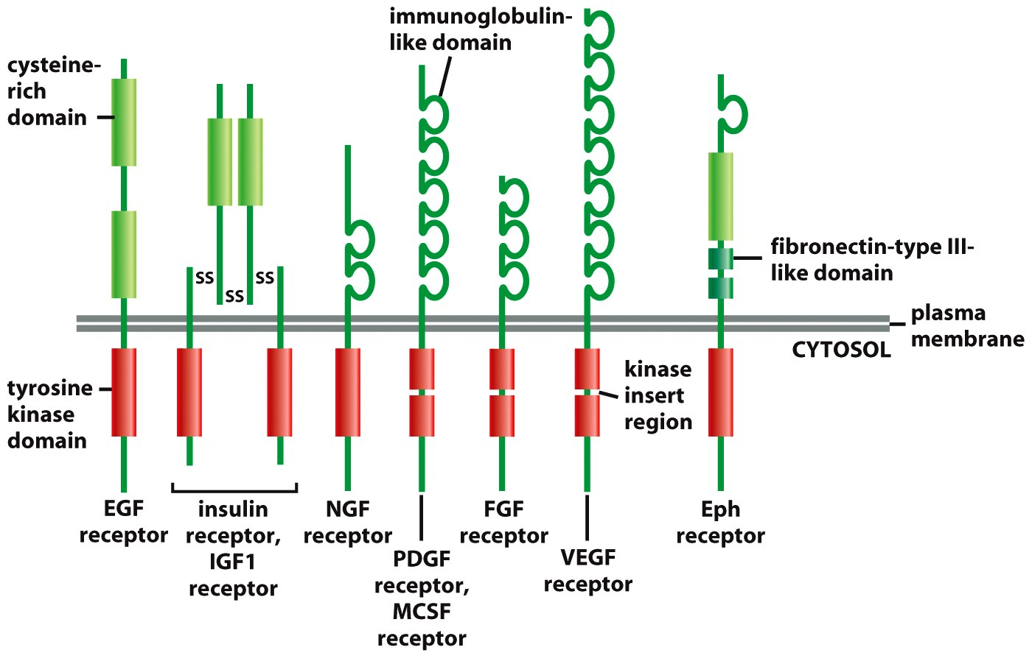
1. Receptor tyrosin kinases (RTKs)
Ligands - EGF, PDGF, HGF, NGF, insulin, ephrins...
Signalling through monomeric GTPases or through lipid modifications by PI3K
Figure 15-52 Molecular Biology of the Cell (© Garland Science 2008)

Slide 4
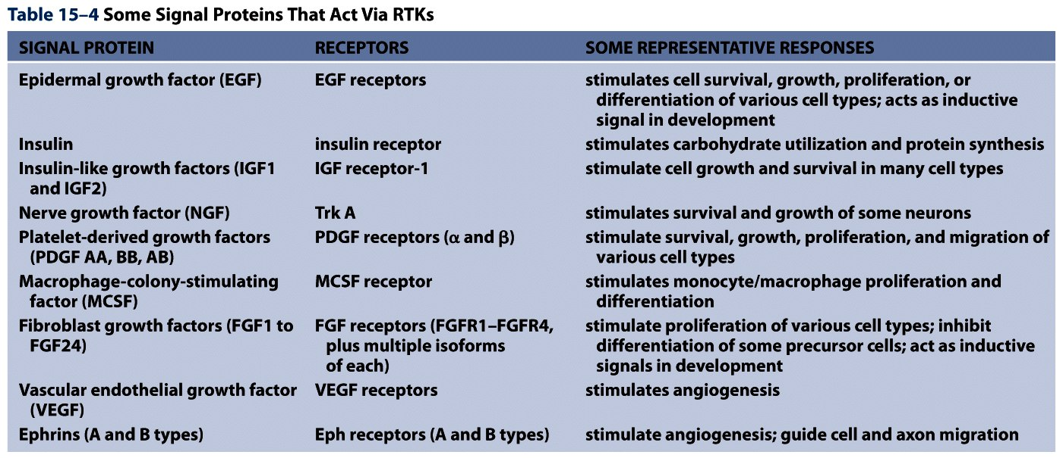
Table 15-4 Molecular Biology of the Cell (© Garland Science 2008)

Slide 5
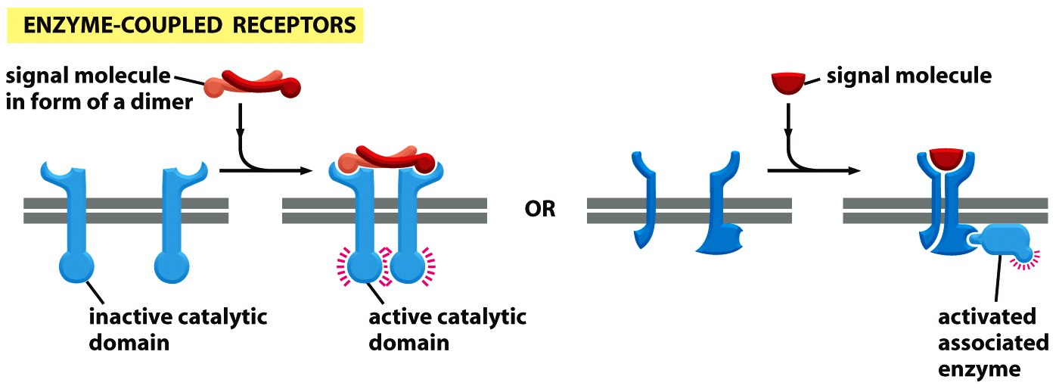
1. Clusterring of receptors
- ligand is a dimer (PDGF)
- ligand is monomer but binds two receptors simultaneously (EGF)
- ligand is monomer but binds to TM heparan sulphate proteoglycans to form multimers (FGF)
- clustering of TM ligand in a neighbouring cell (ephrins)
- receptor is a multimer to start with (insulin)
Figure 15-16c Molecular Biology of the Cell (© Garland Science 2008)
Notes:
Insulin makes hexamers…

Slide 6
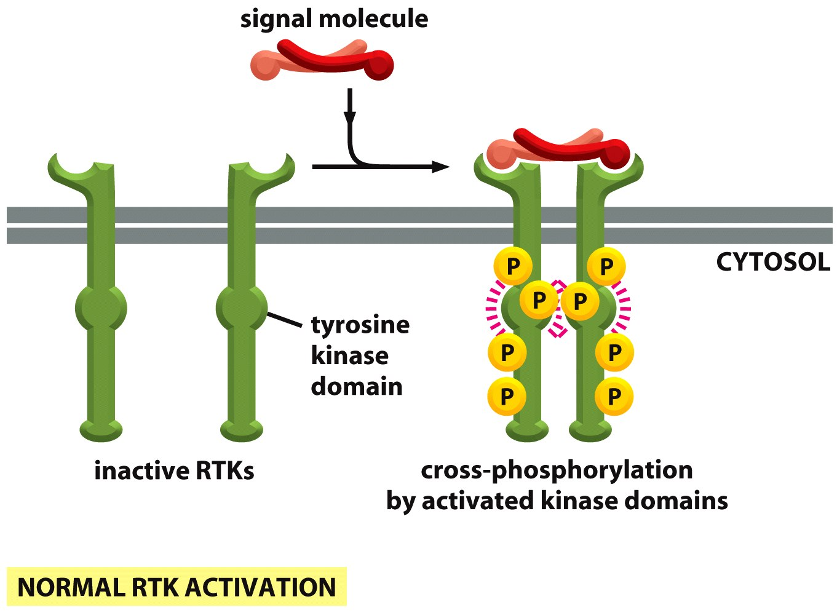
2. induced proximity trans/auto phosphorylation
Figure 15-53a Molecular Biology of the Cell (© Garland Science 2008)
Notes:
6

Slide 7
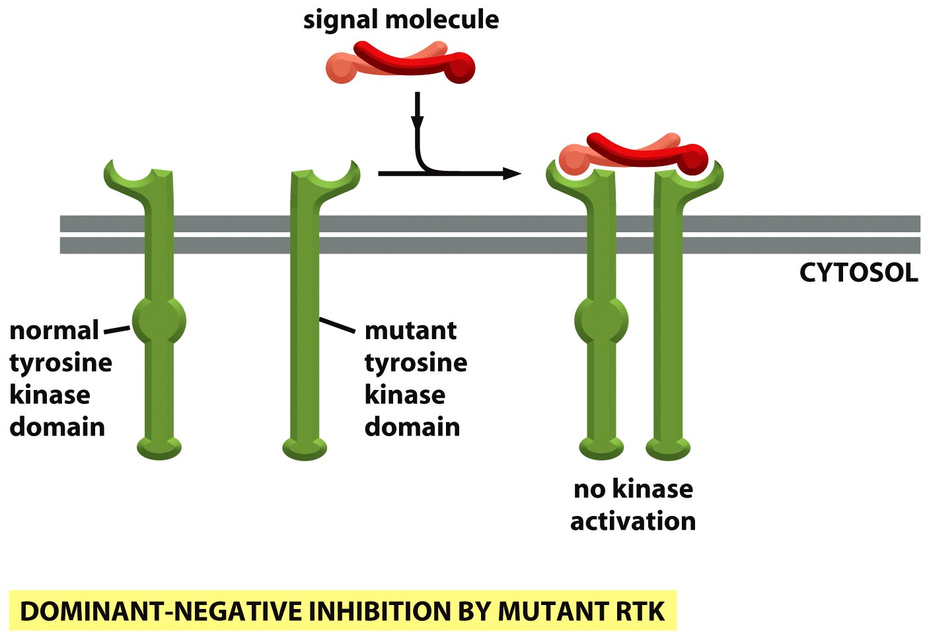
kinase-dead
dimerization OK
How would you create a DN form of enzyme associated receptor?
Figure 15-53b Molecular Biology of the Cell (© Garland Science 2008)
Notes:
7

Slide 8
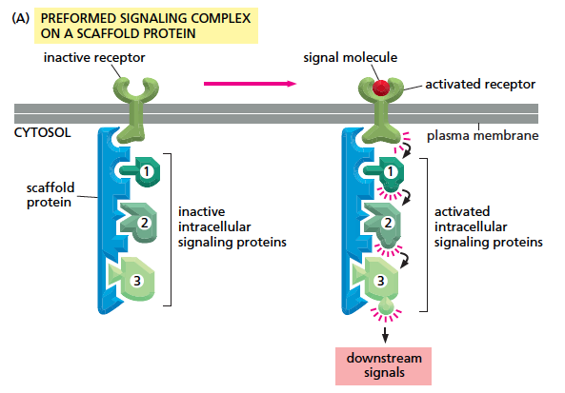
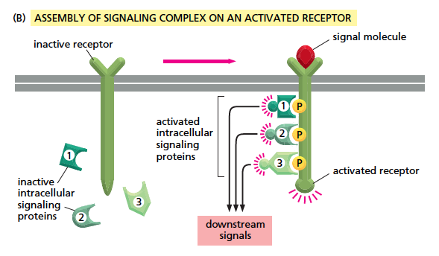
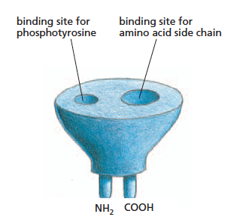
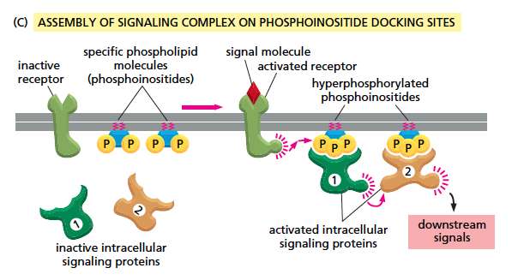
3. transient assembly of intracellular signalling complexes
docking via SH2 domains or PTB domains
some are adaptor proteins (Grb, IRS) that
connect to a protein with enzymatic a.
some are kinases (Src, PI3K)
some are inhibitors
(e.g. c-Cbl, monoUbiq. and endocytosis)
SH2 domain
Notes:
8
PTB – phospho tyrosin binding domain
Insulin – IRS – Pi3K – lipid modification – Pdk1 still on membrane – PKB/AKT in cytoplasm
SH3 –recognition of prolin rich motivs
PH3 – recognition of modified lipids

Slide 9
4. spreading of the intracellular signalling events through the
monomeric GTPases from the Ras superfamily
Only Ras and Rho signal through cell surface receptors
Often tethered to membrane via lipid anchor
Notes:
9
Or AKT in the case of PI3K activation…
H,K,N Ras – three human genes for Ras
As oposed to trimer G-proteins…

Slide 10
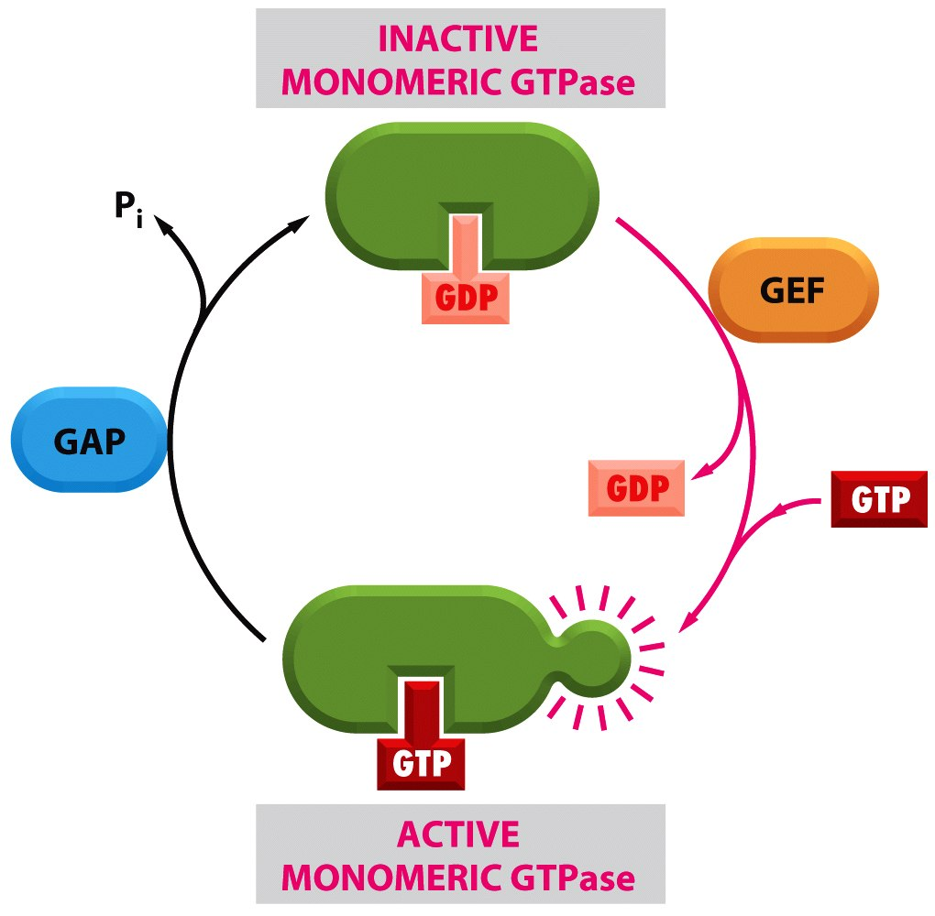
Ras: hyperactive forms such as Ras^{V12}
dominant, constitutively active
resistant to inactivation by GAP
(no GTP hydrolysis)
Ras required for cell proliferation;
mutant in 30% of human cancers
RTKs activate a Ras-GEF or inhibit a Ras-GAP
GEF – guanine exchange factor
GAP – GTPase activating proteins
Figure 15-19 Molecular Biology of the Cell (© Garland Science 2008)
Notes:
Ras is not a kinase…

Slide 11
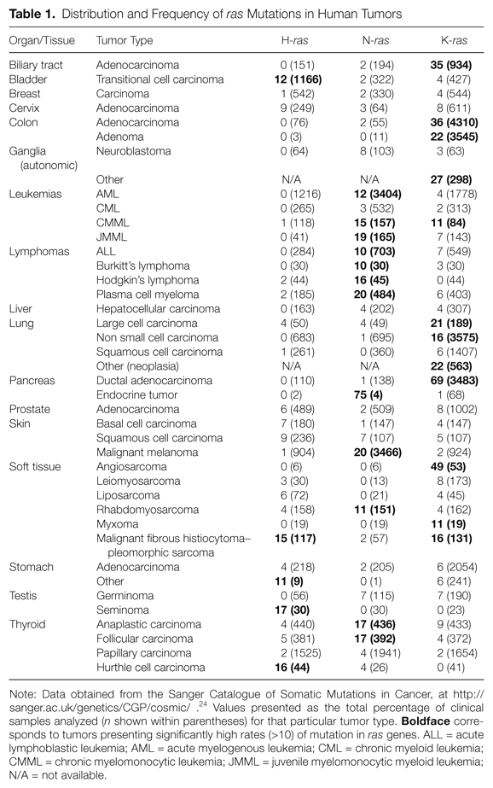
Ras oncogenes are mutated in 20-30% of cancers

Slide 12
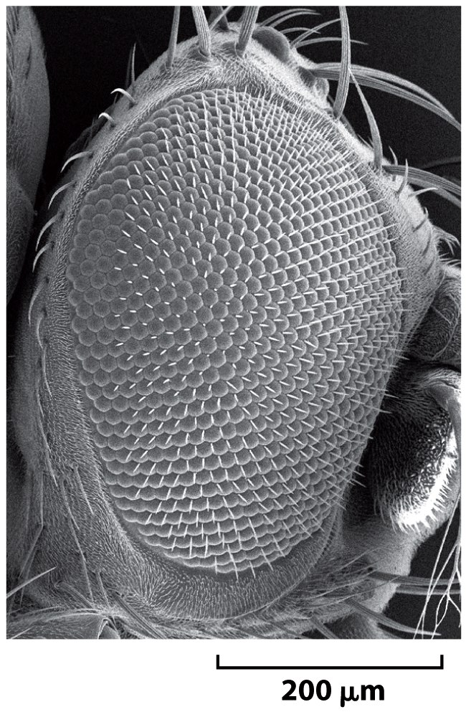
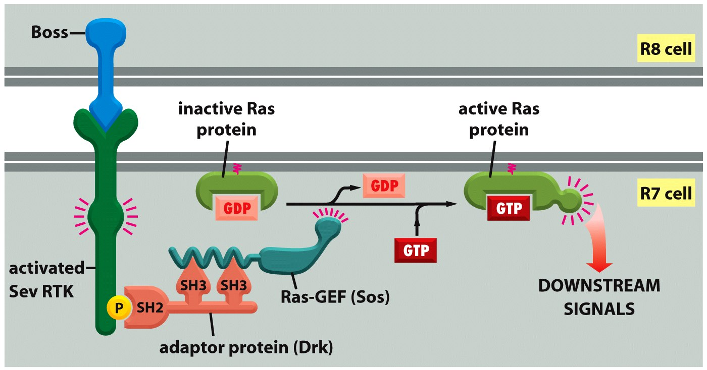
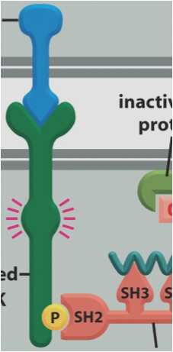
Signalling through Ras: EGFR signalling
b
boss
sevenless
Grb2 in mammals
Figure 15-57 Molecular Biology of the Cell (© Garland Science 2008)
Notes:
12
Ligands: Spitz, Boss, Gurken, Vein… In the membrane or secreted forms (EGF is secreted)
Receptors: Sevenless, Torso, EGFR

Slide 13
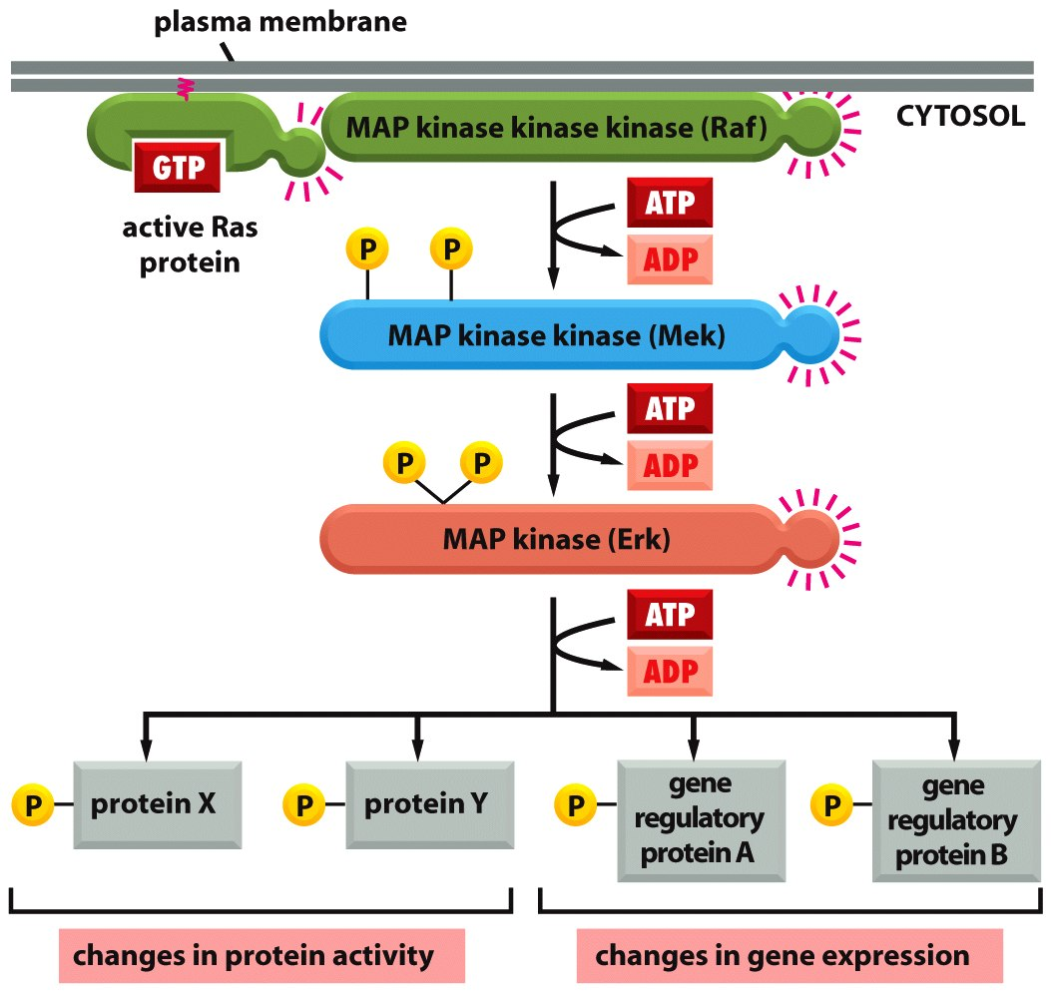
MAPKKK
MAPKK
What is the advantage to have many components on the way?
MAPK
mitogen activated kinase
(extracellular signal regulated kinase)
Receptor tyrosin kinase signalling:
https://www.youtube.com/watch?v=r7GoZ9vFCY8
Figure 15-60 Molecular Biology of the Cell (© Garland Science 2008)
Notes:
13

Slide 14
Signal amplification (of undocked kinases)
input signal
MAPKKK
‘Modules’ avoid spreading’
MAKK
MAKK
MAPK
MAPK
MAKK
MAPK
MAPKK
MAPKK
MAPK
JNK
JNK
JNK
JNK
JNK
MAPK
output signal

Slide 15
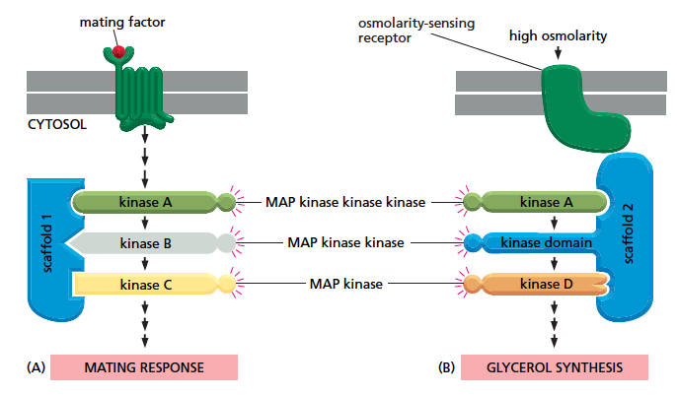
Signaling modules
- complexes of several protein kinases interconnected in series, often bound to a scaffold
Binding to a scaffold reduces crosstalk
BUT also avoids difussion and spreading of signal
Notes:
15

Slide 16
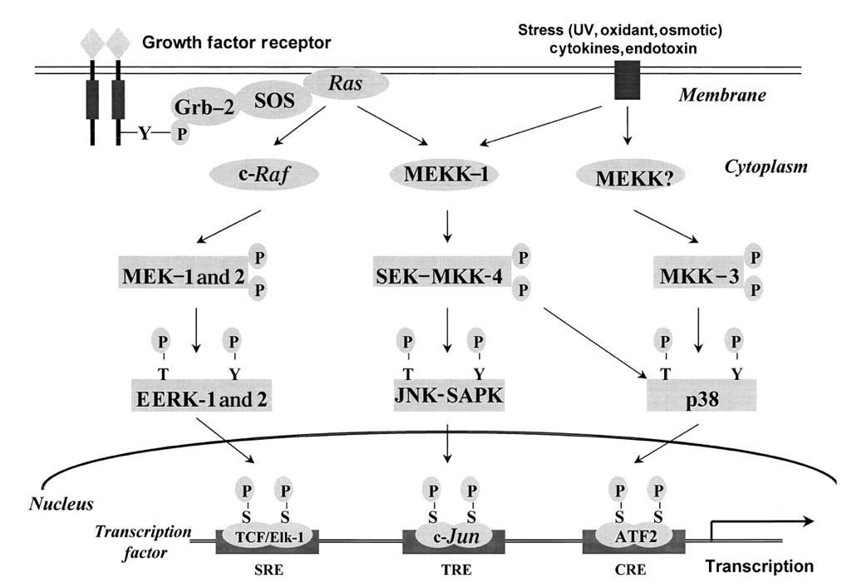
MAP kinase signalling modules
MAPKKK
MAPKK
after activation the MAPK-MAPKK interactions may be weakened, enabling MAPK to travel to the nucleus
MAPK
Mitogenesis module
Stress modules
https://www.youtube.com/watch?v=oDjDUUhGVsI
Notes:
16

Slide 17
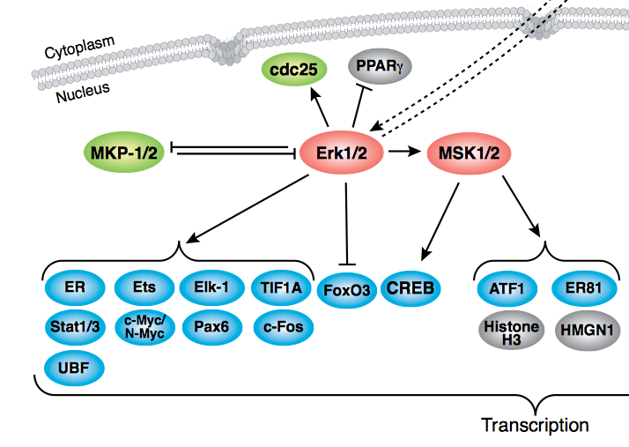
Downstream of MAPK – the effectors
- mostly to promote proliferation and prevent apoptosis
- substrates of MAPK: transcription factors, further kinases (MAPKAP kinases), also negative feedback loops through phosphorylation and activation of MAPK phosphatases (MPK1/2) or ras-GAPs
Transctiption factors:
- Ets family (Ets, Elk-1... after phosphorylation often bind another TF like SRF)
- AP1(homo- or hetero-dimers of c-fos, c-jun, ATF2 and MAF through leucine zipper)
- MEF2, MAX, NFAT.....
MAPKAP kinases:
- MAP kinase activated protein kinases
activation of proliferation and survival programs
through phosphorylation of transcription factors
or other regulatory proteins
- p90 ^{RSK} = ribosomal S6 kinase
MSK = mitogen and stress activated kinase
MNK = MAPK interacting kinase
Notes:
Cdc25 – cell cycle
PPARg – metabolism
MKP-1/2 phosphatase

Slide 18
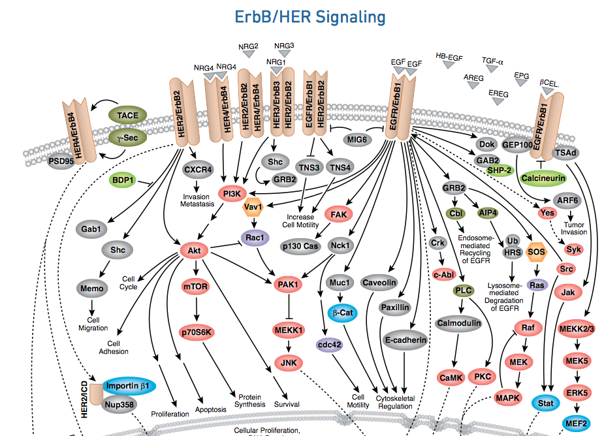
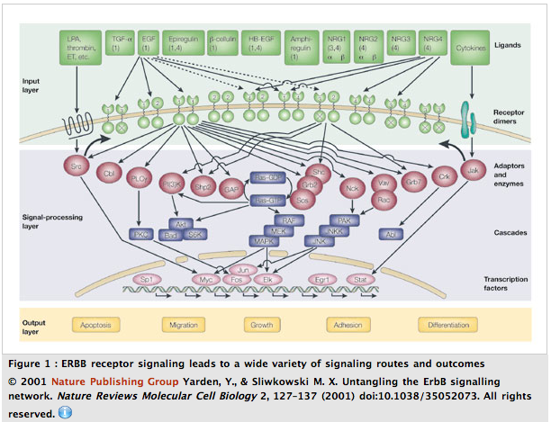
EGFR in mammals: HER1(ErbB1)
http://www.nature.com/scitable/topicpage/activation-of-erbb-receptors-14457210
Notes:
http://learn.cellsignal.eu/hubfs/landing-pages/2016/2016-02,_CancerCampaign_PathwayHandouts/RTK-Signaling/2016_05_RKT_PW_Handout_digital.pdf?__hssc=258173013.1.1470218510288&__hstc=258173013.10b3c021b40d66a6526d297b89a9a476.1470218510287.1470218510287.1470218510287.1&__hsfp=3477883231&hsCtaTracking=33450a05-64e3-48e2-9a76-cb3e71d159dc%7C31d2b856-f570-4829-97df-4bc11cc6e754

Slide 19
ErbB family of tyrosin kinases
4 receptors ErbB1-4 (HER1-4)
exists as homo or heterodimers
different numbers of phosphorylation sites on their C-termini
cellular outcome depends on the dimerization partners and ligands
Ligands : growth factors (EGF family, NGF,TGF-a)
Notes:
EGFR first discovered member of the family, also called ErbB1, Her1

Slide 20
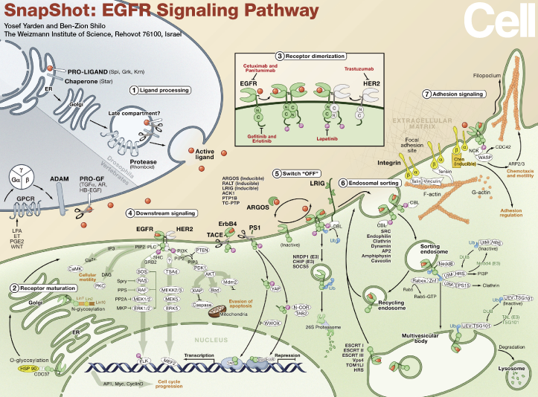
Notes:
Ligand maturation and release…
Receptor maturation, recycling…

Slide 21
Rho family of monomeric GTPases
4. Signalling through the
RhoA, Rac, cdc48...
- regulate actin and microtubule cytoskeleton
- also regulate cell cycle progression, transcription, membrane transport
- used by ephrin receptors but also by integrins, GF receptors, GPCRs…
(Ras protein too)
- activated by rho-GEFs (60 in human), inactivated by rho-GAPs (70 in human)
- inactive rho bound in cytosol to guanine nucleotide dissociating inhibitor
(GDI), preventing it to bind to GEF in the membrane

Slide 22
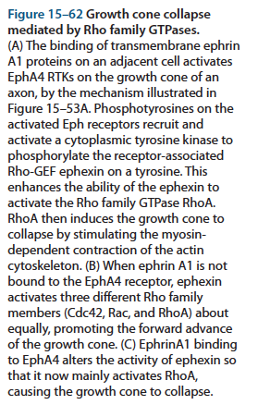
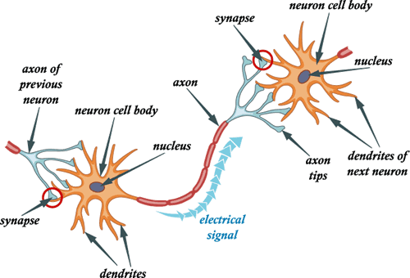
Growth cone extension in axons
Attractant and repellent signalling molecules in the axon environment regulate the direction of its growth
Axon growth: https://www.youtube.com/watch?v=ewNvcFJEHbA
https://www.youtube.com/watch?v=ZWACm6BkDVo

Slide 23
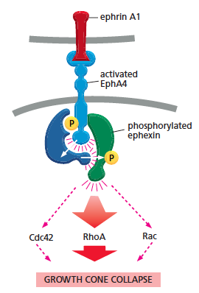
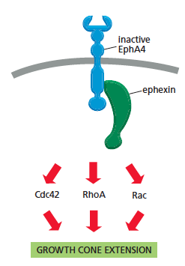
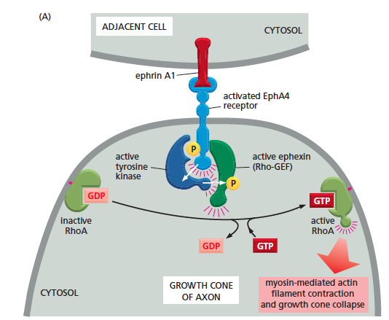
Growth cone extension in axons
through the guidance molecules ephrins
The most abundant class of protein tyrosine kinases.
Axon growth: https://www.youtube.com/watch?v=ewNvcFJEHbA
https://www.youtube.com/watch?v=ZWACm6BkDVo

Slide 24
Enzyme-linked receptors
1. receptor tyrosin kinases (RTKs)
2. tyrosin kinases associated receptors
3. receptor serine/threonine kinases
4. histidin kinase associated receptors
5. receptor guanylyl cyclases

Slide 25
Tyrosin kinases associated receptors
Similar as receptor tyrosine kinases but the receptor is not a kinase. The tyrosine kinase is involved in signalling but it is bound non-covalently to the receptor or it is involved indirectly through another mediatory protein
ligand
kinase
kinase
kinase
kinase
Receptors for antigens on leucocytes, for cytokines, hormones, integrin receptors...
Notes:
Src is not bound direcly ot the receptor

Slide 26
Tyrosin kinases associated with receptors
Src family: Src,Yes, Fgr, Fyn, Lck, Lyn, Hck, and Blk
- cytoplasmic localization through lipid anchor and through association with receptors
- SH2 and SH3 domains
- activated by some adhesion receptors, cytokine receptors, GPCRs or RTKs
FAK (focal adhesion kinase)
JAK (Janus kinase)

Slide 27
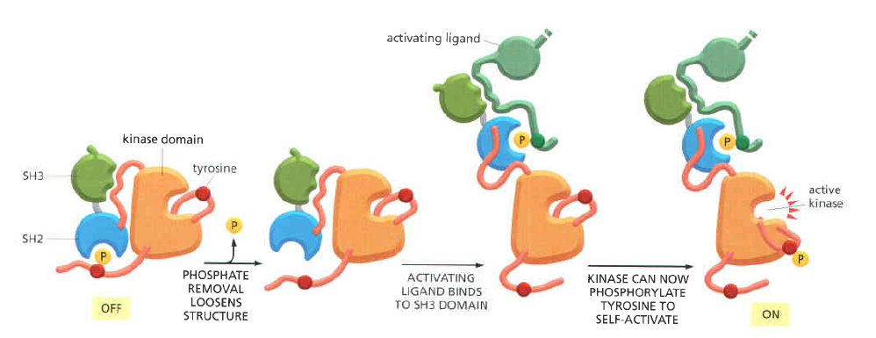
Src
first tyrosine kinase discovered, from the chicken retrovirus Rous sarcoma virus
Peyton Rous, Nobel prize in 1966 = "for his discovery of tumour-inducing viruses”
oncoproteins are gain of function cellular proteins (Bishop and Varmus ,1989)
v-src, c-src
(receptor or
other proteins)
Notes:
Src is often not directly associated with a receptor but still activated by it…
Bishop and Warmus got Noble prize for cracking the mechanism of the retorvirus MMLV that also causes transmisbale cancer and therefore behaves as oncogene (1989).
Oncogenes were first discovered in viruses, only then in normal cells…

Slide 28
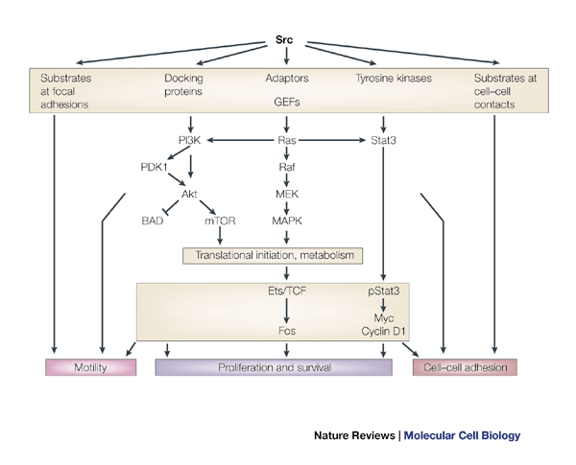

Slide 29
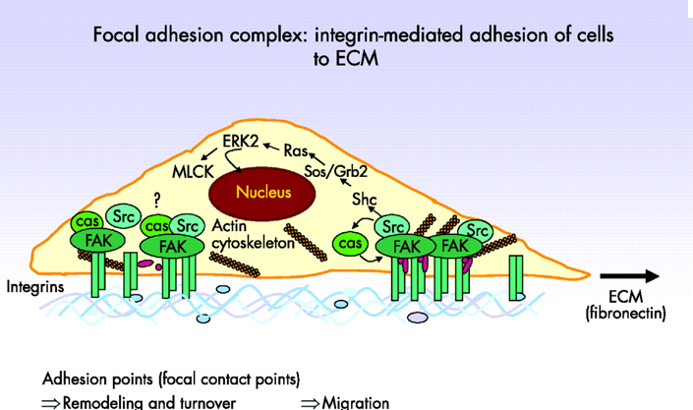
FAK (focal adhesion kinase)
- associated with integrin receptors in focal adhesion points (places of cell contact
with extracellular matrix)
- recruit src, mutual phosphorylation and activation of cell survival and proliferation
programme

Slide 30
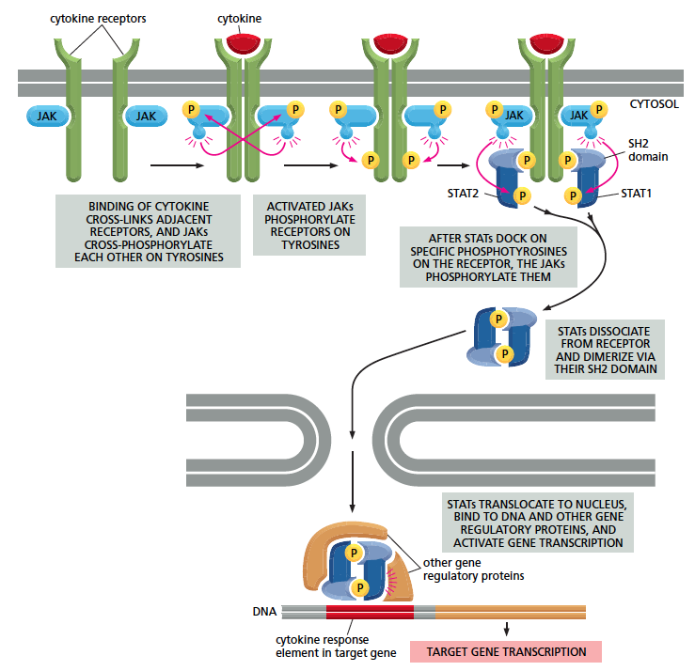
JAK
JAK-STAT pathway
- family of cytokine receptors,
receptors for growth hormone
and prolactine
- stable association with JAK
(Janus kinase, JAK1, JAK2,
JAK3 and Tyk)
- activated JAKs recruits
STATs (signal transducers
and activators of transcription),
in the cytoplasm and
phosphorylates them
- phosphorylated STATs migrate
to the nucleus and activate
transcription

Slide 31
Enzyme-linked receptors
1. receptor tyrosin kinases (RTKs)
2. tyrosin kinases associated receptors
3. receptor serine/threonine kinases
4. histidin kinase associated receptors
5. receptor guanylyl cyclases

Slide 32
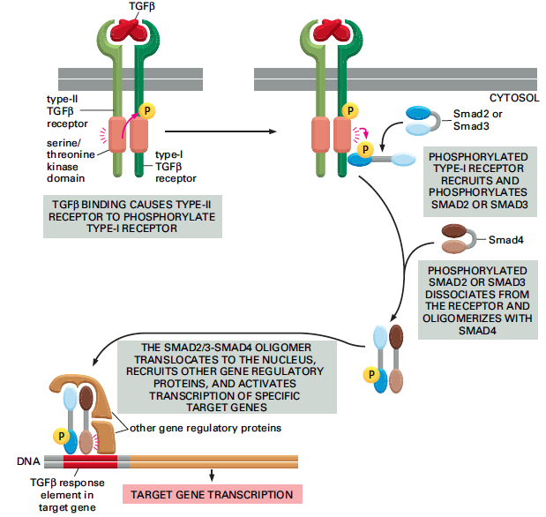
TGF-beta and BMP signalling
transforming growth factor beta and bone morphogenetic protein

Slide 33
- SMADs continuously shuttle between cytoplasm and nucleus during signalling
(phosphorylated in nucleus, dephosphorylated in cytoplasm)
- secreted inhibitory proteins regulate the morphogen (ligand) gradient:
noggin and chordin (for BMP), follistatin (for TGFbeta)
- inhibitory SMADs (SMAD6 and SMAD7)
- compete for activating SMADs
- recruits ubiquitin ligase Smurf to the receptor, promoting its internalization
and degradation
- recruits phosphatases to inactivate the receptor

Slide 34
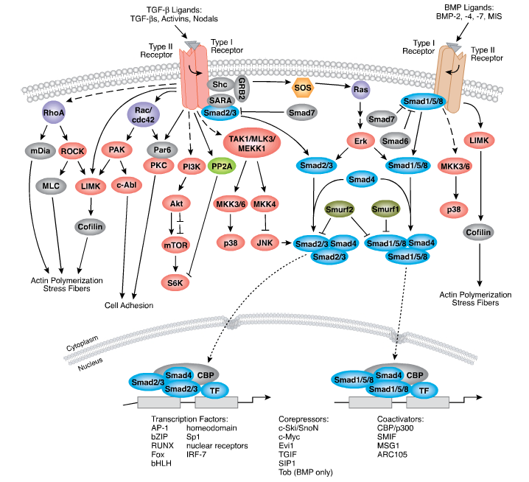

Slide 35
Enzyme-linked receptors
1. receptor tyrosin kinases (RTKs)
2. tyrosin kinases associated receptors
3. receptor serine/threonine kinases
4. histidin kinase associated receptors
5. receptor guanylyl cyclases

Slide 36
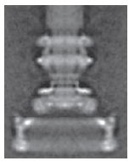
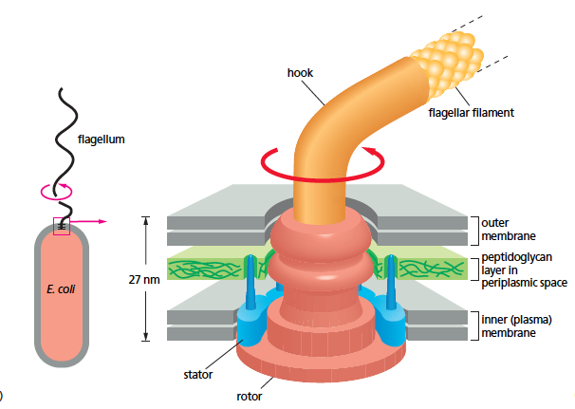
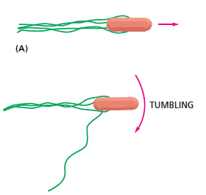
Trypanosoma?? Histidin phosphorylation exists, f.e. coenzym A synthetase
Histidin kinase associated receptors
- bacteria, yeast and plants, not in animals
- bacterial chemotaxis:
Default movement anticlockwise (straight) with occasional clockwise tumbling (stop).
Notes:
Exists also in trypanosoma, f.e. coenzym A synthetase

Slide 37
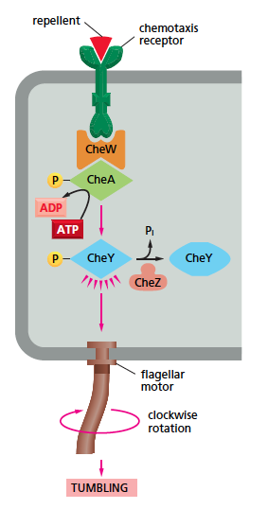
Chemotaxis receptors respond to various atractants and repelents
repellent activates receptor (tumbling), atractant
inactivates it (going forward)
- histidin kinase CheA (adaptor CheW)
- regulator protein CheY binds motor and makes it rotate
clockwise
- intrinsic phosphatase activity of CheY (accelerated by
CheZ)

Slide 38
Adaptation through receptor methylation and demethylation:
Attractant:
(1) decreases the ability of the receptor to activate CheA
(2) slowly (over minutes) alters the receptor so that it can be methylated by a methyl transferase, which returns the receptor’s ability to activate CheA to its original level (tumbling). Bacteria adapts to certain concentration of atractant and stops moving forward
Thus, the unmethylated receptor without a bound atractant has the same activity
as the methylated receptor with a bound atractant, and the tumbling frequency of
the bacterium is therefore the same in both cases. Bacteria adapts to certain concentration of atractant.
Bacteria senses the difference in the concentrations of repellents and attractants,
not the exact concentration!
Notes:
So bacteria stops from time to time to check if atractant is still present…

Slide 39
Enzyme-linked receptors
1. receptor tyrosin kinases (RTKs)
2. tyrosin kinases associated receptors
3. receptor serine/threonine kinases
4. histidin kinase associated receptors
5. receptor guanylyl cyclases

Slide 40
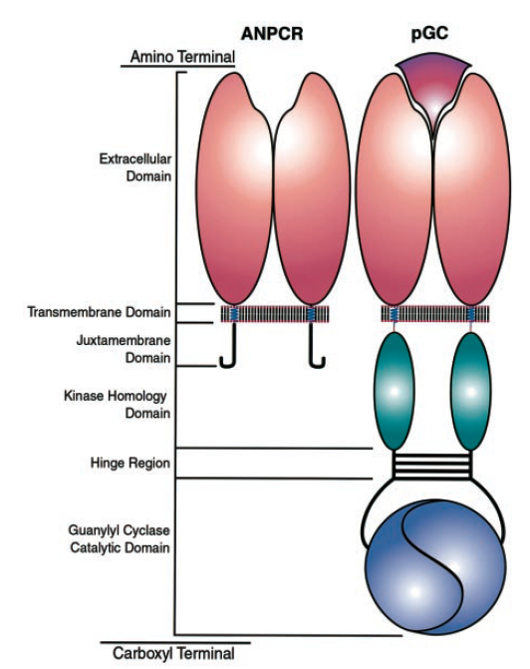
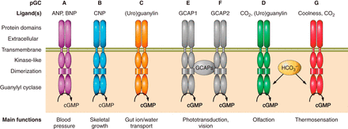
ANPCR – ANP clearance receptor (endocytosis of ANP)
pGC – particulate guanylyl cyclase receptor
Receptor guanylyl cyclases
Intestinal peptide receptor guanylyl cyclases – activated by heat stable enterotoxin from E.coli and other gut bacteria, stimulates gut secretion and diarrhea; in mammals guanylin and uroguanylin
Natriuretic peptide clearance receptors (ANPCR) binds ANP hormone produced by atrial cardiomyocytes, regulates blood pressure by relaxing smooth muscles in the veins
Orphan receptor guanylyl cyclases – no known ligand
cGMP
Recent review: http://physrev.physiology.org/content/96/2/751
Notes:
ANPCR does not have guanylyl cyklase domain but homology to other RGC

Slide 41
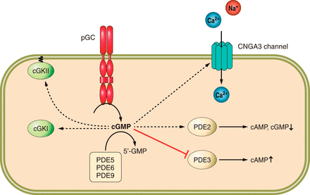
Recent review: http://physrev.physiology.org/content/96/2/751

Slide 42
NUCLEAR RECEPTORS

Slide 43
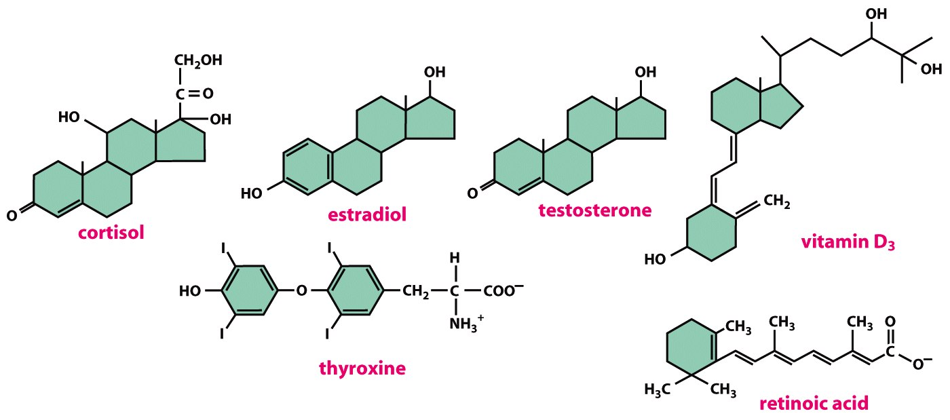
NUCLEAR RECEPTORS
Ligands: lipophylic molecules
Steroid hormones (from cholesterol: sex hormones, vitaminD, cortisol, ecdysone in insects)
Thyroid hormones (from tyrosine)
Retinoids (from vitaminA)
Figure 15-13 Molecular Biology of the Cell (© Garland Science 2008)
Notes:
Sterols are forms of steroids with a hydroxyl group at position three and a skeleton derived from cholestane.

Slide 44
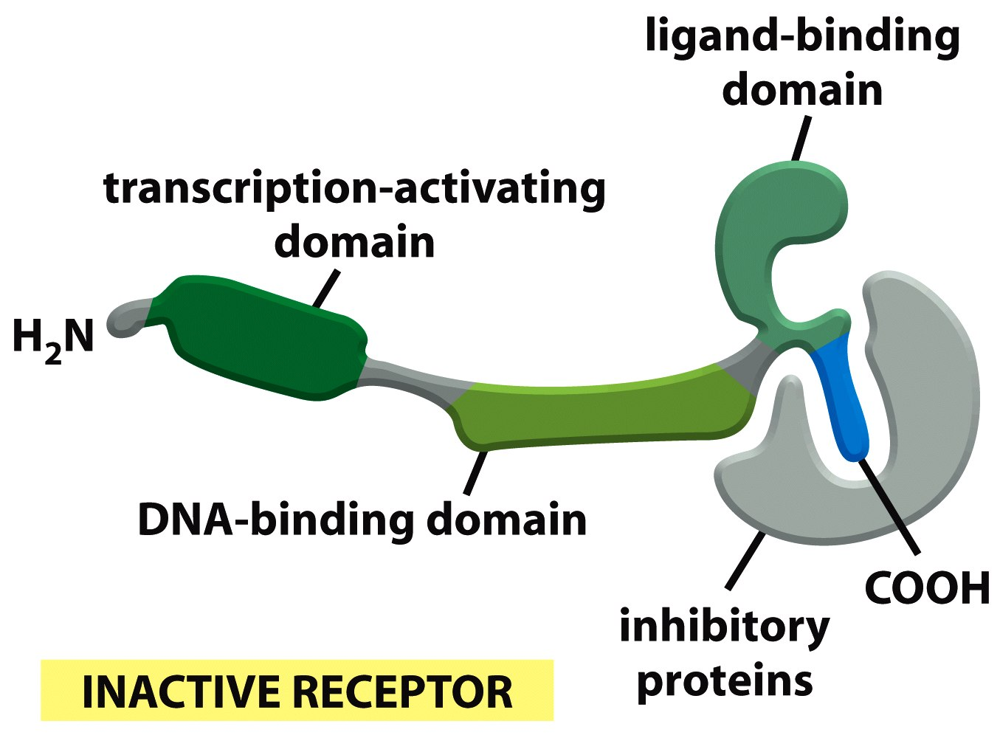
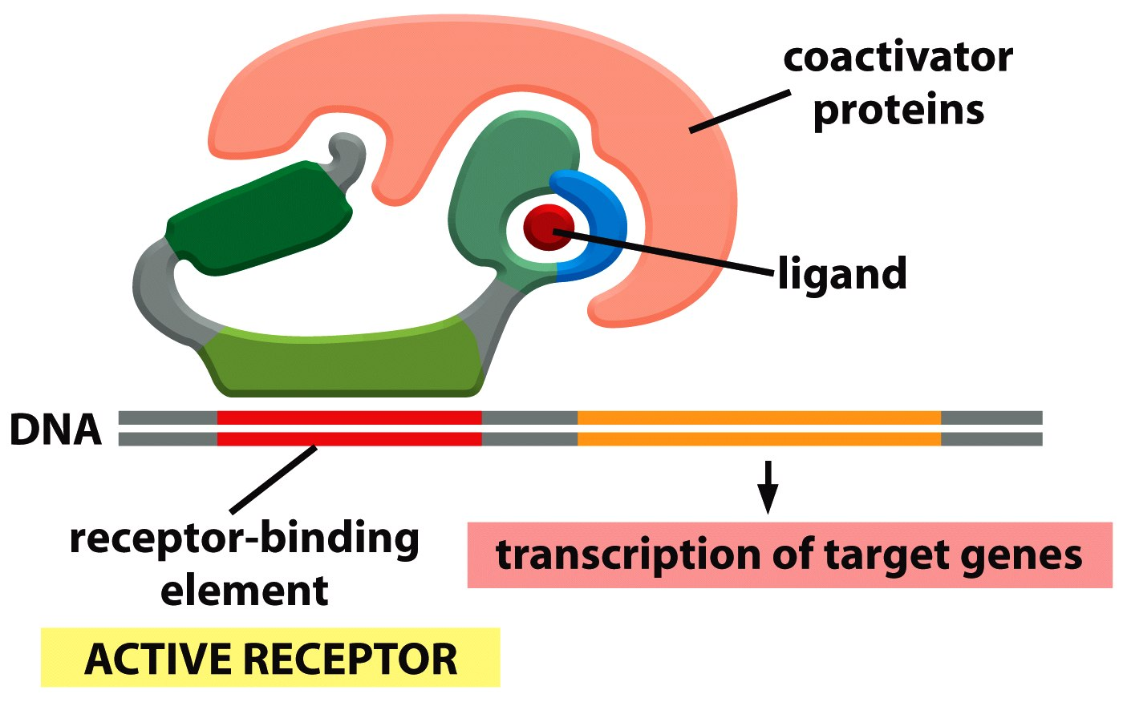
activation of transcirption
inhibition of the receptor

Slide 45
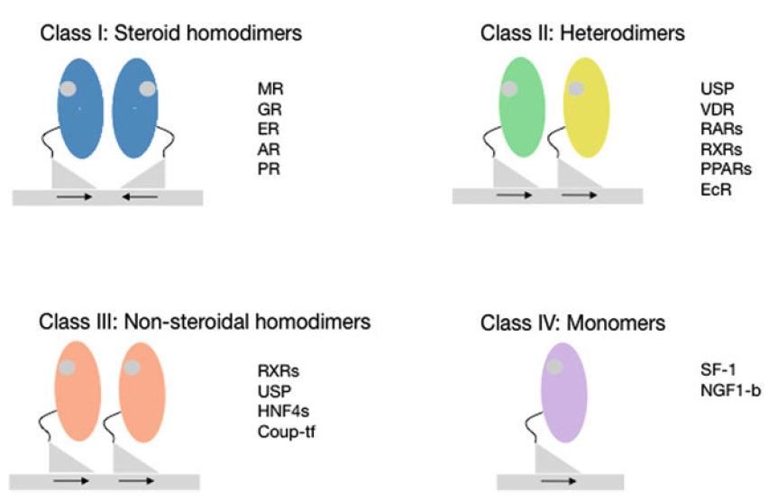
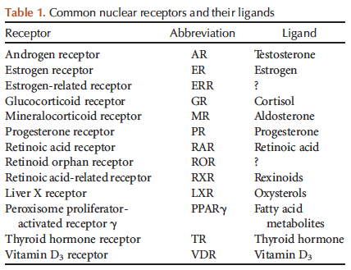
Types of nuclear receptors
mineralokortikoid r.
ultraspiracle
glucocorticoid r.
vitamin D
estrogen r.
retinoic acid
androgen r.
peroxisome
proliferator
progesteron r.
ecdysone
III.
HRE – hormone responsive site, different to each receptor type (ERE- astrogen responsive site, ARE – androgen responsive site…)
hepatocyte nuclear f.
Video tutorial: http://www.nursa.org/flash/gene/nuclearreceptor/start.html
Pardee et al.: A Handbook of Transcription Factors, Subcellular Biochemistry 52, 2011
Notes:
RXR – binds only 9-cis retinoic acid
RAR – binds all-trans retinoic acid or 9-cis retinoic acid
II a III – different spacing between HRE, therefore specificity

Slide 46
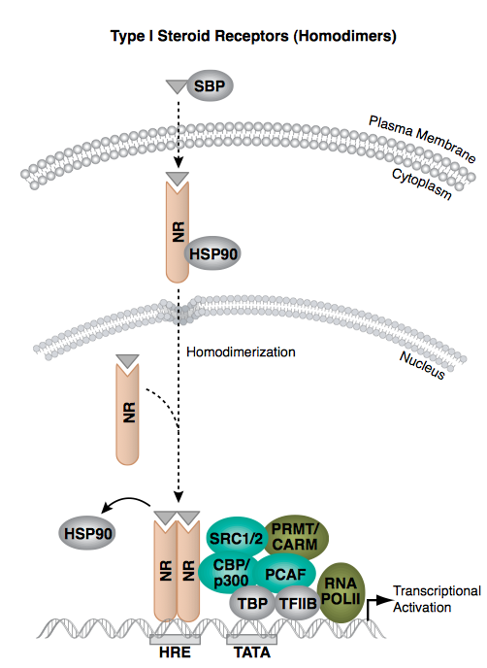
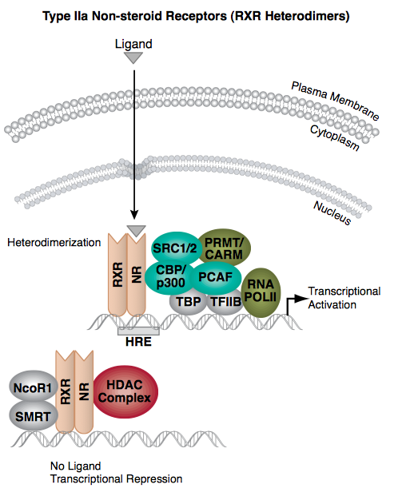
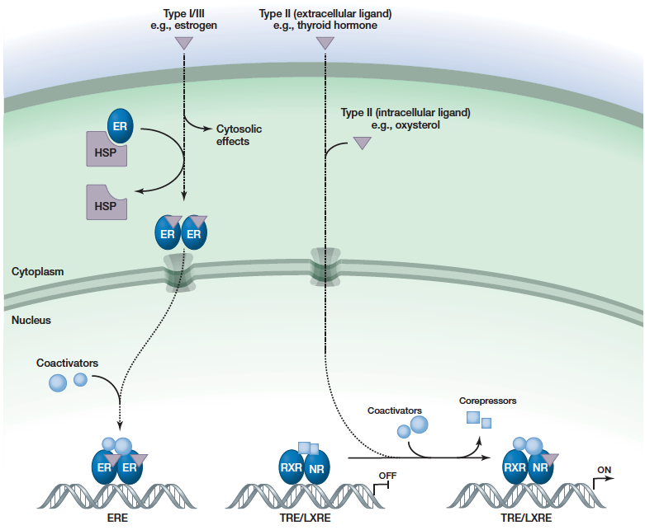
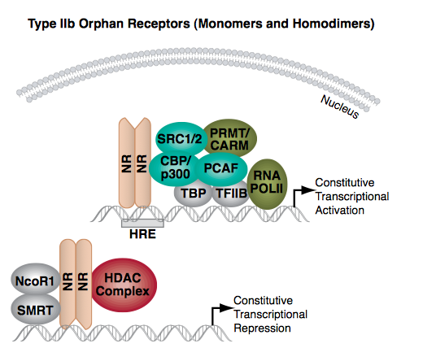
Types of nuclear receptors
Sever and Glass: Cold Spring Harb Perspect Biol 2013;5:a016709
Notes:
Type four – often orphan, not known ligand and function…

Slide 47
Receptor for juvenile hormone (Met)
new class of nuclear receptors
Met
inactive Met (juvenile hormone receptor) homodimer
Met
JH binding to Met promotes dissociation of the inactive complex...
JH
Tai
...and formation of active transcription factor heterodimer with Taiman
JH
Met
Marek Jindra: Proc Natl Acad Sci U S A. 2011 Dec 27;108(52):21128-33, 2011

Slide 48
Tissue specificity of nuclear hormone recruitment
Tissue specific transcription factors determine where NR bind on DNA
Sever and Glass: Cold Spring Harb Perspect Biol 2013;5:a016709

Slide 51
Pardee et al.: A Handbook of Transcription Factors, Subcellular Biochemistry 52, 2011

Slide 52
STOCHASTICITY IN CELL SIGNALLING

Slide 53
STOCHASTICITY IN CELL SIGNALLING
all-or-none
effect
cell-cell
variation
cell noise
Figure 15-24 Molecular Biology of the Cell (© Garland Science 2008)

Slide 54
Reporter assay with a YFP trancriptional reporter
after triggering a signalling pathway
Where is stochasticity important?
Development of early embryo/cell fate decisions/signalling inequalities
SOP/neuron selection during lateral inhibition
Stochastic response
Sprinzak and Elowitz, Nature, 2010

Slide 55
ERK2 gene
ERK2-YFP fusion in genomic locus
YFP
Here, inequalities are wiped out by fold response mechanisms
= as opposed to early embryo or SOP selection where differences are fixed and lead to important functional outcomes…
Response
to EGF
Cohen-Saidon C, Alon U et al.: Molecular Cell (2009)
Notes:
They monitored the amunt of YFP labelled ERK that enters nucleus after EGF stimulation (so not transcription of ERK2)

Slide 56
…fold response after EGF stimulation
similar between cells
Different basal levels…
‘Amount of ERK2 entering the nucleus is proportional to the basal level of
nuclear ERK2 in each cell, suggesting a fold-change response mechanism.’
Cohen-Saidon C, Alon U et al.: Molecular Cell (2009)

Slide 57
Estrogen
signaling
Weber’s law (1834)
Human perception of light and sound is not based on absolute levels but on the magnitude of stimulus relative to the background levels.

Slide 58
Why fold change rather than absolute level of detection?
It might be easier for the cell to generate reliable fold changes than reliable absolute changes.
It might serve as an adjustable noise filter. Absolute variations present when background level of stimulus is high tends to be higher than when background level is low.
How is the fold change detected by the cell?
Negative feed-forward loops.
Where is stochasticity important?
Development of early embryo
SOP/neuron selection during lateral inhibition

Slide 59
Incoherent feed-forward loop
as a fold-change detector
phosphatase
MAPK kinase
Consequence for regulated gene Z: Pulse of activity

Slide 60
Incoherent feed-forward loop
as a fold-change detector
Alon U.: Mol Cell. 2009 Dec 11;36(5):894-9
Gene Z serves as a fold change detector. Dynamics of the output (amplitude and duration of the transcription of gene Z) depend only on the fold-changes in the level of the input signal, and not on the absolute levels of the input signal.

