Slide 1
Systems Analysis and Design

Slide 2
Learning Objectives
Explain the process of managing an information systems project.
Describe the skills required to be an effective project manager.
List and describe the skills and activities of a project manager during project initiation, project execution, and project closedown.
Explain what is meant by critical path scheduling and describe the process of creating Gantt charts and Network diagrams.
Explain how commercial project management software packages can be used to assist in representing and managing project schedules.

Slide 3
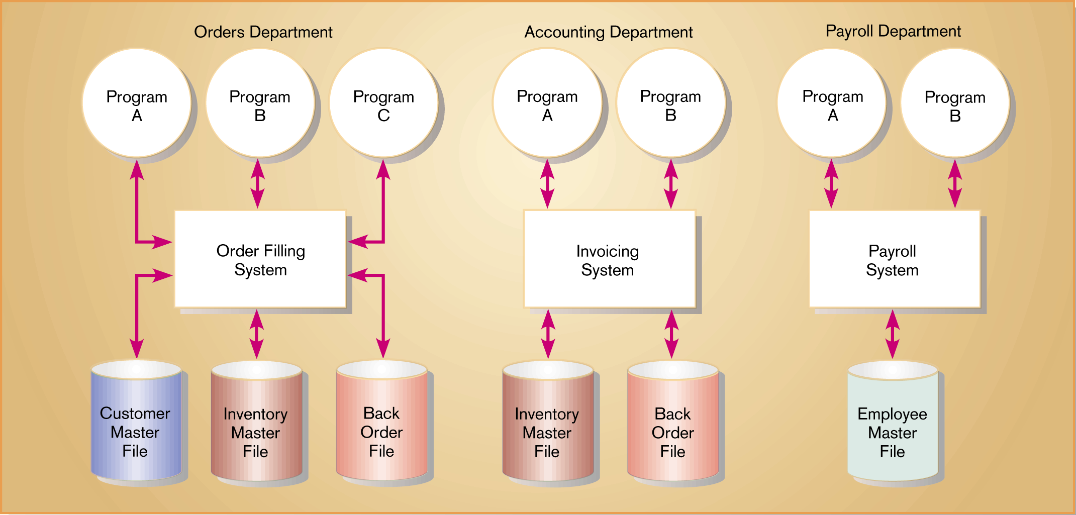
Figure 3-1 Three computer applications at Pine Valley Furniture: Order Filling, Invoicing, and Payroll

Slide 4
Pine Valley Furniture (PVF)
Manufactures high-quality wood furniture
Distributes to retail stores within the U.S.
Started in the early 1980s and expanded by 1984 doubling sale volume
By 1990, Pine Valley Furniture had become a complex company, employing over 50 persons
Company organized into functional areas:
Sales
Manufacturing
Orders
Accounting
Purchasing
Established manual information systems

Slide 5
PVF
PVF installed a network server to automate invoicing, accounts receivable, and inventory control applications.
In the late 1990s, PVF upgraded the network server and implemented a centralized database management system.
PVF decided to develop its application software in-house.
PVF hired staff and bought computer software and hardware.
The new information system will take into account market conditions, the Internet, and WWW.
The Project Manager plays the key role in developing the new information system

Slide 6
Managing the Information Systems Project
Focus of project management
To ensure that information system projects meet customer expectations
Delivered in a timely manner
Meet time constraints and requirements

Slide 7
Managing the Information Systems Project
Project Manager
Systems Analyst responsible for:
Project initiation (SSR is created)
user observed the problem
User contact the IS group
SSR was reviewed
Steering committee was assigned
Detailed project plan was developed.
Planning
Execution
Closing down

Slide 8
Managing the Information Systems Project
Project Manager is a system analyst with a diverse set of skills such as:
Management
Leadership
Technical
Problem solving
Conflict management
Customer relations
Team management
Risk and change management
whose responsible for initiating, planning, executing and closing down a project.

Slide 9
Managing the Information Systems Project
Project is a planned undertaking of related activities to reach an objective that has a beginning and end.
Deliverable is an end product of an SDLC phase.
Feasibility Study, is a study that determine if the proposed system make sense for the organization from an economic and operational standpoint.

Slide 10
Project Management Process
Project Management is a controlled process of initiating, planning, executing, and closing down a project.
Project
Planned undertaking of related activities to reach an objective that has a beginning and an end
Four Phases of PM
Initiation
Planning
Execution
Closing down

Slide 11
Project Management Activities

Slide 12
Initiating the Project
Project initiation – the first phase of the project management process in which activities are performed to assess the size, scope, and complexity of the project and to establish procedures to support later project activities
Establish project initiation team
Establish relationship with customer
Establish project initiation plan
Establish management procedures
Establish project management environment and workbook
Project workbook – an online or hard-copy repository for all project correspondence, inputs, outputs, deliverables, procedures, and standards that are used

Slide 13
Project Workbook

Slide 14
Project charter
A project charter
Project charter – a short, high-level document prepared for both internal and external stakeholders
It formally announces the establishment of the project.
It briefly describes its objectives, key assumptions, and stakeholders.

Slide 15
Planning the Project
Project planning is the second phase of the PM process, which focus on defining clear, discrete activities and the work needed to complete each activity within a single project.

Slide 16
Activities of Planning the Project
Describe project scope, alternatives and feasibility
Scope and Feasibility
Understand the project
What problem is addressed
What results are to be achieved
Measures of success
Completion criteria

Slide 17
Activities of Planning the Project continues
Divide the project into manageable tasks
Work Breakdown Structure (WBS) – the process of dividing the project into manageable tasks and logically ordering them
Gantt chart – a graphical representation of a project that shows each task as a horizontal bar whose length is proportional to its time for completion
Estimate resources and create a resource plan
Constructive Cost Model (COCOMO) – a widely used method which uses parameters that are derived from prior projects of differing complexity
COCOMO uses these different parameters to predict human resource requirements for basic, intermediate, and very complex systems.
Develop a preliminary schedule
Utilize Gantt and PERT charts

Slide 18
Activities of Planning the Project continues
Develop a communication plan
Outline communication processes among customers, team members and management
Who are the stakeholders for this project?
What information does each stakeholder need?
When, and at what interval, does this information need to be produced?
What sources will be used to gather and generate this information?
Who will collect, store, and verify the accuracy of this information?
Determine project standards and procedures
Specify how deliverables are tested and produced
During this activity, you will specify how various deliverables are produced and tested by you and your project team.

Slide 19
Activities of Planning the Project continues
Identify and assess risk
Identify sources of risk
Estimate consequences of risk
Create a preliminary budget
preliminary budget outlines the planned expenses and revenues associated with your project.
Develop a statement of work
Developed primarily for the customer
Outlines work that will be done and clearly describes what the project will deliver
Provides a clear understanding of project size, duration, and outcomes
Set a Baseline Project Plan
Provides an estimate of the project’s tasks and resource requirements and is used to guide the next project phase – execution

Slide 20
Planning the project
Gantt chart: a graphical representation of a project that shows task as a horizontal bar whose length is proportional to its time for completion.
Pert chart: a diagram which shows project tasks and their interrelationships. (Program Evaluation Review Technique)
Example of both charts after few slides.

Slide 21
Activities of Executing the Project
Execute Baseline Project Plan
Acquire and assign resources
Train new team members
Keep project on schedule
Monitor project progress
Adjust resources, budget and/or activities

Slide 22
Activities of Executing the Project continues
Manage changes to Baseline Project Plan
Slipped completion dates
Changes in personnel
New activities
Bungled(clumsily, inadequately) activities
Maintain project workbook
Communicate project status
Meetings, status reports, meeting minutes, seminars and workshops, bulletin boards, memos, specification documents, brown bag lunches, hallway discussions, newsletters, and project workbook

Slide 23
Activities of Closing Down the Project
Termination, the final phase of the project management process that focuses on bringing a project to an end
Types of termination
Natural
Requirements have been met
Unnatural
Project stopped
Documentation
Personnel Appraisal

Slide 24
Activities of Closing Down the Project continues
Conduct post-project reviews
Determine strengths and weaknesses of:
Project deliverables
Project management process
Development process
Close customer contract- CSR or SSR.

Slide 25
Representing and Scheduling Project Plans
Gantt Charts
Useful for depicting simple projects or parts of large projects
Show start and completion dates for individual tasks
PERT Charts
Program Evaluation Review Technique) – a technique that uses optimistic, pessimistic, and realistic time estimates to calculate the expected time for a particular task.

Slide 26
Calculating Expected Time Durations using PERT
Formula for Estimated Time:
ET = (o + 4r + p)/6
Where
ET = expected time for the completion of an activity.
o = optimistic completion time for an activity.
r = realistic completion time for an activity.
p = pessimistic completion time for an activity.

Slide 27
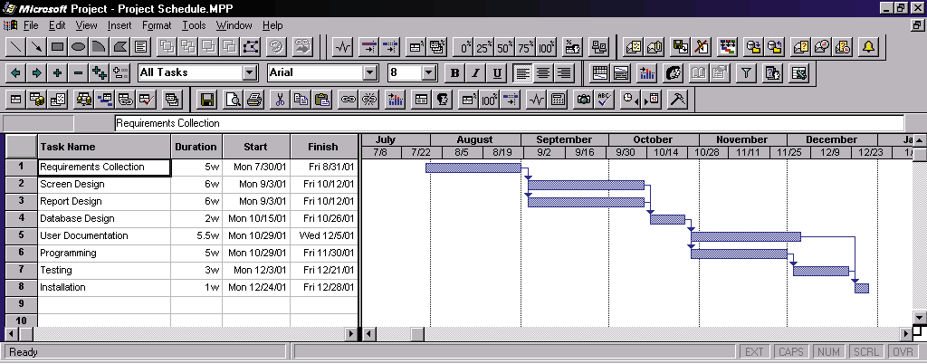
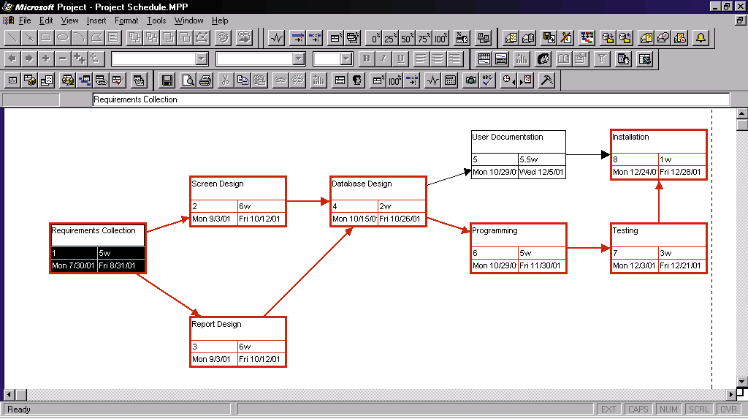
Figure 3-16 Graphical diagrams that depict project plans (a) A Gantt Chart (b) A PERT chart

Slide 28
Comparison of Gantt and PERT Charts
Gantt
Visually shows duration of tasks
Visually shows time overlap between tasks
Visually shows slack time
PERT
Visually shows dependencies between tasks
Visually shows which tasks can be done in parallel
Shows slack time by data in rectangles

Slide 29
Gantt and PERT Charts for Pine Valley Furniture
Steps to construct the chart:
Identify each activity
Requirements Collection
Screen Design
Report Design
Database Design
User Documentation
Software Programming
Installation and Testing

Slide 30
Gantt and PERT Charts for Pine Valley Furniture
Determine time estimates and expected completion times for each activity, Estimated Time= (O+4R+P)/6 where O is optimistic time, R realistic time, and P is pessimistic time.
Determine sequence of activities
Determine critical path
Sequence of events that will affect the final project delivery date

Slide 31
Slack time – the amount of time that an activity can be delayed without delaying the project.
Free slack refers to the amount of time a task can be delayed without delaying the early start of any immediately following tasks.
Total slack refers to the amount of time a task can be delayed without delaying the completion of the project.

Slide 32
Why Using Project Management Software
Many systems are available to help you manage a development project.
Three activities required to use when managing a project:
Establish project start or end date
Enter tasks and assign task relationships
Select scheduling method to review project reports, such as Gantt or PERT chart.

