Slide 1
Business cycle theory

Slide 2
Outline
Historical background
Business cycles
Real business cycle theory
Two principles of Real business cycle theory
Examples of Real business cycle theory
Critical Reflection on Real Business Cycle theory
Conclusion

Slide 3
Historical background
New Keynesian economics and Real business cycle theory were developped.
1970s brought a
distinctive shift in macroeconomics
Emergence of Real business cycle theory was one of the most striking developments in the field of macroeconomics.

Slide 4
First introduction of RBC
Date: 1982
Name of the publiccation: “Time to build and aggregate fluctuations“
Description of how a numerical stochastic general equilibrium model of the post-war U.S. economy can be build.
Authors: Finn Kydland and Edward Prescott
Kydland and Prescott came up with a specific theory, a methodology that serves for testing competing theories of business cycles as well as the first Real Business Cycle model.

Slide 5
Current state of the theory
It is now more than 35 years since the Kydland and Precsott paper.
Various extensions and modifications have been proposed by many researchers.
The theory has been exposed to criticism and challenges.
It is still a very active research area. The current models are far more sophisticated and widely used in international economics, monetary economics, public finance, labor economics, and asset pricing.

Slide 6
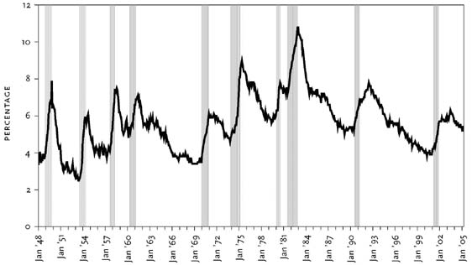
Business cycles
fluctuating levels of economic activity of a country
refer to the ups and downs in aggregate economic economy
Burns and Mitchell defined business cycles as “a type of fluctuation found in the aggregate economic activity of nations”.

Slide 7
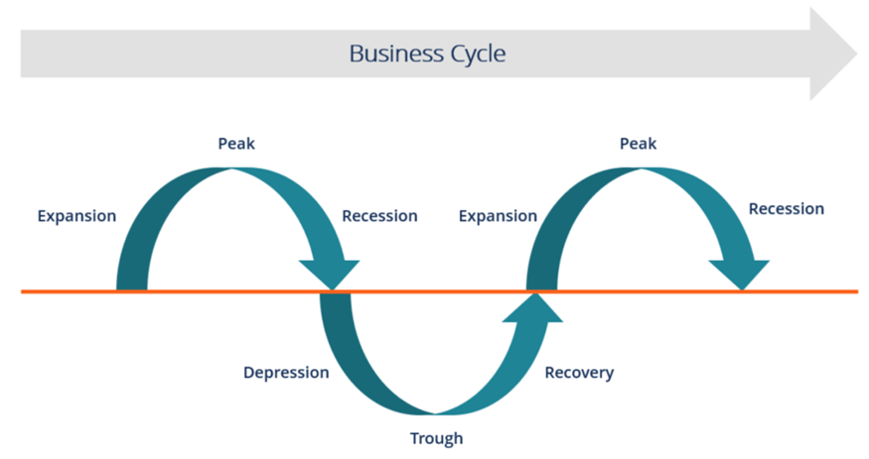
Business cycles
Expansion: An icrease in positive economic indicators can be observed here such as employment, production, output, wages, profits, demand and supply of products, and sales. This stage is characterised by debtors paying their debts on time, by the high velocity of the money supply as well as high investement.
Peak: The economy reaches the peak in that stage. The growth attains the maximum limit. Regarding the economic indicators, they don´t grow further because they are at their highest. Prices are situated at their peak as well. This business cycle stage represents the reversal in the trend of economic growth.
Contraction/Recession: This phase is characterised by rapidly and steadily declining demand for goods and services. Since producers don´t notice the decresing demand instantly, they carry on producing which results in excess supply in the market. Prices start to fall as well as all positive economic indicators.
Depression: Unemploment rises in that phase while the growth keeps declinig.
Trough: The prices of factors, as well as the demand and supply of goods and services, reach their lowest in that phase. This is the lowest the economy can go and represents the negative saturation point for an economy.
Recovery: This phase represents a turnaround from the trough. From this point the economy starts to recover. The recovery proces keep continuing tills the economy returns to steady growth levels.

Slide 8
Real business cycle theory
The theory specifies a dynamic stochastic general equilibrium model, which includes a specification of the stochastic process for the exogenous shocks that generate fluctuations in the model economy
Dynamic= involvement of time. The model takes into consideration the economy over time rather than only an isolated moment.
Stochaistic= stands for randomness built into the model. It corresponds to unexpected events to which probability can´t be assigned and that are characterised by truly uncertainty.
General equilibrium= indicates that we take into account the system as a whole. Hence, it includes all markets in the economy.

Slide 9
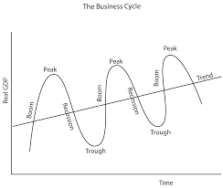
Real business cycle theory
The Real business cycle theory attributes aggregate output fluctuations to a large extent to the real shocks rather than nominal shocks to the economy.
Real shocks can be understand as an unpredictable or unexpected event that can have both negative as well as positive effects on economy.
Real shocks
Economic fluctuations
Economic fluctuations are seen by that theory as efficient responses to exogenous changes in the real economic environment.

Slide 10
Real business cycle theory
Real shocks have big and far-reaching consequences on the economy.
Sources of the changes having an impact on the fluctuations are therefore, according to the theory, nonmonetary.
These sources include primarily changes in technology but also tax rates and government spending, tastes, government regulation, terms of trade, and energy prices.

Slide 11
Two principles of Real business cycle theory
We attribute a little importance to money in business cycles. Therefore, monetary shocks don´t have any significant power to make an explanation of aggregate output fluctuations.
Business cycles are made by rational economic agents responding to real shocks optimally. Productivity growth is considered as the primary cause of fluctuations. However, it can be fluctuations in government purchases , import prices, or preferences as well. Hence, exogenous changes in the economic environment result in fluctuations.

Slide 12
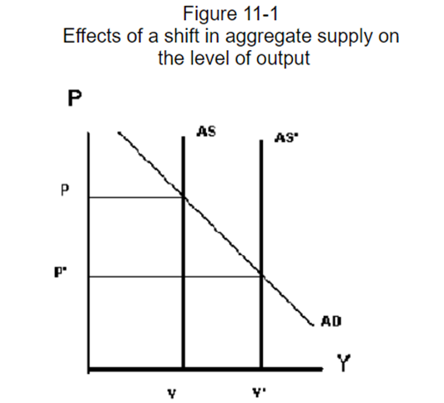
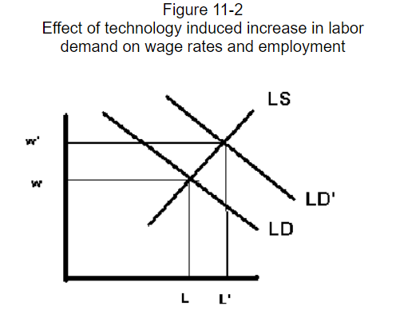
Examples of Real business cycle theory
An exogenous increase in total factor productivity shifts the long run aggregate supply curve from AS to AS’. In the following graphic, we can observe the situation when aggregate supply increases, then total output increases as well.
When aggregate supply is increased by real shocks, then labour demand increases. Hence, it does increases wages and the number of people working as well.

Slide 13
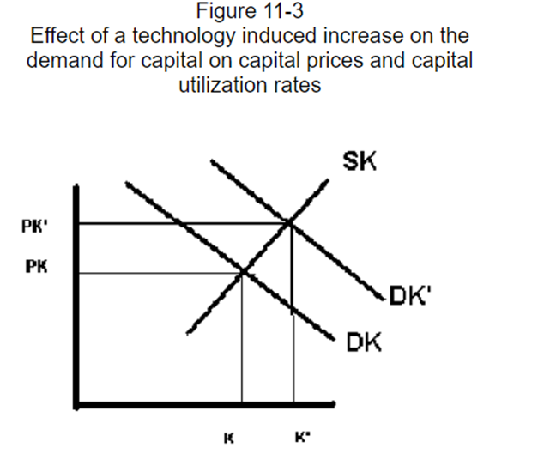
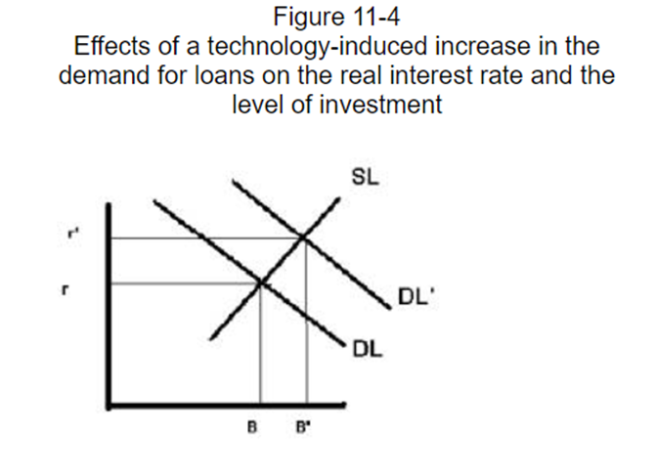
Examples of Real business cycle theory
Higher level of economic activity increases the demand for capital which leads to a higher capital rental rate and capital utilization rate. Hence, more capital is used and corporate profits increase.
Last graph focuses on the impact on investment. It shows that when higher productivity increases the demand for loans. As a result, real interest rates grow as well as the amount of investment.

Slide 14
Critical Reflection
The real business cycle theory has been controversial and influential since its first introduction.
Where are the shocks?
According to the theory, the driving for fluctuations are technological shocks. The theory interprets all movements in measured total factor productivity as the technological shock result. However, discussion of nature of these sources is missing. It seems complicated to interpret the absolute economic contractions that sometimes occur in the real world as a result of productivity shocks.
Interpretation of unemployment
Real business cycle theory´s assumption is that fluctuations in employment are fluctuations of changes in the amount of people who desire to work. They disagree with this assumption and believe that the desired employment is not so sensitive to real wages and the real interest rate. All in all, critics point out the fact that unemployment fluctuates substantially over the business cycle.

Slide 15
Critical Reflection
Flexibility of wages and prices
Real business cycle theory is based on assumption that wages and prices are completely flexible. Hence, markets are always clear. Many critics argue that money wages and prices are inflexible.
Neutrality of money
The theory assumes that money is neutral. Hence monetary policy is assumed not to affect real variables, such as output and employment. Many critics doesn´t accept Precott´s price-free economic analysis due to the conflict of the theory with the empirical evidence of the strong influence on the real economy of monetary policy. Critics argue that reductions of inflation and money growth are always associated with periods of high unemployment.
Exchange failures
Another fundamental objection to this theory is that the fact, that partial breakdowns in the exchange mechanism are dominant factors in cyclical fluctuations, is ignored.
Correctness of the parameters
Acoording to some critics, the real business cycle model is not an inconceivable representation of reality. Some critics find the parameterized model, which is supposed to be based on well-established microeconomic and long-run information, as not sustainable.

