Slide 1
Inflation and monetary policy

Slide 2
Outline
Inflation
Monetary policy
Summary

Slide 3
Inflation
“the inflation between two points in time is defined as the percentage increase of the price index between these two points in time”
Essentials of Economics
“the percentage annual increase in a general price level, commonly measured by the consumer price index (CPI) or some comparable price index”
Macroeconomics

Slide 4
Inflation - calculation
Calculation of the inflation rate:
Consumer price index (CPI)
In order to measure the overal price level
“the cost of a fixed basket of goods (items like food, shelter, clothing and medical care) bought by the typical urban consumer”

Slide 5
Inflation - types
Hyperinflation
CPI < 1 million or 1 billion percent a year
Galloping inflation
The rate is 50 or 100 or 200 percent a year
Moderate inflation
Price-level rise, but it does not change relative prices or incomes gravely

Slide 6
Monetary policy - introduction
one of the major tools of macroeconomics
aims to ensure the stability of prices
tries to support the economic growth
→ control the money supply and the interest rates

Slide 7
Monetary policy – Central bank(s)
the main public authority that is responsible for monetary policy
European Central Bank (ECB) + Federal bank of the U.S. = the most important
various objectives
issuing the national currency
maintain a stable national currency for a country
specify stability
providing of banking services to commercial banks and the government
regulating financial markets and institutions

Slide 8
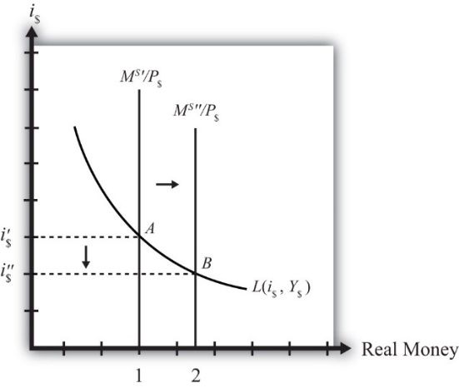
Monetary policy - instruments
Open-market operations
Lower or higher interest rates?

Slide 9
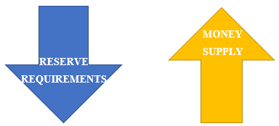
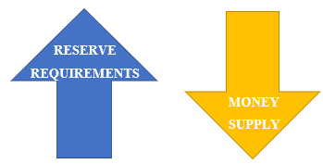
Monetary policy - instruments
Changes in reserve requirements

Slide 10
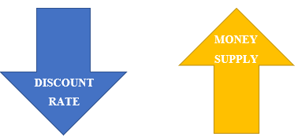
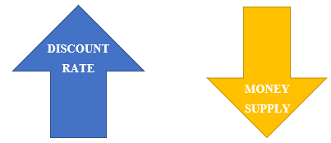
Monetary policy - instruments
Changes in Discount Rate

Slide 11
Summary
INFLATION
A threat to economy (we have to control permanently)
Can be faced by well executed →
→ MONETARY POLICY
That is done by Central banks – they use some instruments in order to influence supply and control of nation‘s money
Open-markets operations
Changes in Reserve requirements
Changes in Discount rate

