Slide 1
Changes in the management of organizations
doc. Ing. Petr Řehoř, Ph.D.

Slide 2
Learning outcomes
You will understand the concepts - industrial and knowing company, functional and process management.
You will clear up yourselves the development of the management of changes.
You will identify changes, that appear in the management of the organizations.
You will know what is 3C flexibility, coaching, or learning organization.

Slide 3
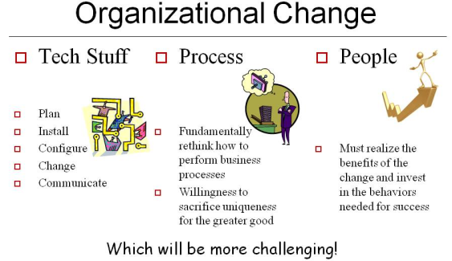
Introduction
50th of the 20th century Kurt Lewin´s 3-phase–model of the change.
At that time the change was managed more down-up, not up-down.
Nowadays management solves mainly 2 main problems – how to better plan realization of changes and how to get over opposition to the changes.
World crisis in the
year 2007.

Slide 4
Development of change management
Engineering – F.W. Taylor, strategy, proces, systems. TQM, reengineering.
Psychological – W. Bridges, human ability to adapt on the changes.
Management of internal changes.
Management in the conditions of the fixed changes.
Management in the conditions of the critical changes.

Slide 5
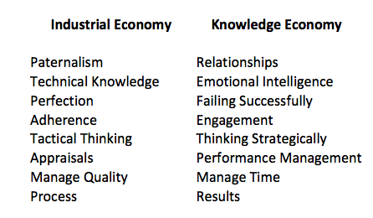
Industrial, knowledge society
Industrial – mass production, organized hierarchically
Knowledge – human structured organisation, access to information capability to transfer information into knowledge.

Slide 6
Functional, proces management
Functional - function as a collection of activities that make a common and unique contribution to the purpose and mission of the business.
Process - is completely closed, timely and logical sequence of activities which are required to work on a process-oriented business object.

Slide 7
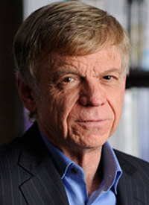
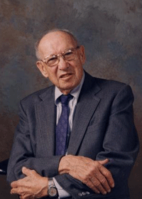
Authors of change management
John Kotter – 8 step proces for leading change
Igor Ansoff – 4 methods for overcoming resistence to change
Kurt Levine – 3 stage theory of change
Peter F. Drucker – management by objectives, turbulent
environment.

Slide 8
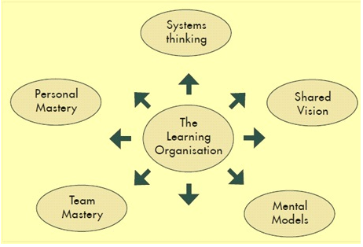
Changes in organizations
Surroundings - 3 C – customer, competition, change
Philosophy – be flexible
Attitude to company development – learning organizations.

Slide 9
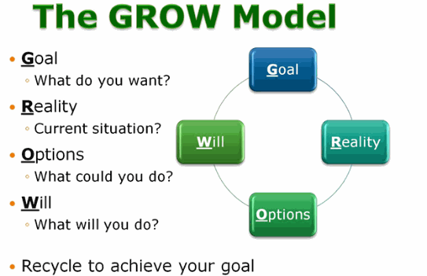
Changes in organizations
Role – to coach.
Dealing with problems –
from operative to
procedural thinking, from deductive
to inductive thinking.
Approach to strategic management – continuous and permanent adaptation.
Open book – empower every employee with required knowledge.

Slide 10
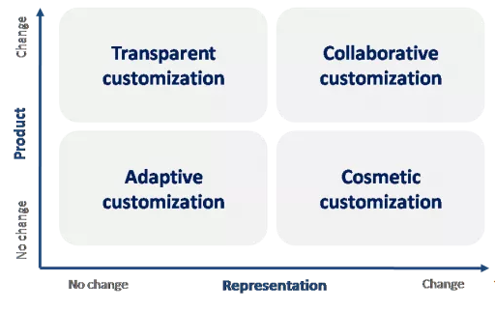
Changes in organizations
Attitude to customer satisfaction – mass customization

Slide 11
Changes in organizations
Organizational structures – network of teams, process orientation.
Technology – Industry 4.0 - automation, data exchanges, cloud, cyber-physical systems, robots, Big Data, AI, IoT and (semi-)autonomous industrial techniques to realize smart industry and manufacturing goals in the intersection of people, new technologies and innovation.

Slide 12
Organizations of 21st century
reduction of the life cycle of strategies,
costs fall on communication and globalization enabling enter the branches to many more companies,
approach to the information through internet moves negotiations from the producers to the customers,
branch superiorities move from one company to the other much more often and more quickly,
attenuation and dissolution of the whole branches,
digitalization and innovation.

Slide 13
Thank you for your atention!

