Slide 1
Reward systems
Total Reward Model. Project remuneration. Remuneration trends in the Czech Republic and the EU

Slide 2
Total Reward Model
Total remuneration model
Total remuneration includes all types of remuneration - indirect and direct, internal and external.
All the aspects of the remuneration, particularly the basic wage or salary, merit remuneration, employee benefits and non-monetary remuneration, which include internal remuneration from the work itself are mutually linked and treated as an integrated and logical unit. Total remuneration combines the influence of two major categories:

Slide 3
Total Reward Model
Transaction remunerations - material, tangible remunerations from a transaction between the employer and employees, which concern monetary remunerations and employee benefits.
Relational remuneration - intangible remuneration related to education and development as well as experience, work experiences.

Slide 4
Total Reward Model
Total remuneration concept - acknowledgement of the fact that the remuneration system should include not only monetary but also non-monetary remunerations such as praise and acknowledgement or growth opportunities could provided just through the process of work performance management.

Slide 5
Total Reward Model
Two upper quadrants - monetary remunerations and employee benefits constitute transaction remuneration. In principle, they have a monetary nature and are important for acquisition and stabilisation of the labour force, but may easily be copied by the competitors. On the other hand, 20 relational (non-monetary) remunerations that correspond to the lower two quadrants are important for increase of the value of the upper two quadrants

Slide 6
Total Reward Model
The major advantage of the total remuneration concept is the pooled effect of various types of remunerations, which has a deeper and longer term impact on the motivation and performance of the employees. Further advantages include improvement of employee relations and higher flexibility of the employees.
The optimum is a combination of 4 quadrants. The motivation of the employees substantially declines if there are problems in some quadrant.

Slide 7
Total Reward Model

Slide 8
Project remuneration
Project remuneration
The projects must be comprehended as components of the working duties of the employees.
Project work is remunerated by means of premiums, bonuses, etc.
This wage form applies mainly to the employees who work on more time intensive internal company projects alongside their standard work.

Slide 9
Project remuneration
Project remuneration
The remuneration of an employee who is working on projects takes three levels into consideration: result of the entire project, result of the given project phase, individual assessment.
When working only on a certain assigned project phase, the performance criteria are evaluated and a bonus sheet is prepared for each project position

Slide 10
Remuneration trends in the Czech Republic and the EU
Labour market in EU
Labour market conditions continue to improve, with employment reaching a record level in the EU. On the back of strong economic growth (2.4%), the number of people in employment in the EU increased by 1.6% in 2017, the largest annual increase rate since the start of the recovery. The unemployment rate is now back to its pre-crisis level. Youth unemployment also continues to decrease quickly,

Slide 11
Remuneration trends in the Czech Republic and the EU
There are a lot of elements that influence pay trends from European Union area:
The existence of multiple types of bargaining at the same time;
• The possibility to connect bargaining at different hierarchical levels;
• The possibility to extent how rewards vary from different levels across organizations, branches or sectors;
• The fact that the timing of bargaining rounds;
• Legislation of the states (e. g.: compulsory minimum wages established by the governments);
• The mechanism of pay indexation implemented;
• The possibility for special sectors to became “pace- setters” for other bargaining rounds.

Slide 12
Remuneration trends in the Czech Republic and the EU
Pay developments (within and between countries over time) are influenced broadly by the following factors:
• cyclical factors
• general labour market conditions
• social factors; • industrial relations factors
• national legislation
• national specificities as well as compositional factors.

Slide 13
Remuneration trends in the Czech Republic and the EU
Compensation trends in the EU
The major compensation trends in the countries of the EU include the following:
• reduced significance of salaries (wages), where the employees place major emphasis on the working environment, job content, work team and career advancement.
• the importance of leisure time is increasing and the elements of flexible management are being implemented
• the offer of benefits is increasing because if the company wants not only to keep the employees, but also build their loyalty to the company, it must offer more than other companies in benefits.

Slide 14
Remuneration trends in the Czech Republic and the EU
Compensation trends in the EU
• Individualisation of compensation is being asserted - (decollectivisation of payroll negotiations, individual approach to wage increases)
• Greater performance motivation (participation of the employees in the profit, share options, bonuses, management of employees’ performance)
• Use of the "carve-out" process - a certain portion of the overall increase in the payroll volume is reserved beforehand for the best-performing employees
• Greater application of the total compensation concept

Slide 15
Remuneration trends in the Czech Republic and the EU
Czech labour market
Employment in the Czech Republic still keeps its record-high values; however, in the year-on-year comparison, it has slightly decreased. Also as for the unemployment it is adequate to speak about stagnation during the whole year 2019 with the level right above two percent. The average wage increased by 6.7%, which was lower than in the preceding quarters. After adjustment by the influence of all the time increasing inflation, the wage increase in real terms was 3.6%.

Slide 16
Remuneration trends in the Czech Republic and the EU
Czech labour market
The year 2019 was an extraordinary one as for many aspects. In its beginning, there was historically the lowest unemployment level, which the Czech economy had for the last time before it became a market economy, i.e. in the 1990’s. On the other hand, also the number of employed persons increased to a record-breaking level. The number of job vacancies reached enormously high numbers (on the contrary to the historically low unemployment). Since the domestic offer was unable to satisfy the business demand for labour force, there was a significant increase in the number of foreigners working in the Czech Republic; they were from countries with higher unemployment and cheap labour force, mainly from the Ukraine, but also from the Balkans and other countries.

Slide 17
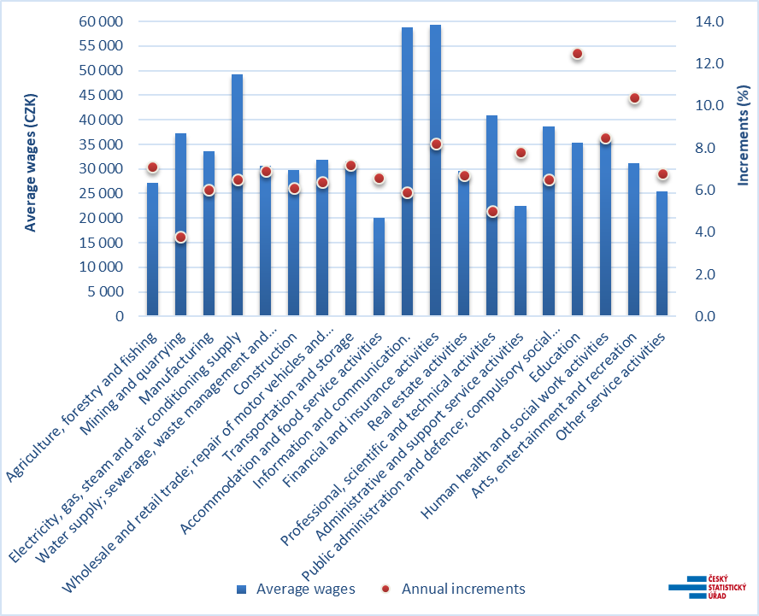
Remuneration trends in the Czech Republic and the EU

Slide 18
Remuneration trends in the Czech Republic and the EU
Remuneration in the Czech Republic - TRENDS
- Performance orientation (increased use of different forms of wage performance components such as bonuses or bonuses)
- Reducing of 13th salary (13th salary companies abolish or use it in relation to the performance of businesses or employees)
- Wage links to the profit of enterprises (growth of variable wage component linked to the profit of enterprises in the form of variable bonuses)

Slide 19
Remuneration trends in the Czech Republic and the EU
Remuneration in the Czech Republic - TRENDS
- Wage growth slowdown (wage growth slows to 3-5%)
- Well-being orientation
- Implementation of the cafeteria system also in small companies
- Increase of benefits importance (increase of flexible benefits due to digitalisation)
- More use of flexible working time for employees
- Increase use of sick days (medical days off without medical confirmation - usually 3-5 days per year)
- Bridge days (days off linking the holidays with weekends)

Slide 20
Remuneration trends in the Czech Republic and the EU
Remuneration in the Czech Republic - TRENDS
- Increase use of sick days (medical days off without medical confirmation - usually 3-5 days per year)
- Bridge days (days off linking the holidays with weekends)

Slide 21
Thank you for your attention
Have a nice day

