Slide 1
SuperMarketa - Introduction
Business Simulator
Ing. Viktor Vojtko, Ph.D. (2019)

Slide 2
Why this simulation?
Synthesis of knowledge from different subjects
Practical application of acquired knowledge
Solving of real business problems
Obtaining basic teamwork skills
Understanding your own limits, knowledge and skills

Slide 3
What is expected from managers?
Hard competence (skills)
Expertise
Working with information and ICT
Soft competence
Communication (negotiation, presentation, languages)
Teamwork
Thinking (analytical, creative, problem solving)
Self-reflection (knowing what I know and do not know) and discipline
Willingness and ability to learn

Slide 4
How are we going to develop the skills?
Complex case study
Managing a supermarket
5 years simulation
Teamwork
Clear roles of team members
Planning of meetings, minutes of meeting
Final presentation
Performance analysis
Self-reflections

Slide 5
Resources
Provided electronic materials
Notes from previous subjects
Business Economics
Microeconomics
Accounting
Marketing
Management
Consultations with game leaders
Additional resources (www.bookboon.com)

Slide 6
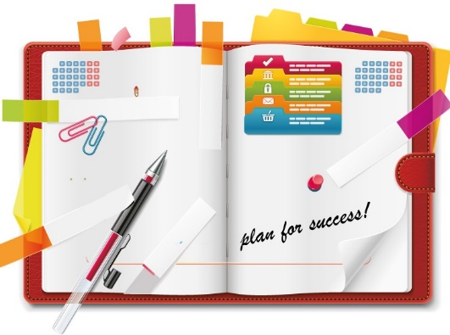
Our plan
Introduction, establishment of teams (1st seminar)
Situation analysis (2nd seminar)
Setting goals, strategic and financial plan development (3rd - 5th seminar)
Making and entering decisions into a computer simulator and analysis of results (6th – 8th seminar)
Final presentations (9th - 10th sem.)

Slide 7
Simulator interface

