Slide 1
Reward systems
New forms of remuneration, teams’remuneration.

Slide 2
New forms of remuneration
Wages and salaries for expected working results
This concerns remunerations provided for a defined set of works and performance. The company assumes fulfilment of the given tasks based on knowledge of the working abilities and performance of the employee and continuously pays him a certain amount. The important thing is to define the targets and options for their check, compilation of plans, working procedures and measurements for assessment of the results and a necessity is also the availability of labour consumption standards. It is often applied to the working positions of blue collar workers, specialists and lower and middle management staff.

Slide 3
New forms of remuneration
Contractual wage
The employee undertakes to fulfil certain tasks for a predefined period for which a certain amount is paid to him. Upon lapse of the given period, check and assessment of his results is done. These results may affect the wages and salaries for the subsequent periods. One of the advantages is the involvement of the employee in the creation of the tasks. A disadvantage may be the difficult creation and check of the standardised working times.

Slide 4
New forms of remuneration
Wage with measured daily output
the basis is a fixed time wage that differs in terms of the evaluation of the work done. A positive aspect of this wage is regular remuneration of the employee, which is not directly tied to performance. It is however difficult in terms of preparation and analysis of information.

Slide 5
New forms of remuneration
Programme wage
It is usually collective in nature. The group of employees receives a certain fixed amount at regular intervals for the duration of the programme. Upon completion of the programme within the set period, in the given quantity and quality, the employees receive a wage plus a portion of the variable component. An advantage is considered to be the collective pressure on the individuals in order to increase performance. The disadvantage is the need to set up a group with similar performances.

Slide 6
New forms of remuneration
Types of levels and wage or salary structures
This is an area in which the corporate remuneration policy is implemented. The structures of the levels are used by the company to classify the individual types of work and working positions in a hierarchy. They also make it possible to determine the size of the monetary remunerations (rates), definition of the framework for increase of the monetary remunerations and the basis that allows the direction of the wage or salary ratio, performance of monitoring and controlling processes and management of other remuneration aspects

Slide 7
New forms of remuneration
wage for qualifications
The wage for qualifications is a form of wage whose increase depends on the scope or depth of knowledge and skills that the employee has acquired and is applying. The objective of the wage is to stimulate the deepening of the employees’ qualifications so that the company can attain higher performance. Thanks to this form of remuneration, the employer can maintain the working positions when it has flexible and multi-sectoral qualified labour.

Slide 8
New forms of remuneration
Forms: allowance to the basic wage, basic wage
Advantages: support for the flexibility of the employees, increase of the organisation’s flexibility, increase of the substitutability of the employees and ease of implementation of new techniques and technologies
Disadvantages: costs (training, courses), risk of remuneration only for the educational certificate not for real work

Slide 9
New forms of remuneration
Remuneration according to competences
Used in companies with focus on corporate culture. The competences do not mean powers, but:
- certain behavioural requirements (soft competences)
- clearer definition of technical capabilities (hard competences)

Slide 10
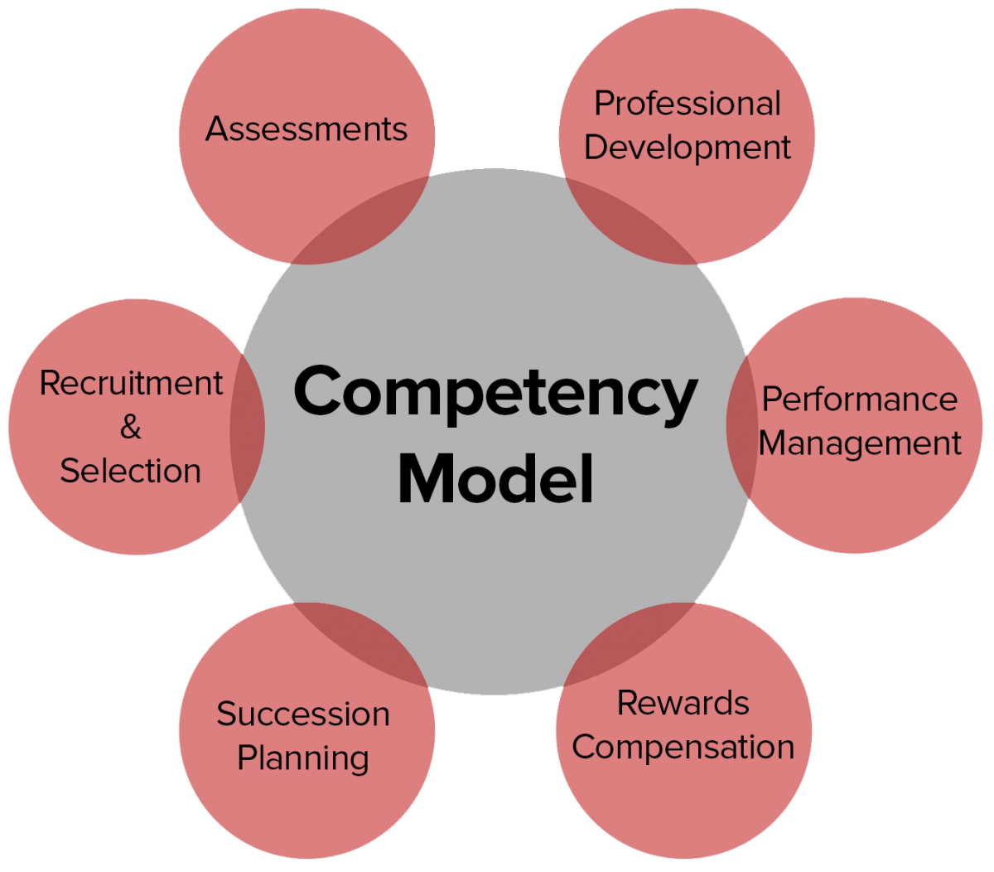
New forms of remuneration

Slide 11
New forms of remuneration
Remuneration according to competences
The hard competences model gives higher respect and provides greater support for career management in the company. For managers, it is more efficient and reliable to evaluate the advancement of the accountant in his career according to comprehensive economic knowledge rather than only according to knowledge.
The soft competence model is created on the basis of analysis of the corporate and company culture. At the highest level, competence is categorised into three segments: professionalism, independence and accountability.

Slide 12
New forms of remuneration
The SCARF Remuneration Model
The model defines 5 factors leading to higher efficiency in motivation and rewarding of employees.
STATUS - arising, for instance, from the name of the profession. Sometimes the new name of a position may mean a big change just in the feeling from the new name, for instance, department head vs. department director
CERTAINTY - the ability to predict the future. This concerns the transparency of the criteria and sustainability of the rewarding system.

Slide 13
New forms of remuneration
The SCARF Remuneration Model
AUTONOMY - opportunity to participate in decision-making concerning one’s own work
RELATEDNESS - mutual relationships of employees at work
FAIRNESS - fairness of the system. Attachment, rotation, promotion opportunities

Slide 14
New forms of remuneration
Team remuneration
The objective of team remuneration is to link the remuneration of the individual to efficient team performance

Slide 15
New forms of remuneration
Team remuneration
The most common form is distribution of the team remuneration according to some predefined, clear and comprehensible formula. The formula is determined on the basis of quantitative or qualitative indicators.

Slide 16
New forms of remuneration
Team types:
Organisational teams - members are organisationally connected and the objective is to achieve the corporate objectives
2. Work teams - independent permanent teams with members who closely co-operate in the creation of the products or services

Slide 17
New forms of remuneration
Team types:
Project teams - people from various functional departments to fulfil some project
4. Ad hoc teams - functional teams for solution of a particular problem - short-term

Slide 18
New forms of remuneration
Types of team remuneration:
Distribution of bonuses - the bonus is either a % of the basic wage or takes the form of the same amount for each member
Team and individual remuneration - payment of both the team and individual bonus

Slide 19
New forms of remuneration
Types of team remuneration:
High and low individual performance in the team - the bonus is defined by the team leader according to the individual performance
4. Project team bonuses - bonuses for achieving and exceeding target results

Slide 20
Thank you for your attention
Have a nice day

