Slide 1
Introduction to software engineering

Slide 2
Objectives of software engineering?
"Software engineering is a systematic, disciplined, and qualified approach to software development, creation, and maintenance."
IEEE definition, 1993
"The goal of software engineering is to define procedures that increase the likelihood that customers will be able to deliver (and maintain) products of sufficient quality (SW deployed on HW) within the required deadlines and at an appropriate price."

Slide 3
programmer error is the cause of the crash

Slide 4
Why is software development difficult?
The problem domain (also called application domain) is difficult
The solution domain is difficult
The development process is difficult to manage
Software offers extreme flexibility
Software is a discrete system
Continuous systems have no hidden surprises
Discrete systems can have hidden surprises! (Parnas)
David Lorge Parnas is an early pioneer in
software engineering who developed the
concepts of modularity and information hiding
in systems which are the foundation of
object oriented methodologies.
Notes:
So, in addition to the requirements of the system which have to be unambigous, we need to identify the end user ,the person that is ultimately using the system.
The problem domain is sometimes difficult, just because we are not experts in it. That is, it might not be intellectually challenging, but because you are not an expert in it, you have to learn it. Couple this with learning several problem domains, and that is what you will have to do as a software engineer, and the problem becomes obvious.
The development process is very difficult to manage. This has taken some time and some billion dollars to learn, but we are now starting to accept the fact, that software development is a complex activity. One of the assumptions that managers have made in the past, is that software development can be managed as a set of steps in linear fashion, for example: Requirements Specification, followed by System Design followed by Implementation followed by Testing and Delivery.
In reality this is not that easy. Software Development does not follow a linear process. It is highly nonlinear. There are dependencies between the way you design a system and the functionality you require it to have. Moreover, and that makes it really tricky, some of these dependencies cannot be formulated unless you try the design.
Another issue: Software is extremely flexible. We can change almost anything that we have designed in software. While it is hard to change the layout of a washing machine, it is extremely easy to change the program running it.
Here is another problem: When you are sitting in a plane in a window seat, and you push a button to call the steward for a drink, you don’t expect the system to take a hard left turn and dive down into the pacific. This can happen with digital systems. One of the reasons: While you can decompose the system into subsystems, say “Call Steward” and “Flight Control” subsystems, if you don’t follow good design rules, you might have used some global variable for each of these subsystems.
In the old days, when memory was expensive, programmers did this, as we learned in the case of the space shuttle.
And one of these global variables used by the “Flight Control” subsystem might have unintentionally ben been overwritten by the “Call Steward” SubSystem.

Slide 5
Software Engineering is more than writing Code
Problem solving
Creating a solution
Engineering a system based on the solution
Modeling
Knowledge acquisition
Rationale management
Notes:
It requires the most differing activities and abilities in problem solving, abstract thinking, knowledge acquisition and understanding the reasons behind decisions
We will cover each of these areas in class as we move along.
To aid you in each of these areas, we are using 3 types of weapons, Techniques, Methodologies and Tools

Slide 6
Techniques, Methodologies and Tools
Techniques:
Formal procedures for producing results using some well-defined notation
Methodologies:
Collection of techniques applied across software development and unified by a philosophical approach
Tools:
Instruments or automated systems to accomplish a technique
CASE = Computer Aided Software Engineering
Notes:
:Techniques are well known procedures that you know will produce a result (Algorithms, cook book recipes are examples of techniques).
Some people use the word “method” instead of technique, but this word is already reserved in our object-oriented development language, so we won’t use it here.
A collection of techniques is called a methodology. (A cookbook is a methodology).
A Tool is an instrument that helps you to accomplish a method. Examples of tools are: Pans, pots and stove.
Note that these weapons are not enough to make a really good sauce. That is only possible if you are a good cook. In our case, if you are a good software engineer.
Techniques, methodologies and tools are the domain of discourse for computer scientists as well. What is the difference?

Slide 7
Computer Science vs. Engineering
Computer Scientist
Assumes techniques and tools have to be developed.
Proves theorems about algorithms, designs languages, defines knowledge representation schemes
Has infinite time…
Engineer
Develops a solution for a problem formulated by a client
Uses computers & languages, techniques and tools
Software Engineer
Works in multiple application domains
Has only 3 months...
…while changes occurs in the problem formulation (requirements) and also in the available technology.
Notes:
A computer scientist assumes that techniques, methodologies and tools are to be developed. They investigate in designs for each of these weapons, and prove theorems that specify they do what they are intended to do. They also design languages that allow us to express techniques. To do all this, a computer scientist has available an infinite amount of time.
A software engineering views these issues as solved. The only question for the software engineer is how these tools, techniques and methodologies can be used to solve the problem at hand. What they have to worry about is how to do it under the time pressure of a deadline. In addition they have to worry about a budget that might constrain the solution, and often, the use of tools. Good software engineering tools can cost up to a couple of $10,000 Dollars

Slide 8
Software Engineering: A Working Definition
Software Engineering is a collection of techniques,
methodologies and tools that help with the
production of
A high quality software system developed with a given budget before a given deadline
while change occurs
Challenge: Dealing with complexity and change
20
Notes:
Let‘s come up with th a working definition for software engineering. This definition helps us to get started, because it contains the major problem areas that we have to deal with during software development.

Slide 9
Software Engineering: A Problem Solving Activity
Analysis:
Understand the nature of the problem and break the problem into pieces
Synthesis:
Put the pieces together into a large structure
For problem solving we use techniques, methodologies and tools.
Notes:
What is Software Engineering? The goal is to produce high quality software to satisfy a set of functional and nonfunctional requirements. How do we do that?
First, and foremost, by acknowledging that it is a problem solving activity. That is, it has to rely on well known techniques that are used all over the world for solving problems. There are two major parts of any problem solving process:
Analysis: Understand the nature of the problem. This is done by looking at the problem and trying to see if there are subaspects that can be solved independently from each other. This means, that we need to identify the pieces of the puzzle (In object-oriented development, we will call this object identification).
Synthesis: Once you have identified the pieces, you want to put them back together into a larger structure, usually by keeping some type of structure within the structure.

Slide 10
Software development methodologies

Slide 11
Project size and methodology
There is no universal good practice / methodology for all types of projects.
The size of the project is an important factor in choosing the methodology.
Large projects should be divided into sub-projects. Individual sub-projects can then be controlled by different methodologies.

Slide 12
Simplified definition of SW development methodology
The methodology usually divides development into certain phases (= time slots).
It also determines:
what to do at what stage,
what procedures to use,
what is the result of the phase,
what (documents,…) should be used in the solution.

Slide 13
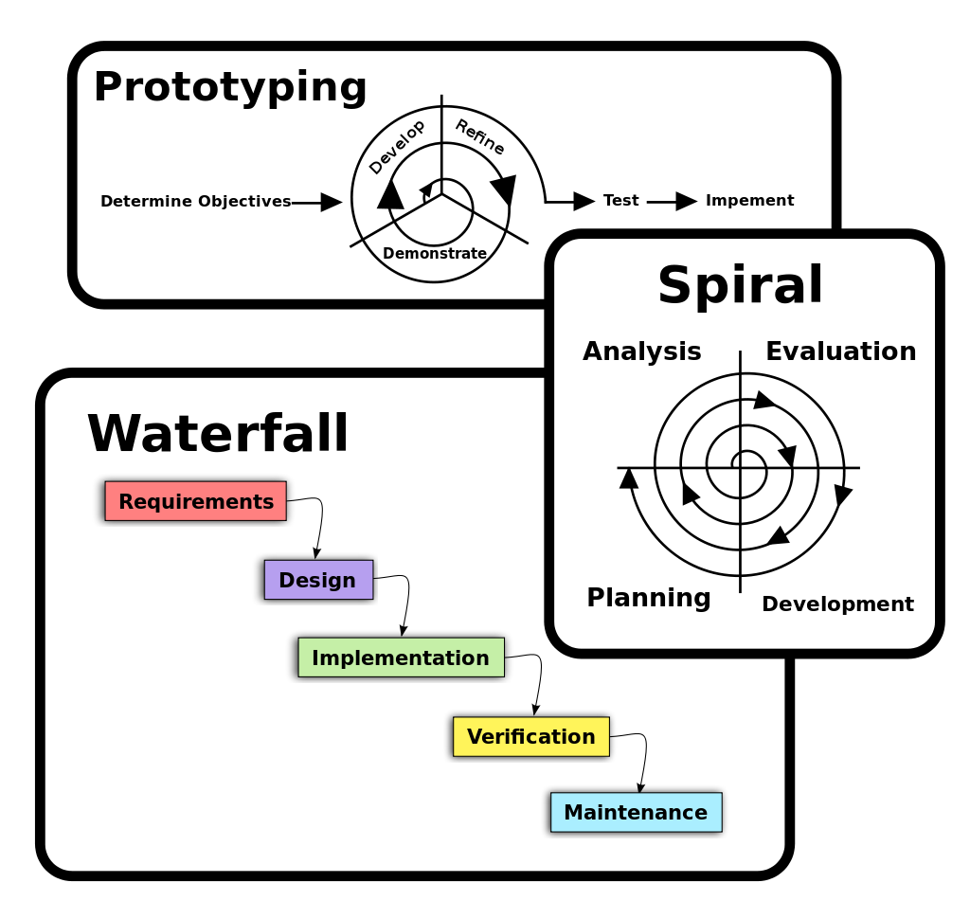
Three basic (reference) SW development procedures
Individual methodologies are a combination of these methods
Wikipedia

Slide 14
Unified Process Methodology (UP)
One of many rather traditional methodologies
-4 phase:
-Starting,
-processed,
-realization,
-handover.
in each phase, several iterations of these activities take place:
-collection / revision of requirements,
-analysis,
-proposal,
-implementation,
-testing.
-the emphasis on individual activities is different in different stages of development.

Slide 15
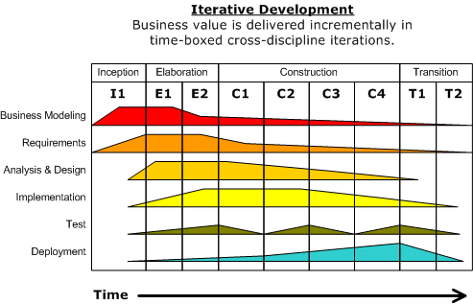
Metodika Unified Proces (UP)
- traditional methodology
Wikipedia

Slide 16
Agile methodologies
Part of the lecture will be devoted later.
https://en.wikipedia.org/wiki/Agiln_Methods

