Slide 1
Systems Analysis and Design

Slide 2
Learning Objectives
Define information systems analysis and design.
Describe the different types of information systems.
Describe the information Systems Development Life Cycle (SDLC).
Explain Rapid Application Development (RAD), prototyping, Joint Application Development (JAD), and Computer Aided Software Engineering (CASE).
Describe agile methodologies and eXtreme programming.
Explain Object Oriented Analysis and Design and the Rational Unified Process (RUP).

Slide 3
Learning Objectives
Describe the information systems development life cycle (SDLC)
Describe four types of information systems:
Transaction Processing Systems (TPS)
Management Information Systems (MIS)
Decision Support Systems (DSS)

Slide 4
Introduction
Information Systems Analysis and Design
Complex process whereby computer-based information systems are developed and maintained, Used by a team of business and systems professionals.
Application Software
computer software -result of systems analysis and design-
Designed to support organizational functions or processes

Slide 5
Introduction
Software engineering processes have been developed to assist in analysis and design
Methodologies
Comprehensive, multi-step approaches to systems development
Techniques
Processes that are followed to ensure that work is well thought-out, complete and comprehensible to others on the project team
Tools
Computer programs to assist in application of techniques to the analysis and design process

Slide 6
Introduction
Information Systems Analysis and Design
A method used by companies to create and maintain systems that perform basic business functions
Main goal is to improve employee efficiency by applying software solutions to key business tasks
A structured approach must be used in order to ensure success

Slide 7
Introduction
System analyst: the organizational role most responsible for the analysis and design of IS.
Systems Analyst performs analysis and design based upon:
Understanding of organization’s objectives, structure and processes
Knowledge of how to exploit information technology for advantage

Slide 8
Software engineering process
A process used to create an information system
Consists of:
Methodologies
A sequence of step-by-step approaches that help develop the information system
Techniques
Processes that the analyst follows to ensure thorough, complete and comprehensive analysis and design
Tools
Computer programs that aid in applying techniques

Slide 9
Introduction

Slide 10
Approaches to Systems Development
1950s: focus on efficient automation of existing processes
1960s: advent of 3GL procedural or third-generation, faster and more reliable computers
1970s: system development becomes more like an engineering discipline
1980s: major breakthrough with 4GL, CASE tools, object oriented methods
1990s: focus on system integration, client/server platforms, Internet
The new century: Web application development, wireless PDAs (personal digital assistant) , component-based applications

Slide 11
Approaches to Systems Development
Process-Oriented Approach
Focus is on flow, use and transformation of data in an information system
Involves creating graphical representations such as data flow diagrams and charts
Data are tracked from sources, through intermediate steps and to final destinations
Natural structure of data is not specified
Disadvantage: data files are tied to specific applications

Slide 12
Approaches to Systems Development
Data-Oriented Approach
Depicts ideal organization of data, independent of where and how data are used
Data model describes kinds of data and business relationships among the data
Business rules depict how organization captures and processes the data

Slide 13
Types of Information systems

Slide 14
Types (classes)of Information Systems
Transaction Processing Systems (TPS)
Process orientation
Automate handling of data about business activities (transactions)
their goal to improve response time, efficiency, accuracy and using fewer people.
Management Information Systems (MIS)
Converts raw data from transaction processing system into meaningful form
Data orientation
Decision Support Systems (DSS)
DSS Components: Database, model base, user dialogue
Involves data warehouses, executive information systems (EIS)
Designed to help decision makers
Provides interactive environment for decision making

Slide 15
Systems Development Life Cycle
System Development Methodology
Standard process followed in an organization to conduct all the steps necessary to analyze, design, implement and maintain IS.
- Is a standard process followed in an organization to conduct all
the steps necessary to analyze, design, implement, and
maintain information systems.
Consists of:
Analysis
Design
Implementation
Maintenance

Slide 16
Systems Development Life Cycle
Series of steps used to manage the phases of development for an information system or
The traditional methodology used to develop, maintain, and replace IS.
Consists of six phases:
Project Identification and Selection
Project Initiation and Planning
Analysis
Design
Implementation
Maintenance

Slide 17
Systems Development Life Cycle
Phases are not necessarily sequential
Each phase has a specific outcome and deliverable
Individual companies use customized life cycles

Slide 18
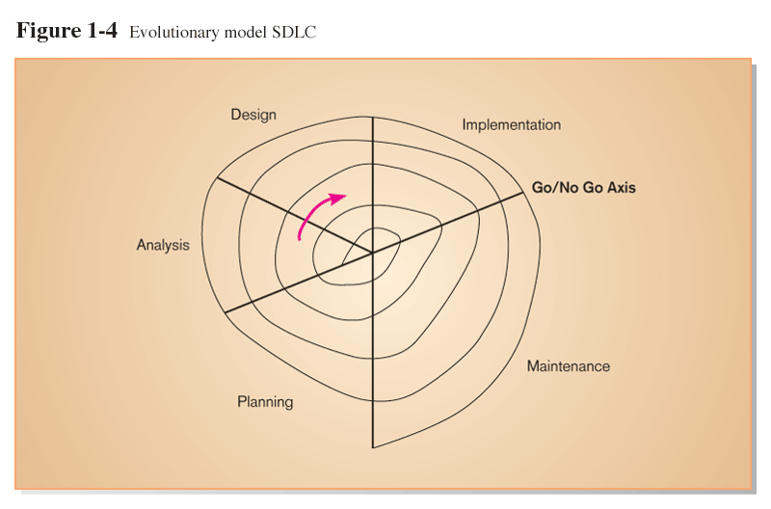
Standard and Evolutionary Views of SDLC

Slide 19
Phases of the Systems Development Life Cycle
Project Identification and Selection (chapter 4)
Two Main Activities
Identification of need
Prioritization and translation of need into a development schedule
Helps organization to determine whether or not resources should be dedicated to a project.
Project Initiation and Planning (chapter 5)
Two Activities
Formal preliminary investigation of the problem at hand
Presentation of reasons why system should or should not be developed by the organization

Slide 20
Systems Development Life Cycle
Analysis (chapters 6,7,8,and 9)
Study of current procedures and information systems
Determine requirements
Study current system
Structure requirements and eliminate redundancies
Generate alternative designs
Compare alternatives
Recommend best alternative

Slide 21
Systems Development Life Cycle
Design (chapters 10,11))
Logical Design
Concentrates on business aspects of the system
all functional features of the system chosen for development in analysis are described independently of any computer platform.
Physical Design
Technical specifications
The logical specifications of the system from logical design are transformed into the technology-specific details from which all programming and system construction can be accomplished.
Implementation (chapters 15)
Implementation
Hardware and software installation
Programming
User Training
Documentation

Slide 22
Systems Development Life Cycle
Maintenance (chapter 16)
System changed to reflect changing conditions
System obsolescence

Slide 23
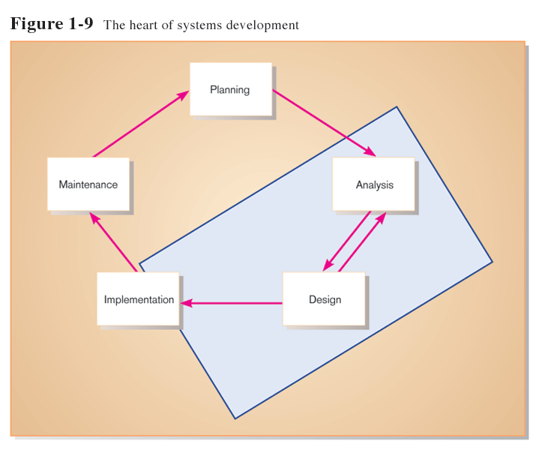
The Heart of the Systems Development Process

Slide 24
Traditional Waterfall SDLC

Slide 25
Problems with Waterfall Approach
System requirements “locked in” after being determined (can't change).
Limited user involvement (only in requirements phase).
Too much focus on milestone deadlines of SDLC phases to the detriment of sound development practices.

Slide 26
Approaches to Improving Development
Prototyping
Iterative development process:
Requirements quickly converted to a working system.
System is continually revised.
Close collaboration between users and analysts.
Is a form of Rapid Application Development.
Building a scaled-down working version of the system
Advantages:
Users are involved in design
Captures requirements in concrete form

Slide 27
Prototyping

Slide 28
RAD
Rapid Application Development (RAD)
Methodology to radically decrease design and implementation time.
Involves: extensive user involvement, prototyping, JAD sessions, integrated CASE tools, and code generators.
System methodology to radically decrease the time needed to design and implement information systems. It relies on extensive user involvement.
RAD cycle is limited to the design, construction, and development phases.

Slide 29
RAD

Slide 30
JAD
Joint Application Design (JAD)
Users, Managers and Analysts work together for several days
System requirements are reviewed
Structured process involving users, analysts, and managers.
Several-day intensive workgroup sessions.
Purpose: to specify or review system requirements.

Slide 31
AGILE
Agile methodologies, it argues that software development methodologies adapted from engineering generally do not fit with real world software development. In civil engineering requirements tends to be well understood, construction become very predictable.
Motivated by recognition of software development as fluid, unpredictable, and dynamic.
Three key principles
Adaptive rather than predictive.
Emphasize people rather than roles.
Self-adaptive processes, as software is developed, the process used should be refined and improved of course after reviewed by people working on the project.
Agile is not for every project, it is for:
- unpredictable or dynamic requirement.
- responsible and motivated developers.
- customers who understand the process and will get involved.

Slide 32
eXtreme Programming
Short, incremental development cycles.
Automated tests
Two-person programming teams and a customer on site
Coding and testing operate together by the same process.
Advantages:
Communication between developers.
High level of productivity.
High-quality code

Slide 33
CASE
Computer-Aided Software Engineering (CASE) tools
Diagramming tools enable graphical representation.
Computer displays and report generators help prototype how systems “look and feel”.
Analysis tools automatically check for consistency in diagrams, forms, and reports.
Central repository for integrated storage of diagrams, reports, and project management specifications.
Documentation generators standardize technical and user documentation.
Code generators enable automatic generation of programs and database code directly from design documents, diagrams, forms, and reports.

Slide 34
Object Oriented Analysis and design (OOAD)
Is a system development methodologies and techniques based on objects rather than data or processes.
Object is a structure that encapsulate attributes and methods that operate on those attributes.
Object class is a logical grouping of objects that have the same (similar) attributes and behavior (method).
Inheritance: hierarchical arrangement of classes enable subclasses to inherit properties of super classes.

Slide 35
Phases of OOSAD-based Development

Slide 36
RUP
An object-oriented systems development methodology.
RUP establishes four phase of development: inception, elaboration, construction, and transition.
Each phase is organized into a number of separate iterations.

Slide 37
SDLC criticisms…
Reliance on the life cycle approach forced intangible and dynamic processes such as analysis and design into timed phases that were doomed to fail. (martin, 1999)
Massive amount of processes and documentation does slow down development, Agile developers claims that source code is enough documentation.
Criticism of the SDLC that is based on fiction is that all versions of SDLC are waterfall-like with no feedback between steps.
Another false criticism is that a life cycle approach limits the involvement of users, yet Agile and Extreme programming approaches advocate an analysis-design-code-test sequence, and that is itself is a cycle.

