Slide 1
WORKING CAPITAL
Optimal Debt Structure

Slide 2
Source structure
is maintaining optimal balance between long-term and short-term sources.
Short-term debt capital is cheaper than long-term debt capital.
Short-term debt capital should be used only for financing liquid assets,
Long-Term Capital (Long-term Debt and Equity) should cover Fixed Assets and permanently locked-up Current Assets

Slide 3
Net Working Capital
Net Working Capital
Fixed
Assets
Equity
Long-term
Capital
Net
working
capital
Long-
term
Debt
Current
Assets
Short-
term
Debt
Short-term
capital

Slide 4
Net Working Capital- exapmle
Assess the relationships between the asset structure and the capital structure of the company on the basis of the balance sheet data (in thous. CZK).
Fixed Assets= 290 000
Current Assets = Inventory+Receivables+Cash and bank accounts = 510 000
Long-term Capital (Long-term debt + Equity) = 580 000
Short-term Capital (Short-term debt) = 220 000
Net working Capital (NWC) = Current Assets – Short-term Capital = 510 000 - 220 000 = 290 000
Assets Balance Liabilities
Fixed Assets | 290 000 | Registered Capital | 260 000
Inventory | 250 000 | Funds from earnings | 30 000
Receivables | 110 000 | Profit | 150 000
Cash and bank accounts | 150 000 | Long-term Payables | 140 000
 |  | Short-term Payables | 220 000
AssetsTotal | 800 000 | Liabilities Total | 800 000

Slide 5
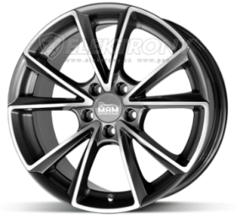
Net Working Capital (NWC) – Three Approachs
We assume that with its fixed assets and production capacity the company can manufacture 10,000 units (for instance, wheel disks) per year.
The company may have a different level of circulating assets to secure production.
Approach A
Assets
in thous.
CZK
Approach B
Approach C
Current Assets
5 000
10 000 units of output

Slide 6
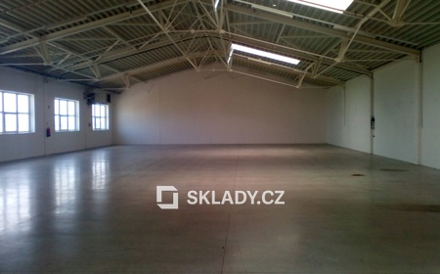
Net Working Capital (NWC) – Three Approachs
From the viewpoint of company liquidity
Approach A is conservative (the most conservative of all the three variants) - it has the highest OM level as compared with approaches B and C.
Approach C will have the lowest liquidity. It is an aggressive approach (with a minimum OM level that is only necessary to secure production).

Slide 7
Net Working Capital (NWC) – Three Approachs
From the viewpoint of company profitability
It is clear from the formula that the lower Current Assets level (shift of approach A to approach C) shall increase potential profitability.
Approach C has the highest ROA.
A more aggressive circulating capital policy shall lead to higher profit.

Slide 8
Net Working Capital (NWC) – Three Approachs
From the viewpoint of company risk
The shift from approach A (conservative) to approach C (aggressive) means:
Reduced cash flow (short-term financial assets)
Reduced receivables (strict observance of the maturity - consequence of loss of suppliers
Reduced inventories may result in lower sales revenues

Slide 9
Net Working Capital (NWC) – Three Approachs
A more aggressive approach to the management of working capital shall lead to higher risk.
Profitability develops inversely to liquidity.
Higher profitability brings a higher risk.

Slide 10
The three variants of approachs
Profitability develops inversely to liquidity
Higher profitability brings a higher risk.
High level
Low level
Liquidity
Approach A | Approach B | Approach C
Approach C | Approach B | Approach A
Approach C | Approach B | Approach A
Profitability
Risk
The optimal level of circulating assets (respectively, NWC) is determined by the approach of the management and balancing of profitability and risk.

Slide 11
Thank you for your attencion

