Slide 1
High impact Data Warehousing with SQL Server Integration Services and Analysis Services

Slide 2
A DW architecture
Reports
Dashboards
Scorecards
Excel
BI tools
Analysis Services
Datawarehouse
(SQL Server, Oracle, DB2, Teradata)
Integration Services
SQL/Oracle
SAP/Dynamics
Legacy
Text
XML
Notes:
TPs:
Datawarehouse as a central repository of the data allows business monitoring, analysis, planning etc. It is a bridge between numerous heterogenous data sources in the organization and the tools (reports, excel, scorecards and dashboards) that end users need to get business insight. Having the right data, cleaned and conformed is the key to successful BI implementations and ROI for the business.
However (animate integration services) it takes effort to bring the data in. You need a powerful tool to transform, clean, and load the data. This is where Integration Services comes into the picture. It is our tool, that you get as part of SQL Server, that allows you to get your data right before it is stored in the DW.
Now that you have the data in the data warehouse, the work is not done. While you probably have all of the data there, the data is not readily consumable by end users. You need to make it business friendly – define common business entities (dimensions and measures), common business calculations (variance to budget, profit, etc), metrics (KPIs), and present the data to users in a format that is easy understandable (end user friendly names, hierarchies etc). Animate analysis services. This is where AS comes handy. It makes the data in DW much easier to consume by a variety of BI tools and eventually your end users.
SQL Server has a very powerful offering for building data warehouses. Not only that you get SQL relational database system, but you also get in the same box AS and IS to implement end to end DW environment.

Slide 3
Session Objectives
Assumptions
Experience with SSIS and SSAS
Goals
Discuss design, performance, and scalability for building ETL packages and cubes (UDMs)
Best practices
Common mistakes

Slide 4
SQL Server 2005 BPA availability!
BPA = Best Practice Analyzer
Utility that scans your SQL Server metadata and recommends best practices
Best practices from dev team and Customer Support Services
What’s new:
Support for SQL Server 2005
Support for Analysis Services and Integration Services
Scan scheduling
Auto update framework
CTP available now, RTM April
http://www.microsoft.com/downloads/details.aspx?FamilyId=DA0531E4-E94C-4991-82FA-F0E3FBD05E63&displaylang=en

Slide 5
Agenda
Integration Services
Quick overview of IS
Principles of Good Package Design
Component Drilldown
Performance Tuning
Analysis Services
UDM overview
UDM design best practices
Performance tips

Slide 6
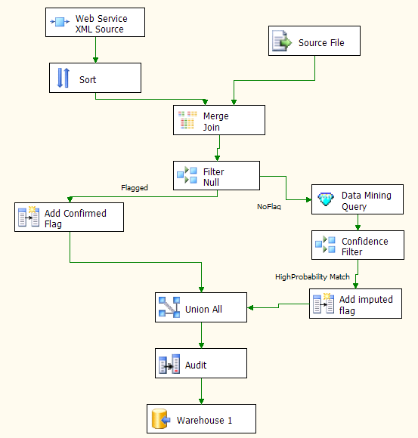
What is SQL Server Integration Services?
Introduced in SQL Server 2005
The successor to Data Transformation Services
The platform for a new generation of high-performance data integration technologies

Slide 7
ETL Objective: Before SSIS
Alerts & escalation
ETL
Data mining
Call center data: semi structured
Text mining
Staging
Staging
Warehouse
ETL
Legacy data: binary files
Hand
coding
Cleansing
&
ETL
Reports
ETL
Staging
Application database
Mobile
data
Integration and warehousing require separate, staged operations.
Preparation of data requires different, often incompatible, tools.
Reporting and escalation is a slow process, delaying smart responses.
Heavy data volumes make this scenario increasingly unworkable.

Slide 8
Changing the Game with SSIS
Alerts & escalation
Text mining
components
Data mining
components
Mobile
data
Call center:
semi-structured data
Custom
source
Merges
Warehouse
Legacy data: binary files
Standard
sources
Data-cleansing
components
SQL Server Integration Services
Application database
Reports
Integration and warehousing are a seamless, manageable operation.
Source, prepare, and load data in a single, auditable process.
Reporting and escalation can be parallelized with the warehouse load.
Scales to handle heavy and complex data requirements.

Slide 9
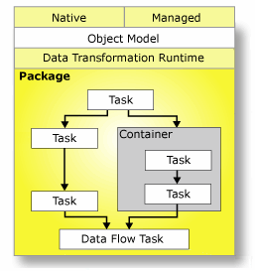
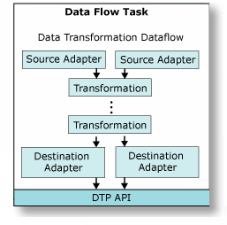
SSIS Architecture
Control Flow (Runtime)
A parallel workflow engine
Executes containers and tasks
Data Flow (“Pipeline”)
A special runtime task
A high-performance data pipeline
Applies graphs of components to data movement
Component can be sources, transformations or destinations
Highly parallel operations possible

Slide 10
Agenda
Overview of Integration Services
Principles of Good Package Design
Component Drilldown
Performance Tuning

Slide 11
Principles of Good Package Design - General
Follow Microsoft Development Guidelines
Iterative design, development & testing
Understand the Business
Understanding the people & processes are critical for success
Kimball’s “Data Warehouse ETL Toolkit” book is an excellent reference
Get the big picture
Resource contention, processing windows, …
SSIS does not forgive bad database design
Old principles still apply – e.g. load with/without indexes?
Platform considerations
Will this run on IA64 / X64?
No BIDS on IA64 – how will I debug?
Is OLE-DB driver XXX available on IA64?
Memory and resource usage on different platforms
Notes:
Also mention Building Data Warehouses with Microsoft SQL Server
BIDS only runs on x86 due to the fact that VS.Net only supports this platform. On x64 we’re still OK since BIDS runs in the WoW. However on Itanium the message is if you’re using Itanium then ‘develop on x86, deploy on IA64’. In other words dev would use an x86 box, but staging and production would be Itanium. The next issue is that specific OleDb drivers may be available on x86 but not on any of the 64bit platforms. In these cases we suggest either using a 3rd party driver provider (such as ETI) or split your packages up such that the extraction is done on a 32bit box which has the driver, and then process the rest of the solution on 64. We have many partners who have excellent drivers on 64bit platforms though

Slide 12
Principles of Good Package Design - Architecture
Process Modularity
Break complex ETL into logically distinct packages (vs. monolithic design)
Improves development & debug experience
Package Modularity
Separate sub-processes within package into separate Containers
More elegant, easier to develop
Simple to disable whole Containers when debugging
Component Modularity
Use Script Task/Transform for one-off problems
Build custom components for maximum re-use
Notes:
Process modularity – multiple people can work on it
Containers are objects in SQL Server 2005 Integration Services (SSIS) that provide structure to packages and services to tasks. They support repeating control flows in packages, and they group tasks and containers into meaningful units of work. Containers can include other containers in addition to tasks.
Packages use containers for the following purposes:
Repeat tasks for each element in a collection, such as files in a folder, schemas, or SQL Management Objects (SMO) objects. For example, a package can run Transact-SQL statements that reside in multiple files.
Repeat tasks until a specified expression evaluates to false. For example, a package can send a different e-mail message seven times, one time for every day of the week.
Group tasks and containers that must succeed or fail as a unit. For example, a package can group tasks that delete and add rows in a database table, and then commit or roll back all the tasks when one fails.
The Sequence container defines a control flow that is a subset of the package control flow. Sequence containers group the package into multiple separate control flows, each containing one or more tasks and containers that run within the overall package control flow.
There are many benefits of using a Sequence container:
Disabling groups of tasks to focus package debugging on one subset of the package control flow.
Managing properties on multiple tasks in one location by setting properties on a Sequence container instead of on the individual tasks.
Providing scope for variables that a group of related tasks and containers use.

Slide 13
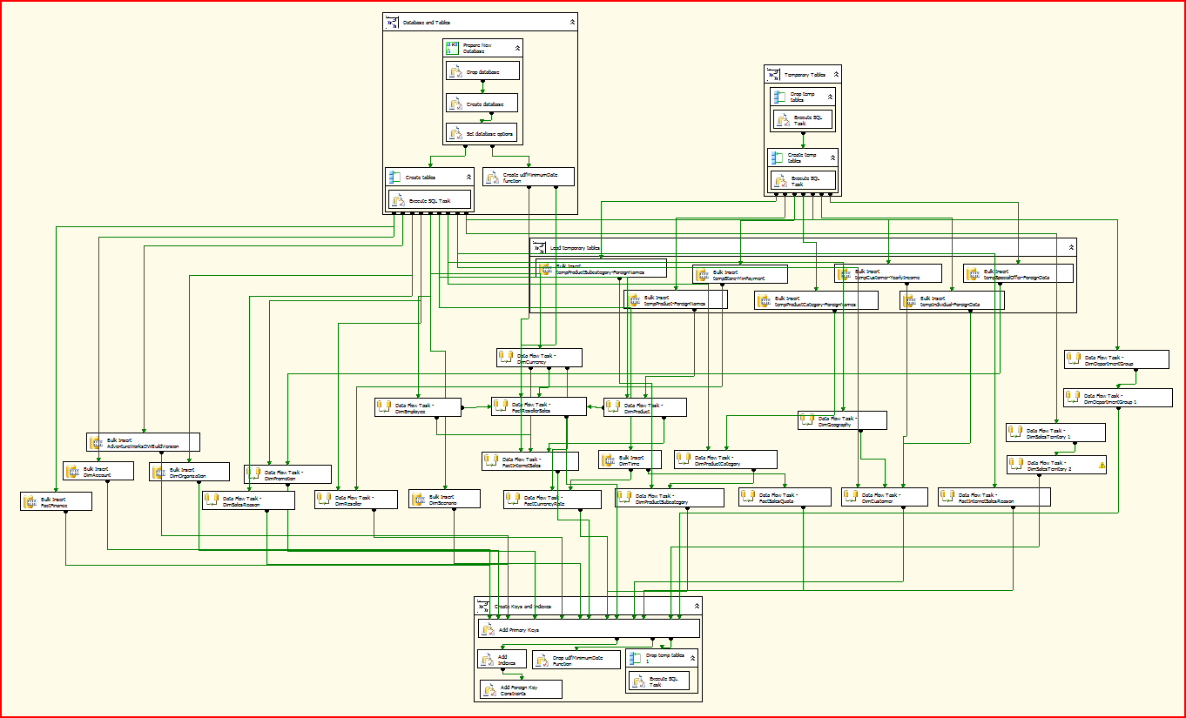
Bad Modularity

Slide 14
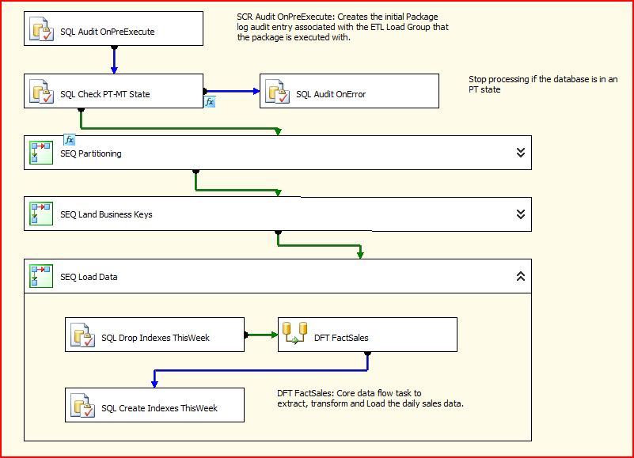
Good Modularity

Slide 15
Principles of Good Package Design - Infrastructure
Use Package Configurations
Build it in from the start
Will make things easier later on
Simplify deployment Dev → QA → Production
Use Package Logging
Performance & debugging
Build in Security from the start
Credentials and other sensitive info
Package & Process IP
Configurations & Parameters
Notes:
Demo? – show how to set up performance logs for SSIS
Using package configurations can provide the following benefits:
Configurations make it easier to move packages from a development environment to a production environment. For example, a configuration can update the connection string in the connection manager that the package uses.
Configurations are useful when you deploy packages to many different servers. For example, a variable in the configuration for each deployed package can contain a different disk space threshold, under which the package does not run.
Configurations make packages more flexible. For example, a configuration can update the value of a variable that is used in a property expression.
Logging
- Different providers – SQL profiler, SQL table, text, xml, windows log
Demo: Monitoring Performance of the Data Flow Engine
Control Panel -> Admin Tools -> Performance -> Perf counters -> New Counter Log
Buffer Memory – The amount of memory buffers currently in use. If bigger than amount of physical memory, swapping occurs -> performance goes down
Rows read – the number of rows that a source produces (doesn’t include rows from reference tables using lookup)
Rows written – the number of rows offered to a destination. Does not reflect rows written to the destination data store
Security
Package protection level (don’t save sensitive, encrypt all with password, encrypt all with user key, encrypt sensitive with password/user key, rely on SQL Server storage – db roles)
Sensitive = password part of the connection string, variables that are marked as sensitive

Slide 16
Principles of Good Package Design - Development
SSIS is visual programming!
Use source code control system
Undo is not as simple in a GUI environment!
Improved experience for multi-developer environment
Comment your packages and scripts
In 2 weeks even you may forget a subtlety of your design
Someone else has to maintain your code
Use error-handling
Use the correct precedence constraints on tasks
Use the error outputs on transforms – store them in a table for processing later, or use downstream if the error can be handled in the package
Try…Catch in your scripts
Notes:
Precendence constraints – you can put a function on a constraint (if previous task succeeds and some function returns true then go execute next task)

Slide 17
Component Drilldown - Tasks & Transforms
Avoid over-design
Too many moving parts is inelegant and likely slow
But don’t be afraid to experiment – there are many ways to solve a problem
Maximize Parallelism
Allocate enough threads
EngineThreads property on DataFlow Task
“Rule of thumb” - # of datasources + # of async components
Minimize blocking
Synchronous vs. Asynchronous components
Memcopy is expensive – reduce the number of asynchronous components in a flow if possible – example coming up later
Minimize ancillary data
For example, minimize data retrieved by LookupTx
Notes:
In DTS it was hard to do parallel processing
Synchronous – row goes in, gets worked on, goes out
Asynchronous – ex. Aggregate, Sort, blocks until all rows are read in. As soon as you have Asynchronous component, means you are doing memcopy, it is expensive, and will slow down your package
If you use Lookup transform, avoid doing SELECT *, just get the data that you need

Slide 18
Debugging & Performance Tuning - General
Leverage the logging and auditing features
MsgBox is your friend
Pipeline debuggers are your friend
Use the throughput component from Project REAL
Experiment with different techniques
Use source code control system
Focus on the bottlenecks – methodology discussed later
Test on different platforms
32bit, IA64, x64
Local Storage, SAN
Memory considerations
Network & topology considerations
Notes:
Throughput component - Project REAL is downloadable from the ms website, it is a sample end-to-end BI solution built on actual B&N data. We built a throughput script for this which measures the stats of min/max/avg rows per second going through any specific part of a package. There are also several Project REAL whitepapers

Slide 19
Debugging & Performance Tuning - Volume
Remove redundant columns
Use SELECT statements as opposed to tables
SELECT * is your enemy
Also remove redundant columns after every async component!
Filter rows
WHERE clause is your friend
Conditional Split in SSIS
Concatenate or re-route unneeded columns
Parallel loading
Source system split source data into multiple chunks
Flat Files – multiple files
Relational – via key fields and indexes
Multiple Destination components all loading same table
Notes:
Do in SQL:
Type conversions, null coercing, coalescing, data type sharpening
select nullif(name, ‘’) from contacts order by 1
select convert(tinyint, code) from sales

Slide 20
Debugging & Performance Tuning - Application
Is BCP good enough?
Overhead of starting up an SSIS package may offset any performance gain over BCP for small data sets
Is the greater manageability and control of SSIS needed?
Which pattern?
Many Lookup patterns possible – which one is most suitable?
See Project Real for examples of patterns: http://www.microsoft.com/sql/solutions/bi/projectreal.mspx
Which component?
Bulk Import Task vs. Data Flow
Bulk Import might give better performance if there are no transformations or filtering required, and the destination is SQL Server.
Lookup vs. MergeJoin (LeftJoin) vs. set based statements in SQL
MergeJoin might be required if you’re not able to populate the lookup cache.
Set based SQL statements might provide a way to persist lookup cache misses and apply a set based operation for higher performance.
Script vs. custom component
Script might be good enough for small transforms that’re typically not reused
Notes:
This slide provides more in depth info for slide 17

Slide 21
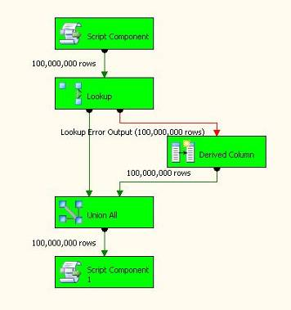
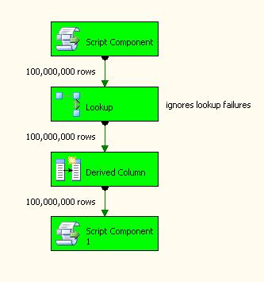
Case Study - Patterns
Use Error Output for handling Lookup miss
Ignore lookup errors and check for null looked up values in Derived Column
105 seconds
83 seconds

Slide 22
Debugging & Performance Tuning – A methodology
Optimize and Stabilize the basics
Minimize staging (else use RawFiles if possible)
Make sure you have enough Memory
Windows, Disk, Network, …
SQL FileGroups, Indexing, Partitioning
Get Baseline
Replace destinations with RowCount
Source->RowCount throughput
Source->Destination throughput
Incrementally add/change components to see effect
This could include the DB layer
Use source code control!
Optimize slow components for resources available
Notes:
SQL features - Utilise these other technolgies as much as possible. For instance if the SSIS insertion speed is slow, maybe its actually the fact that the DB should be utilising filegroups better, or maybe you need partitioned tables, etc. Comes back to the earlier statement of right tool for the right job - every piece of the solution needs to be well oiled in order for it to run smoothly, and SSIS can't fix bad DB design problems

Slide 23
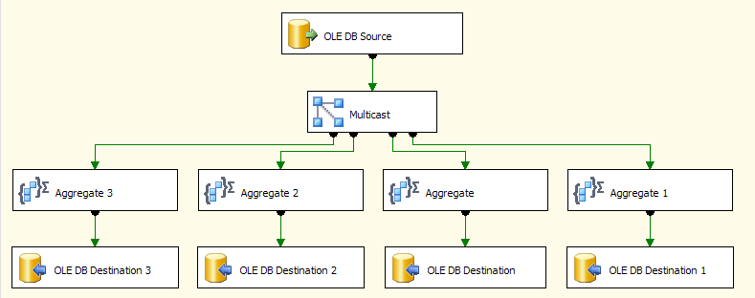
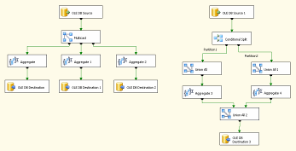
Case Study - Parallelism
Focus on critical path
Utilize available resources
Memory Constrained
Reader and CPU Constrained
Let it rip!
Optimize the slowest
Notes:
Memory Constrained
Optimized for low memory. Aggregate transform internally tries to create minimum memory when calculating aggregates. If one aggregation can be created from another, only the base aggregation is stored.
Reader and CPU constrained: optimized for a slow reader and reduced CPU constraints – all the aggregates will execute on the same thread.
Let it rip: completely parallellized operation – all sources, destinations, aggregations occur in parallel, with no constraints on memory. However, some of the aggregations might be significantly more expensive to calculate than others, and the final option (Optimize the slowest) balances the use of “Reader and CPU constrained” for the left side and introduces a UnionAll to give a thread each to the aggregate on the right.

Slide 24
Summary
Follow best practice development methods
Understand how SSIS architecture influences performance
Buffers, component types
Design Patterns
Learn the new features
But do not forget the existing principles
Use the native functionality
But do not be afraid to extend
Measure performance
Focus on the bottlenecks
Maximize parallelism and memory use where appropriate
Be aware of different platforms capabilities (64bit RAM)
Testing is key

Slide 25
Analysis Services

Slide 26
Agenda
Server architecture and UDM basics
Optimizing the cube design
Partitioning and Aggregations
Processing
Queries and calculations
Conclusion

Slide 27
Client Server Architecture
Excel
OLEDB
ADOMD
TCP
Client Apps
Analysis Server
XMLA
BIDS
AMO
IIS
SSMS
HTTP
Profiler
ADOMD .NET
Notes:
Client components are simple XMLA wrappers
No client side logic for query evaluation, processing
Client side caching limited to metadata – no caching of data, formulas, dimension members
Pros
Less demanding on client for memory and CPU
Better utilization of server resources
Query performance far less affected by network latency
Client components scale to middle tier workload
Cons
All queries require server roundtrip – could be slower than AS2000 where queries were answered by client cache
More load on the server – can affect throughput in multi-user scenario

Slide 28
Dimension
An entity on which analysis is to be performed (e.g. Customers)
Consists of:
Attributes that describe the entity
Hierarchies that organize dimension members in meaningful ways
Customer ID | First Name | Last Name | State | City | Marital Status | Gender | … | Age
123 | John | Doe | WA | Seattle | Married | Male | … | 42
456 | Lance | Smith | WA | Redmond | Unmarried | Male | … | 34
789 | Jill | Thompson | OR | Portland | Married | Female | … | 21

Slide 29
Attribute
Containers of dimension members.
Completely define the dimensional space.
Enable slicing and grouping the dimensional space in interesting ways.
Customers in state WA and age > 50
Customers who are married and male
Typically have one-many relationships
City → State, State → Country, etc.
All attributes implicitly related to the key

Slide 30
Hierarchy
Ordered collection of attributes into levels
Navigation path through dimensional space
User defined hierarchies – typically multiple levels
Attribute hierarchies – implicitly created for each attribute – single level
Customers by Geography
Customers by Demographics
Country
Marital
State
Gender
City
Customer
Customer

Slide 31
Dimension Model
Country
Country
State
Marital
City
Gender
Gender
State
Customer
Customer
Customer
City
Gender
Marital
Age
Customer
State
Gender
Customer
City
Country
Marital
Attributes
Hierarchies

Slide 32
Cube
Collection of dimensions and measures
Measure → numeric data associated with a set of dimensions (e.g. Qty Sold, Sales Amount, Cost)
Multi-dimensional space
Defined by dimensions and measures
E.g. (Customers, Products, Time, Measures)
Intersection of dimension members and measures is a cell (USA, Bikes, 2004, Sales Amount) = $1,523,374.83

Slide 33
A Cube
Units of beer sold in
Boston in January
Bos
M
a
r
k
e
t
NYC
Chi
Mar
Sea
Feb
Jan
Time
Peas
Corn
Bread
Milk
Beer
Product

Slide 34
Measure Group
Group of measures with same dimensionality
Analogous to fact table
Cube can contain more than one measure group
E.g. Sales, Inventory, Finance
Multi-dimensional space
Subset of dimensions and measures in the cube
AS2000 comparison
Virtual Cube → Cube
Cube → Measure Group

Slide 35
Measure Group
Measure Group
 | Sales | Inventory | Finance
Customers | X
Products | X | X
Time | X | X | X
Promotions | X
Warehouse |  | X
Department |  |  | X
Account |  |  | X
Scenario |  |  | X

Slide 36
Agenda
Server architecture and UDM Basics
Optimizing the cube design
Partitioning and Aggregations
Processing
Queries and calculations
Conclusion

Slide 37
Top 3 Tenets of Good Cube Design
Attribute relationships
Attribute relationships
Attribute relationships

Slide 38
Attribute Relationships
One-to-many relationships between attributes
Server simply “works better” if you define them where applicable
Examples:
City → State, State → Country
Day → Month, Month → Quarter, Quarter → Year
Product Subcategory → Product Category
Rigid v/s flexible relationships (default is flexible)
Customer → City, Customer → PhoneNo are flexible
Customer → BirthDate, City → State are rigid
All attributes implicitly related to key attribute

Slide 39
Attribute Relationships (continued)
City
Gender
Marital
Age
State
Customer
Country

Slide 40
Attribute Relationships (continued)
Country
State
City
Gender
Marital
Age
Customer

Slide 41
Attribute Relationships Where are they used?
MDX Semantics
Tells the formula engine how to roll up measure values
If the grain of the measure group is different from the key attribute (e.g. Sales by Month)
Attribute relationships from grain to other attributes required (e.g. Month → Quarter, Quarter → Year)
Otherwise no data (NULL) returned for Quarter and Year
MDX Semantics explained in detail at:
http://www.sqlserveranalysisservices.com/OLAPPapers/AttributeRelationships.htm

Slide 42
Attribute Relationships Where are they used?
Storage
Reduces redundant relationships between dimension members – normalizes dimension storage
Enables clustering of records within partition segments (e.g. store facts for a month together)
Processing
Reduces memory consumption in dimension processing – less hash tables to fit in memory
Allows large dimensions to push 32-bit barrier
Speeds up dimension and partition processing overall

Slide 43
Attribute Relationships Where are they used?
Query performance
Dimension storage access is faster
Produces more optimal execution plans
Aggregation design
Enables aggregation design algorithm to produce effective set of aggregations
Dimension security
DeniedSet = {State.WA} should deny cities and customers in WA – requires attribute relationships
Member properties
Attribute relationships identify member properties on levels

Slide 44
Attribute Relationships How to set them up?
Creating an attribute relationship is easy, but …
Pay careful attention to the key columns!
Make sure every attribute has unique key columns (add composite keys as needed)
There must be a 1:M relation between the key columns of the two attributes
Invalid key columns cause a member to have multiple parents
Dimension processing picks one parent arbitrarily and succeeds
Hierarchy looks wrong!

Slide 45
Attribute Relationships How to set them up?
Don’t forget to remove redundant relationships!
All attributes start with relationship to key
Customer → City → State → Country
Customer → State (redundant)
Customer → Country (redundant)

Slide 46
Attribute Relationships Example
Time dimension
Day, Week, Month, Quarter, Year
Year: 2003 to 2010
Quarter: 1 to 4
Month: 1 to 12
Week: 1 to 52
Day: 20030101 to 20101231
Year
Quarter
Week
Month
Day

Slide 47
Attribute Relationships Example
Time dimension
Day, Week, Month, Quarter, Year
Year: 2003 to 2010
Quarter: 1 to 4 - Key columns (Year, Quarter)
Month: 1 to 12
Week: 1 to 52
Day: 20030101 to 20101231
Year
Quarter
Week
Month
Day

Slide 48
Attribute Relationships Example
Time dimension
Day, Week, Month, Quarter, Year
Year: 2003 to 2010
Quarter: 1 to 4 - Key columns (Year, Quarter)
Month: 1 to 12 - Key columns (Year, Month)
Week: 1 to 52
Day: 20030101 to 20101231
Year
Quarter
Week
Month
Day

Slide 49
Attribute Relationships Example
Time dimension
Day, Week, Month, Quarter, Year
Year: 2003 to 2010
Quarter: 1 to 4 - Key columns (Year, Quarter)
Month: 1 to 12 - Key columns (Year, Month)
Week: 1 to 52 - Key columns (Year, Week)
Day: 20030101 to 20101231
Year
Quarter
Week
Month
Day

Slide 50
Defining Attribute Relationships

Slide 51
User Defined Hierarchies
Pre-defined navigation paths thru dimensional space defined by attributes
Attribute hierarchies enable ad hoc navigation
Why create user defined hierarchies then?
Guide end users to interesting navigation paths
Existing client tools are not “attribute aware”
Performance
Optimize navigation path at processing time
Materialization of hierarchy tree on disk
Aggregation designer favors user defined hierarchies

Slide 52
Natural Hierarchies
1:M relation (via attribute relationships) between every pair of adjacent levels
Examples:
Country-State-City-Customer (natural)
Country-City (natural)
State-Customer (natural)
Age-Gender-Customer (unnatural)
Year-Quarter-Month (depends on key columns)
How many quarters and months?
4 & 12 across all years (unnatural)
4 & 12 for each year (natural)

Slide 53
Natural Hierarchies Best Practice for Hierarchy Design
Performance implications
Only natural hierarchies are materialized on disk during processing
Unnatural hierarchies are built on the fly during queries (and cached in memory)
Server internally decomposes unnatural hierarchies into natural components
Essentially operates like ad hoc navigation path (but somewhat better)
Create natural hierarchies where possible
Using attribute relationships
Not always appropriate (e.g. Age-Gender)

Slide 54
Best Practices for Cube Design
Dimensions
Consolidate multiple hierarchies into single dimension (unless they are related via fact table)
Avoid ROLAP storage mode if performance is key
Use role playing dimensions (e.g. OrderDate, BillDate, ShipDate) - avoids multiple physical copies
Use parent-child dimensions prudently
No intermediate level aggregation support
Use many-to-many dimensions prudently
Slower than regular dimensions, but faster than calculations
Intermediate measure group must be “small” relative to primary measure group

Slide 55
Best Practices for Cube Design
Attributes
Define all possible attribute relationships!
Mark attribute relationships as rigid where appropriate
Use integer (or numeric) key columns
Set AttributeHierarchyEnabled to false for attributes not used for navigation (e.g. Phone#, Address)
Set AttributeHierarchyOptimizedState to NotOptimized for infrequently used attributes
Set AttributeHierarchyOrdered to false if the order of members returned by queries is not important
Hierarchies
Use natural hierarchies where possible

Slide 56
Best Practices for Cube Design
Measures
Use smallest numeric data type possible
Use semi-additive aggregate functions instead of MDX calculations to achieve same behavior
Put distinct count measures into separate measure group (BIDS does this automatically)
Avoid string source column for distinct count measures

Slide 57
Agenda
Server architecture and UDM Basics
Optimizing the cube design
Partitioning and Aggregations
Processing
Queries and calculations
Conclusion

Slide 58
Partitioning
Mechanism to break up large cube into manageable chunks
Partitions can be added, processed, deleted independently
Update to last month’s data does not affect prior months’ partitions
Sliding window scenario easy to implement
E.g. 24 month window → add June 2006 partition and delete June 2004
Partitions can have different storage settings
Partitions require Enterprise Edition!

Slide 59
Benefits of Partitioning
Partitions can be processed and queried in parallel
Better utilization of server resources
Reduced data warehouse load times
Queries are isolated to relevant partitions → less data to scan
SELECT … FROM … WHERE [Time].[Year].[2006]
Queries only 2006 partitions
Bottom line → partitions enable:
Manageability
Performance
Scalability

Slide 60
Best Practices for Partitioning
No more than 20M rows per partition
Specify partition slice
Optional for MOLAP – server auto-detects the slice and validates against user specified slice (if any)
Must be specified for ROLAP
Manage storage settings by usage patterns
Frequently queried → MOLAP with lots of aggs
Periodically queried → MOLAP with less or no aggs
Historical → ROLAP with no aggs
Alternate disk drive - use multiple controllers to avoid I/O contention

Slide 61
Best Practices for Aggregations
Define all possible attribute relationships
Set accurate attribute member counts and fact table counts
Set AggregationUsage to guide agg designer
Set rarely queried attributes to None
Set commonly queried attributes to Unrestricted
Do not build too many aggregations
In the 100s, not 1000s!
Do not build aggregations larger than 30% of fact table size (agg design algorithm doesn’t)
Notes:
Examines the AggregationUsage property to build list of candidate attributes
Full: Every agg must include the attribute
None: No agg can include the attribute
Unrestricted: No restrictions on the algorithm
Default: Unrestricted if attribute is All, key or belongs to a natural hierarchy, None otherwise

Slide 62
Best Practices for Aggregations
Aggregation design cycle
Use Storage Design Wizard (~20% perf gain) to design initial set of aggregations
Enable query log and run pilot workload (beta test with limited set of users)
Use Usage Based Optimization (UBO) Wizard to refine aggregations
Use larger perf gain (70-80%)
Reprocess partitions for new aggregations to take effect
Periodically use UBO to refine aggregations

Slide 63
Agenda
Server architecture and UDM Basics
Optimizing the cube design
Partitioning and Aggregations
Processing
Queries and calculations
Conclusion

Slide 64
Improving Processing
SQL Server Performance Tuning
Improve the queries that are used for extracting data from SQL Server
Check for proper plans and indexing
Conduct regular SQL performance tuning process
AS Processing Improvements
Use SP2 !!
Processing 20 partitions: SP1 1:56, SP2: 1:06
Don’t let UI default for parallel processing
Go into advanced processing tab and change it
Monitor the values:
Maximum number of datasource connections
MaxParallel – How many partitions processed in parallel, don’t let the server decide on its own.
Use INT for keys, if possible.
Parallel processing requires Enterprise Edition!
Notes:
Example:
<Batch> ....
<Parallel maxParallel="Integer">
<!-- One or more XMLA commands -->
</Parallel> ....
</Batch>
AS SP2 processing improvements - Implemented dimension property caching which is why processing is faster. Processing improvement usually seen for >2 processors.
Recommendation: Use integer keys
maxParallel is an optional Integer attribute. Indicates the maximum number of threads on which to run commands in parallel. If not specified or set to 0, the instance of Microsoft SQL Server Analysis Services determines an optimal number of threads based on the number of processors available on the computer. Recommendation between 0.5 to 1.0 times the number of cpus or else thrashing can occur.

Slide 65
Improving Processing
For best performance use ASCMD.EXE and XMLA
Use <Parallel> </Parallel> to group processing tasks together until Server is using maximum resources
Proper use of <Transaction> </Transaction>
ProcessFact and ProcessIndex separately instead of ProcessFull (for large partitions)
Consumes less memory.
ProcessClearIndexes deletes existing indexes and ProcessIndexes generates or reprocesses existing ones.
Notes:
Many threads are throttled by the max number of datasource connections. Check the limit on the datasource.
I suggest using MaxParallel parameter to control concurrency when processing in parallel, rather than let the system decide.
Do ProcessFact and ProcessIndex separately. They behave differently so we will learn more when done separately. Some customers do 2 steps because they are done using the relational database faster. Also ProcessFacts uses about 1.5 CPUs (roughly) and ProcessIndex will use more CPUs to build the aggregations. Depends on how many aggregations you have. So we expect ProcessFacts to scale well, and ProcessIndex to use all the CPUs.
NUMA units are percentage of min(physical,virtual) or bytes if > 100. Allocations are distributed across all NUMA nodes, and will try to use large OS pages. Note that getting large pages from the OS can take a long time, up to a few minutes for huge machines.
I would start with a value corresponding to the amount of memory used in steady state or 50% of memory used during processing. Then go up to something like 80% of memory used during processing. You want to pre-allocate enough to avoid the problem, but not steal from other processes (the relational database).
You can get feedback for the amount actually allocated by using a debug monitor (dbmon.exe, or get one from http://www.sysinternals.com).
ProcessClearIndexes - not in the docs, clears indexes; when you need it: if index is invalid, ProcessIndexes won't do anything because it sees them as being already created

Slide 66
Best Practices for Processing
Partition processing
Monitor aggregation processing spilling to disk (perfmon counters for temp file usage)
Add memory, turn on /3GB, move to x64/ia64
Fully process partitions periodically
Achieves better compression over repeated incremental processing
Data sources
Avoid using .NET data sources – OLEDB is faster for processing

Slide 67
Agenda
Server architecture
UDM Basics
Optimizing the cube design
Partitioning and Aggregations
Processing
Queries and calculations
Conclusion

Slide 68
Non_Empty_Behavior
Most client tools (Excel, Proclarity) display non empty results – eliminate members with no data
With no calculations, non empty is fast – just checks fact data
With calculations, non empty can be slow – requires evaluating formula for each cell
Non_Empty_Behavior allows non empty on calculations to just check fact data
Note: query processing hint – use with care!
Create Member [Measures].[Internet Gross Profit] As
[Internet Sales Amount] - [Internet Total Cost],
Format_String = "Currency",
Non_Empty_Behavior = [Internet Sales Amount];

Slide 69
Auto-Exists
Attributes/hierarchies within a dimension are always existed together
City.Seattle * State.Members returns {(Seattle, WA)}
(Seattle, OR), (Seattle, CA) do not “exist”
Exploit the power of auto-exists
Use Exists/CrossJoin instead of .Properties – faster
Requires attribute hierarchy enabled on member property
Filter(Customer.Members,
Customer.CurrentMember.Properties(“Gender”) = “Male”)
Exists(Customer.Members, Gender.[Male])

Slide 70
Conditional Statement: IIF
Use scopes instead of conditions such as Iif/Case
Scopes are evaluated once statically
Conditions are evaluated dynamically for each cell
Always try to coerce IIF for one branch to be null
Create Member Measures.Sales As
Iif(Currency.CurrentMember Is Currency.USD,
Measures.SalesUSD, Measures.SalesUSD * Measures.XRate);
Create Member Measures.Sales As Null;
Scope(Measures.Sales, Currency.Members);
This = Measures.SalesUSD * Measures.XRate;
Scope(Currency.USA);
This = Measures.SalesUSD;
End Scope;
End Scope;

Slide 71
Best Practices for MDX
Use calc members instead of calc cells where possible
Use .MemberValue for calcs on numeric attributes
Filter(Customer.members, Salary.MemberValue > 100000)
Avoid redundant use of .CurrentMember and .Value
(Time.CurrentMember.PrevMember, Measures.CurrentMember ).Value can be replaced with Time.PrevMember
Avoid LinkMember, StrToSet, StrToMember, StrToValue
Replace simple calcs with computed columns in DSV
Calculation done at processing time is always better
Many more at:
Analysis Services Performance Whitepaper: http://download.microsoft.com/download/8/5/e/85eea4fa-b3bb-4426-97d0-7f7151b2011c/SSAS2005PerfGuide.doc
http://sqljunkies.com/weblog/mosha
http://sqlserveranalysisservices.com

Slide 72
Conclusion
AS2005 is major re-architecture from AS2000
Design for perf & scalability from the start
Many principles carry through from AS2000
Dimensional design, Partitioning, Aggregations
Many new principles in AS2005
Attribute relationships, natural hierarchies
New design alternatives – role playing, many-to-many, reference dimensions, semi-additive measures
Flexible processing options
MDX scripts, scopes
Use Analysis Services with SQL Server Enterprise Edition to get max performance and scale

Slide 73
Resources
SSIS
SQL Server Integration Services site – links to blogs, training, partners, etc.: http://msdn.microsoft.com/SQL/sqlwarehouse/SSIS/default.aspx
SSIS MSDN Forum: http://forums.microsoft.com/MSDN/ShowForum.aspx?ForumID=80&SiteID=1
SSIS MVP community site: http://www.sqlis.com
SSAS
BLOGS: http://blogs.msdn.com/sqlcat
PROJECT REAL-Business Intelligence in Practice
Analysis Services Performance Guide
TechNet: Analysis Services for IT Professionals
Microsoft BI
SQL Server Business Intelligence public site: http://www.microsoft.com/sql/evaluation/bi/default.asp
http://www.microsoft.com/bi

