Slide 1
Introduction to change management
doc. Ing. Petr Řehoř, Ph.D.

Slide 2
Learning outcomes
you will know the terms change and the management of changes,
you will be able to explain the attitude to the change and the principles of the change,
you learn of the aim and contribution of the change,
you will learn to characterize the success of the organization,
you will distinquish 2 tools of success.

Slide 3
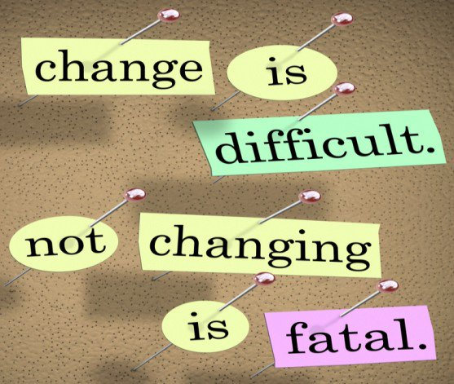
Introduction
Every day the organizations are confronted with the need of the change.
The change to better is indicated as betterment.
The change to worse is indicated as decline
(deterioration).

Slide 4
Change
Widespread appreciable, measurable or quantified difference in the condition or properties of some entity in determinated index system.
Changes are inevitable.

Slide 5
Benefits of change
risks associated with the introduction of change are minimised,
the time required to implement a change is minimised,
the possibility of a change being unsuccessful is considerably reduced,
more rapid adaptation to customer requirements,
return on investment is increased,
employees produce improved performances and feel more motivated

Slide 6
Levels of change

Slide 7
Attitudes to change
Passive
Reactive
Proactive

Slide 8
Goals of change

Slide 9
Change management
The process, tools and techniques to manage the people-side of the change processes, to achieve the required outcomes, and to realise the change effectively within the infividual change agent, the inner team, and the wider system.
A structured approach to moving from the current state to a future state.

Slide 10
Change management
We change for a reason.
Organizational change requires individual change.
Organizational outcomes are the collective result of individual change.
Change management is an enabling framework for managing the people side of change.

Slide 11
Change management

Slide 12
Principles of change management
The change must be based on the efficient organizational analysis.
All participated sides should be connected with the change.
The change in the organization is always complex.
Naturally, people defend against changes.
People must know, can and want for the acceptance of the change.

Slide 13
Change manager
know mutual ralations among the processes in the systém.
be able to communicate with the individuals, groups and to understand the whole process of the next, connected changes.
know how the participants of the process will react on the whole changed process.
be able to use different methods and tools for diagnostics and principles.

Slide 14
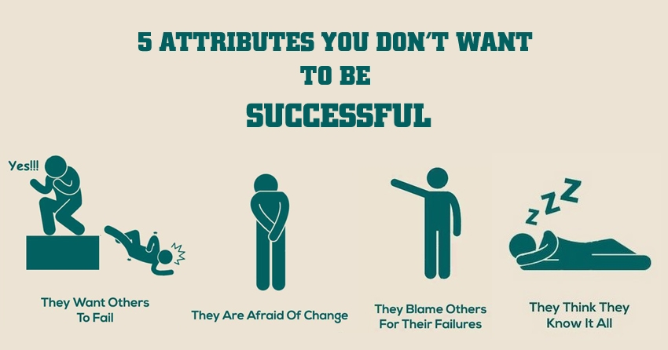
10 steps to successful
Understand change.
Assess the impact of change.
Assemble a change management team.
Build a vision for change.
Put a strategy and place.
Win support.
Communicate effectively.
Overcome challenges.
Measure success.
Review lessons learned.

Slide 15
Model 7S

Slide 16
EFQM model

Slide 17
Thank you for your attention.

