Slide 1
Old Testament Exegesis
Step 2
Biblical text and its language

Slide 2
When the textual unit has been chosen, and the text has been prepared, now the linguistic aspects can be analysed. The language analysis consists of three main aspects:
Lexical analysis
Syntactic analysis
Macrosyntactic analysis

Slide 3
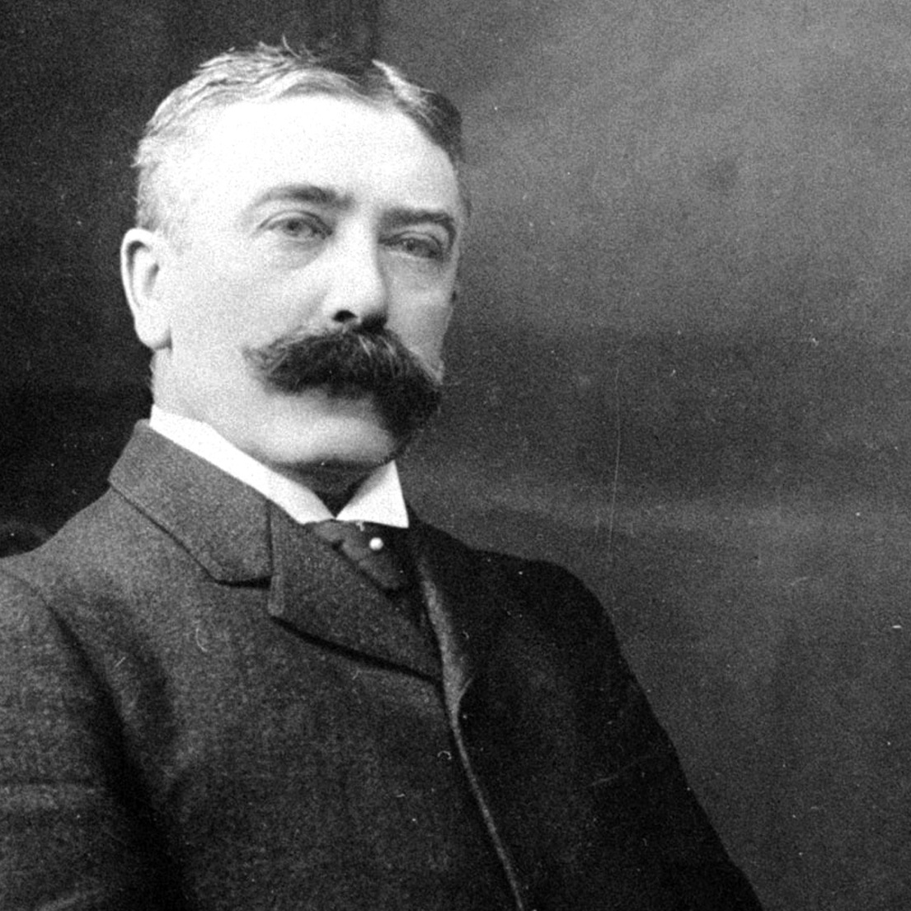
Ferdinand de Saussure:
Speech units obtain their meaning through relations to other units
signe vs. signifié
collocation
“meaning is a convention“

Slide 4
Five myths about the word meaning:
1. One, basic meaning: Each word has one, basic meaning; it is present in all instances of the word. (↔ decisive is the context!)
2. Etymology: The original meaning of a word is decisive, and it is always present in the word (↔ etymology sometimes can help, but it is the context that determines the meaning of a word)

Slide 5
Five myths about the word meaning (continues):
3. Combined meanings: Meaning of an idiom is obtained by summing the meaning of its components (↔ an idiom has its own meaning, which can be independent of the meaning of its components).
4. Understanding the denotate, we understand the word (↔ we have to understand the connotates, too; these can be culturally dependent).

Slide 6
Five myths about the word meaning:
5. Transposition of meanings: If a word can have more meanings (polysemy), all of them are present in each instance of the word (↔ sometimes might be true, but generally the context decides which one of the meanings is actually present)

Slide 7
How do we procede:
We find (semantically) difficult words (e.g. by comparing translations)
We determine key terms
Lexical analysis of the key terms
Their meaning in general (including polysemy)
In various contexts
In the present context

Slide 8
Syntax: sentence structure
Various levels of syntax:
Word morphology
Word groups: adnominal construction, relations of words to each other etc.
Clause structure: subject, predicate, modifiers…
Sentence structure: matrix clause, independent clauses, syndetic or asyndetic connections, etc.

Slide 9
In Hebrew, some forms have a different function in different context; e.g. „perfect“ conveys a different meaning in narrative and in discursive texts.
A practical advice: When determining the structure of clauses and sentences in our textual unit, use an hierarchical structure. What is the prevailing clause-type?

