Slide 1
Systems Analysis and Design

Slide 2
Learning Objectives
Understand the logical modeling of processes through studying data flow diagrams
How to draw data flow diagrams using rules and guidelines
How to decompose data flow diagrams into lower-level diagrams
Balancing of data flow diagrams

Slide 3
Learning Objectives
Explain the differences among four types of DFDs: current physical, current logical, new physical and new logical
Discuss the use of data flow diagrams as analysis tools
Compare and contrast data flow diagrams with Oracle’s process modeling tool and with functional hierarchy diagrams

Slide 4
Process Modeling

Slide 5
Process Modeling
Graphically represent the processes that capture, manipulate, store and distribute data between a system and its environment and among system components
Data flow diagrams (DFD)
Graphically illustrate movement of data between external entities and the processes and data stores within a system

Slide 6
Process Modeling
Modeling a system’s process
Utilize information gathered during requirements determination and organized it into meaningful representation.
In addition you must also model the process logic and timing (chapter 9).
And structure of data within the system (chapter 10)

Slide 7
Deliverables for Process Modeling
Deliverables and Outcomes
Set of coherent, interrelated data flow diagrams, such diagrams are:
- Context data flow diagram (DFD)
Scope of system
- DFDs of current system
Enables analysts to understand current system
it shows what data processing functions performed by the current system
- DFDs of new logical system
Show data flows, structure and functional requirements of new system
- Description of each DFD component, entries for all of the objects
included in all diagrams (in data dictionary or CASE repository)

Slide 8
Definitions and Symbols

Slide 9
Data Flow Diagramming Mechanics
Four symbols are used in DFD - see figure 7-2
process as an oval.
data store as a rectangle
source/sink as s square
data flow as an arrow
Two different standard sets can be used
DeMarco and Yourdan
Gane and Sarson

Slide 10
Data Flow Diagramming Mechanics
Data Flow
Depicts data that are in motion and moving as a unit from one place to another in the system.
Drawn as an arrow
Select a meaningful name to represent the data

Slide 11
Data Flow Diagramming Mechanics
Data Store
Depicts data at rest
May represent data in
File folder
Computer-based file
Notebook
The name of the store as well as the number are recorded in between lines

Slide 12
Data Flow Diagramming Mechanics
Process
Depicts work or action performed on data so that they are transformed, stored or distributed
Number of process as well as name are recorded

Slide 13
Data Flow Diagramming Mechanics
Source/Sink
Depicts the origin and/or destination of the data
Sometimes referred to as an external entity
Drawn as a square symbols

Slide 14
Data Flow Diagramming Definitions
Context Diagram
A data flow diagram (DFD) of the scope of an organizational system that shows the system boundaries, external entities that interact with the system and the major information flows between the entities and the system
Level-0 Diagram
A data flow diagram (DFD) that represents a system’s major processes, data flows and data stores at a high level of detail

Slide 15
Developing DFDs: An Example
Hoosier Burger’s automated food ordering system
Context Diagram (Figure 7-4) contains one process, no data stores, four data flows, and three sources/sinks
Next step is to expand the context diagram to show the breakdown of processes level-0 DFD (Figure 7-5)

Slide 16
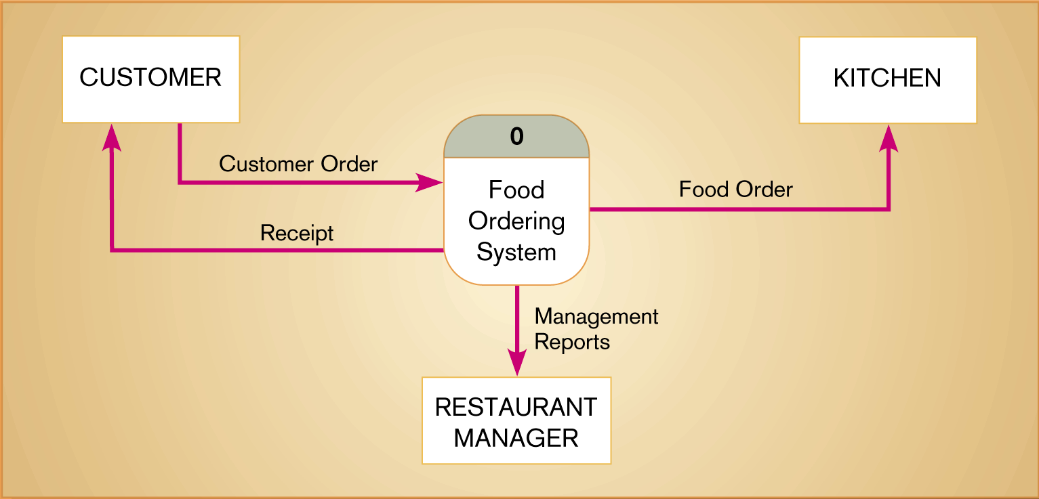
Figure 7-4 Context diagram of Hoosier Burger’s food ordering system

Slide 17
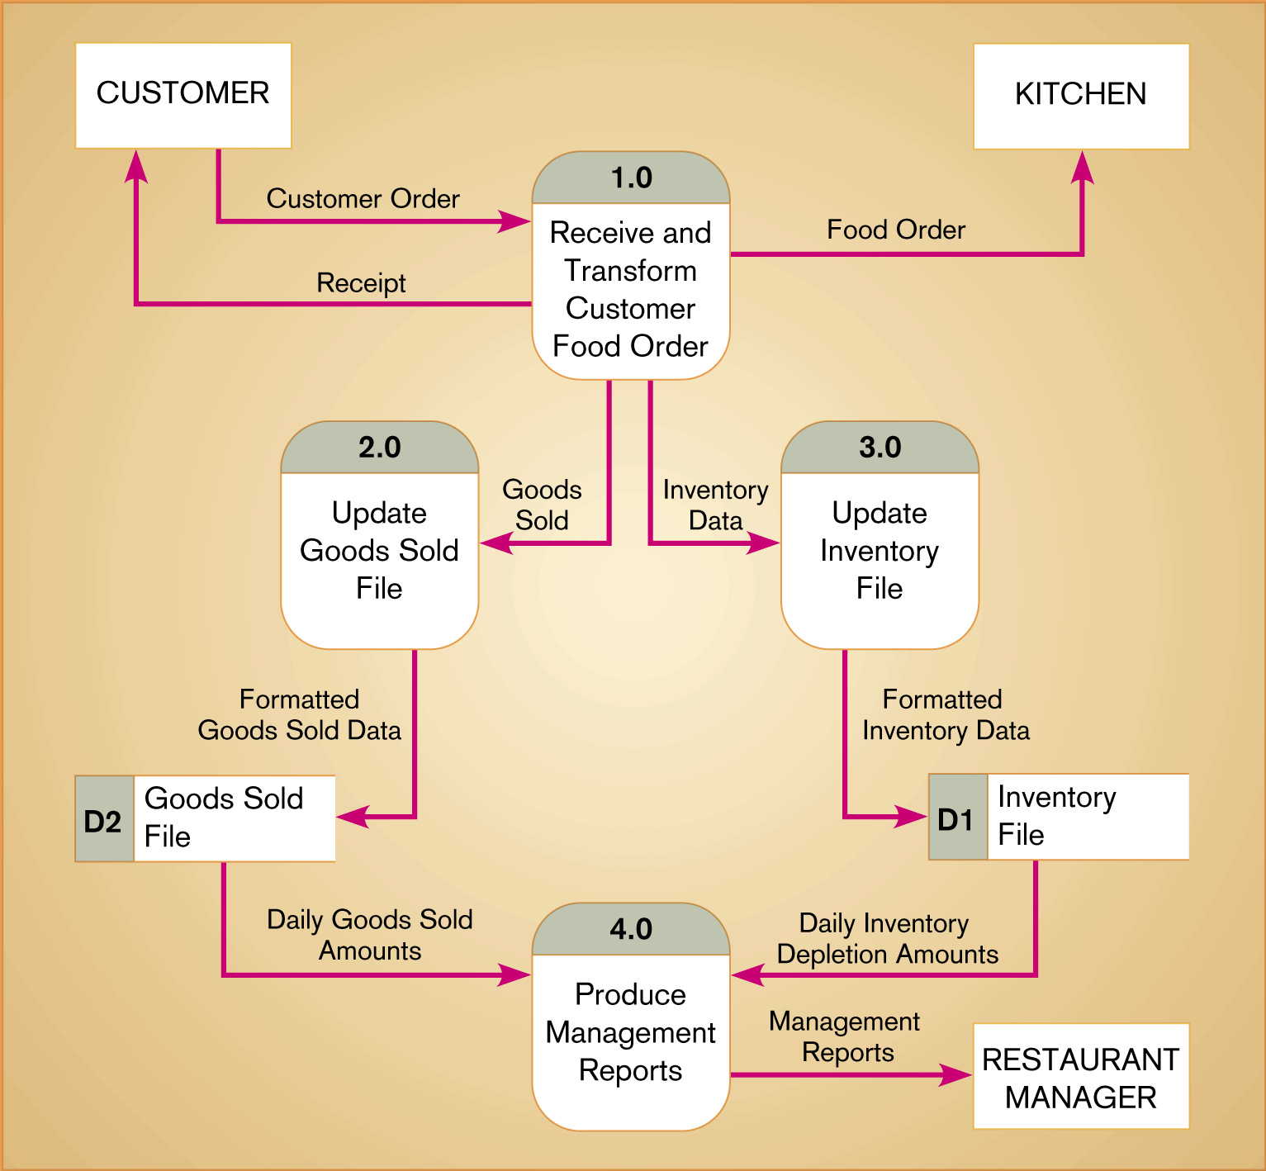
Figure 7-5 Level-0 DFD of Hoosier Burger’s food ordering system

Slide 18
Level-1 DFD

Slide 19
Level-n DFD

Slide 20
Data Flow Diagramming Rules
Basic rules that apply to all DFDs
Inputs to a process are always different than outputs
Objects always have a unique name
In order to keep the diagram uncluttered, you can repeat data stores and sources/sinks on a diagram
Every process has a unique name.

Slide 21
Data Flow Diagramming Rules
Process
No process can have only outputs (a miracle)
No process can have only inputs (black hole)
A process has a verb phrase label
Data Store
Data cannot be moved directly from one store to another
Data cannot move directly from an outside source to a data store
Data cannot move directly from a data store to a data sink
Data store has a noun phrase label

Slide 22
Data Flow Diagramming Rules
Source/Sink
Data cannot move directly from a source to a sink
A source/sink has a noun phrase label
Data Flow
A data flow has only one direction of flow between symbols
A fork means that exactly the same data goes from a common location to two or more processes, data stores or sources/sinks

Slide 23
Data Flow Diagramming Rules
Data Flow (Continued)
A join means that exactly the same data comes from any two or more different processes, data stores or sources/sinks to a common location
A data flow cannot go directly back to the same process it leaves
A data flow to a data store means update
A data flow from a data store means retrieve or use
A data flow has a noun phrase label

Slide 24
What is wrong of the following if any?

Slide 25
Decomposition of DFDs
Functional decomposition, Is an iterative process of breaking a system description down into finer and finer detail.
Creates a set of charts in which one process on a given chart is explained in greater detail on another chart.
Continues until no sub-process can logically be broken down any further.
Lowest level is called a primitive DFD
Level-N Diagrams
A DFD that is the result of n nested decompositions of a series of sub processes from a process on a level-0 diagram

Slide 26
Balancing DFDs
Conservation Principle: conserve inputs and outputs to a process at the next level of decomposition.
Balancing: conservation of inputs and outputs to a data flow diagram process when that process is decomposed to a lower level.
Balanced means:
Number of inputs to lower level DFD equals number of inputs to associated process of higher-level DFD
Number of outputs to lower level DFD equals number of outputs to associated process of higher-level DFD

Slide 27
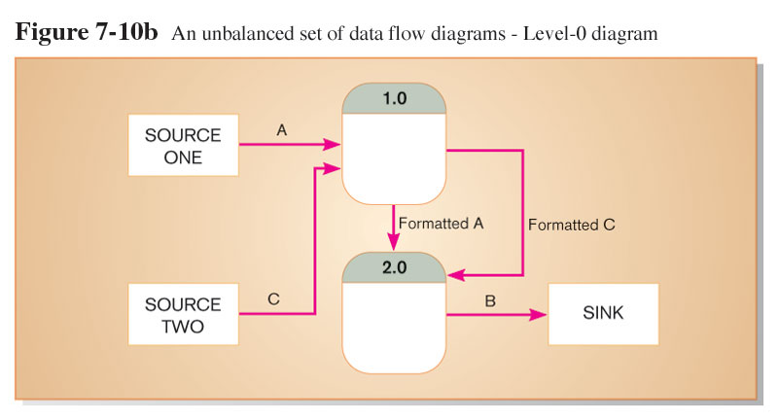
Balancing DFDs

Slide 28
Balancing DFDs
Data flow splitting is when a composite data flow at a higher level is split and different parts go to different processes in the lower level DFD.
The DFD remains balanced because the same data is involved, but split into two parts.

Slide 29
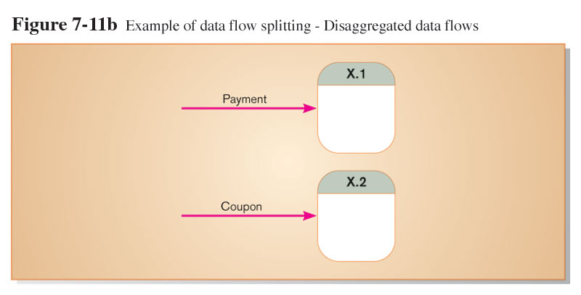
Balancing DFDs

Slide 30
Four Different Types of DFDS used in the systems development process:
Current Physical
Process labels identify technology (people or systems) used to process the data.
Data flows and data stores identify actual name of the physical media.
Current Logical
Physical aspects of system are removed as much as possible.
Current system is reduced to data and processes that transform them.

Slide 31
Four Different Types of DFDS
Current Physical
Process labels identify technology (people or systems) used to process the data.
Data flows and data stores identify actual name of the physical media.
Current Logical
Physical aspects of system are removed as much as possible.
Current system is reduced to data and processes that transform them.
New Logical
Includes additional functions.
Obsolete functions are removed.
Inefficient data flows are reorganized.
New Physical
Represents the physical implementation of the new system.

Slide 32
Guidelines for Drawing DFDs
Completeness
DFD must include all components necessary for system
Each component must be fully described in the project dictionary or CASE repository
Consistency
The extent to which information contained on one level of a set of nested DFDs is also included on other levels

Slide 33
Guidelines for Drawing DFDs
Timing
Time is not represented well on DFDs
Best to draw DFDs as if the system has never started and will never stop.
Iterative Development
Analyst should expect to redraw diagram several times before reaching the closest approximation to the system being modeled (How many?)

Slide 34
Guidelines for Drawing DFDs
Primitive DFDs
Lowest logical level of decomposition
Decision has to be made when to stop decomposition

Slide 35
Guidelines for Drawing DFDs
Rules for stopping decomposition
When each process has been reduced to a single decision, calculation or database operation
When each data store represents data about a single entity
When the system user does not care to see any more detail

Slide 36
Guidelines for Drawing DFDs
Rules for stopping decomposition (continued)
When every data flow does not need to be split further to show that data are handled in various ways
When you believe that you have shown each business form or transaction, on-line display and report as a single data flow
When you believe that there is a separate process for each choice on all lowest-level menu options

Slide 37
Using DFDs as Analysis Tools
Gap Analysis is the process of discovering discrepancies between two or more sets of data flow diagrams or discrepancies within a single DFD.
Inefficiencies in a system can often be identified through DFDs, such inefficiency is a violation of DFD drawing rules, such an obsolete data are captured but not used any where in the system .

Slide 38
Use Cases
A description of a system’s behavior or functionality under various conditions as the system responds to requests from users.
Use case diagram is a picture showing system behavior along with the key actors that interact with the system.

Slide 39
Use Cases key symbols
Actor
Use case represented as ellipse.
System boundary.
connection.
Extended relationship, is an association between two use cases where one adds new behaviors or action to the other.
Include relationship, is an association between two use cases where one use case uses the functionality in the other. In figure 7-23 the include relationship between the reorder supplies and track sales and inventory data, use case implies that the former uses the latter. In this case when the manager reorder supplies, the sales and inventory data are tracked,

Slide 40
Use Cases
For identifying Use Cases it is recommended that you ask the following:
- what are the main task performed by each actor?
- will the actor read or update any information in the system?
- will the actor have to be informed of unexpected changes?

Slide 41
Example of Use case

Slide 42
Another Example of Use Case

