Slide 1
Change management gurus
doc. Ing. Petr Řehoř, Ph.D.

Slide 2
Learning outcomes
you will know about the history of change management,
you will learn about famous gurus of change management.

Slide 3
Introduction
How can business leaders respond to the drivers of change without wasting resources on failed change initiatives?
Learning a lesson or two from these noted change management gurus is as good a place to start as any.

Slide 4
History of change management timeline
1911 – Scientific management
1932 – The Hawthorne studies
1946 – Organization development
1949 – Sociotechnical systems theory
1954 – Leadership theory
1980 – Turbulent changes
1985 - Innovation
1996 – 8 Steps change model
2006 – Adkar model

Slide 5
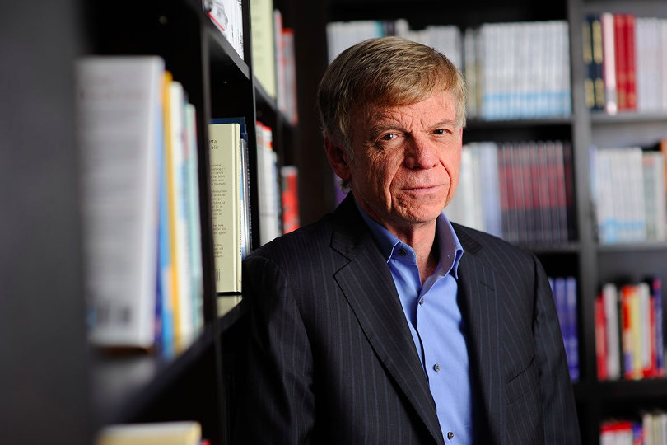
John Kotter
New York Times best-selling author, Harvard professor.
Leading change, A sence of urgency.
Kotter’s 8-Step Process for Leading Change.

Slide 6
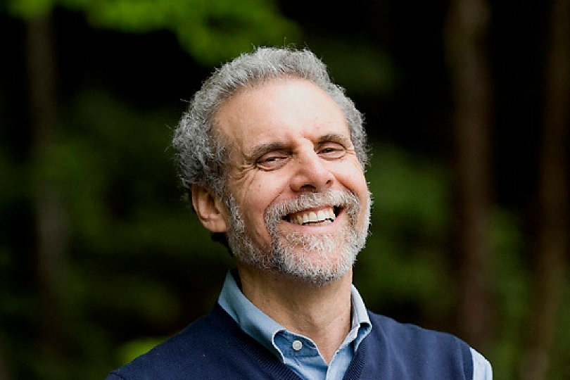
Daniel Goleman
Emotional Intelligence - fundamental skills that allow us to understand and manage our own emotions as well as those around us.
Leaders of successful change management initiatives often exhibit remarkable competency in personal areas such as self-
awareness, self-
management, empathy,
social awareness, and
relationship management.

Slide 7
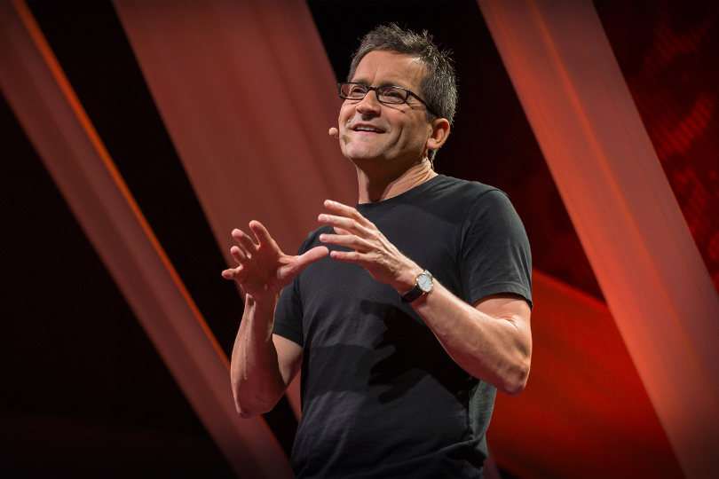
Jim Hemerling
5 Ways to Lead in an Era
of Constant Change:
Inspire engagement by
connecting the need for
change with a deeper sense of purpose.
Look for ways to invest in talent and leadership development.
Give people the tools, resources, and support.
Instill a culture of continuous learning and self-development.
Create an inclusive environment of open debate and solicited suggestions.

Slide 8
Jeff Hiatt
ADKAR a model for change in business, government, and our community - a way to address employee resistance to organizational change:
Awareness.
Desire.
Knowledge.
Ability.
Reinforcement.

Slide 9
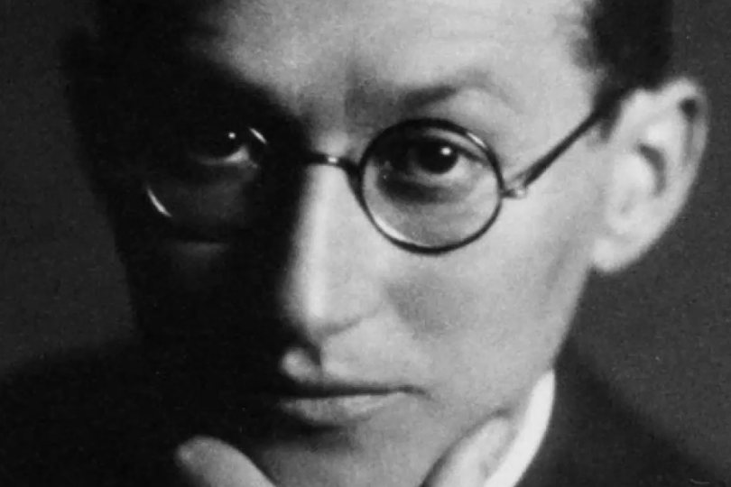
Kurt Lewin
A physicist and social scientist.
Managing change through three distinct stages:
Unfreeze
Change
Refreeze
Model addresses the roadblocks of organizational transformation, notably motivation, implementation, and adherence.

Slide 10
Don James
Business mapping methodology.
Change management approach: define what must change, articulate why change must occur, identify the change constituents, develop a vision for the adopted change, define the change strategy, develop the change plan, broadly communicate, engage the organization, monitor progress, know when to call victory.

Slide 11
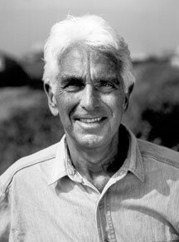
Warren Bennis
Leaders: The Strategies for Taking Charge - four competencies that leaders need to develop:
forming a vision which provides people with a bridge to the future;
giving meaning to that vision through communication;
building trust, the lubrication
that makes it possible for
organisations to work;
searching for self-knowledge and self-regard.

Slide 12
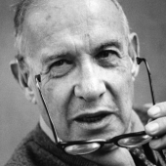
Peter F. Drucker
management consultant, educator, and author
concept known as management by objectives and self-control, and he has been described as the founder of modern management
Managing in Turbulent Times
Innovation and Entrepreneurship
Managing in a Time of Great Change
Management Challenges for 21st Century

Slide 13
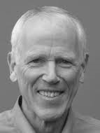
Richard Bevan
Changemaking: Tactics and resources for managing organizational change
success change involves the following: listen to the stakeholders, learn about the issues, lead with clarity and involvement, align systems, communicate relentlessly, follow-up and course-correct. Then consider who will be most affected; ask questions and listen carefully to the responses

Slide 14
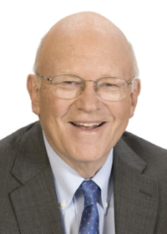
Ken Blanchard
Who killed change?
A step-by-step guide at the back shows you how to apply the story’s lessons to the real world with key questions to help evaluate the health of your organization’s change initiatives, and enabling and sustaining the desired change.

Slide 15
Thank you for
the attenttion!!!

