Slide 1
Cestovka – Strategic Plan Development
Business Simulator
Ing. Viktor Vojtko, Ph.D. (2019)

Slide 2
Decisions to be made
List price for summer tour package - affects the amount of sold tour packages and total revenue
List price for winter tour package - affects the amount of sold tour packages and total revenue
Last minute discount percentage - affects the amount of sold tour packages and total revenue for the period when last minute is being applied
Number of months for the last minute discount application
Deposit percentage (max. 50%) - the deposit customers pay at the time of ordering, the rest is being paid in the month of the trip, it affects income, the amount of sold tours and revenue
Booking of FIX accommodation - affects the availability of trips for a month +5 (eg. booking in January affects amount and price of available accommodation in June)
Booking of CONTINGENT accommodation - affects the availability of trips for a month +5 (eg. booking in January affects amount and price of available accommodation in June)
Promotion budget - influences the amount of sold tour packages, income and expenses

Slide 3
Marketing strategy
We want to attract enough of right customers according to existing segments and competitors’ position
Market targeting related decisions
Pricing and last minute discount
Promotion budget
Deposit size

Slide 4
Supplier strategy
We want to have enough supplier capacity for the least cost
Supplier related decisions:
In advance booking of FIX or CONTINGENT accommodation

Slide 5
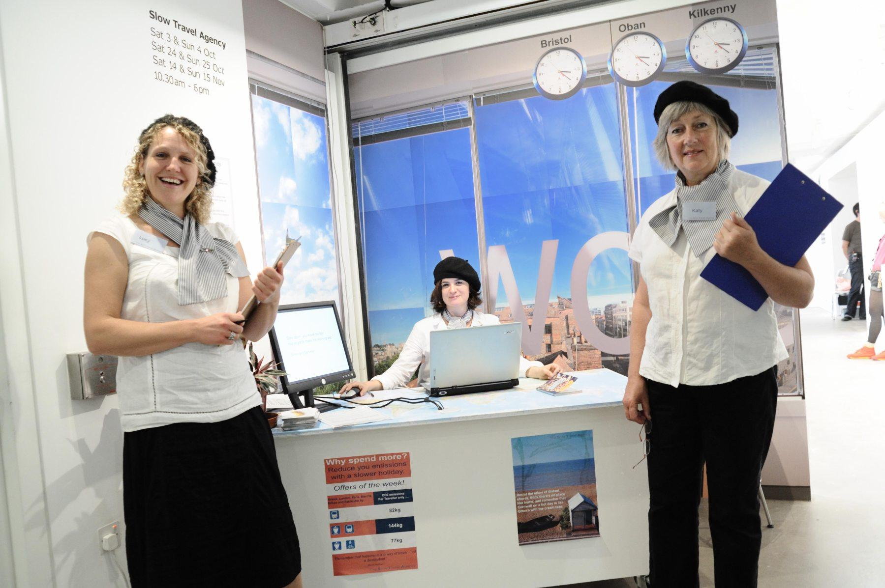
HR and operation strategy
We want to have an optimum number of employees from operational capacity perspective and give them salaries that are comparable to competition
HR related decisions (indirect):
Number of employees
Change of employee wages

Slide 6
Financial strategy
We want to have enough money for operations and necessary payments to suppliers as well as to minimize cost related to financial capital
We also want to achieve planned profitability for owners
Finance related decisions:
Pricing
Owners’ equity
Loans

Slide 7
Strategic plan development
We have to combine all the previous strategies together in a way when they support each other
Marketing
Supplies
HR and operation
Finance

