Slide 1
Process of the change management
doc. Ing. Petr Řehoř, Ph.D.

Slide 2
Learning outcomes
you will meet the process of the change,
you will be able to define terms separated point and SUCCESS,
you will learn more about the aversion of the labours to the changes,
you will learn the possibilities, how to break the aversion to the changes,
you will know, what participants of the change we differ,
you will obtain the survey of it, how to communicate the change.

Slide 3
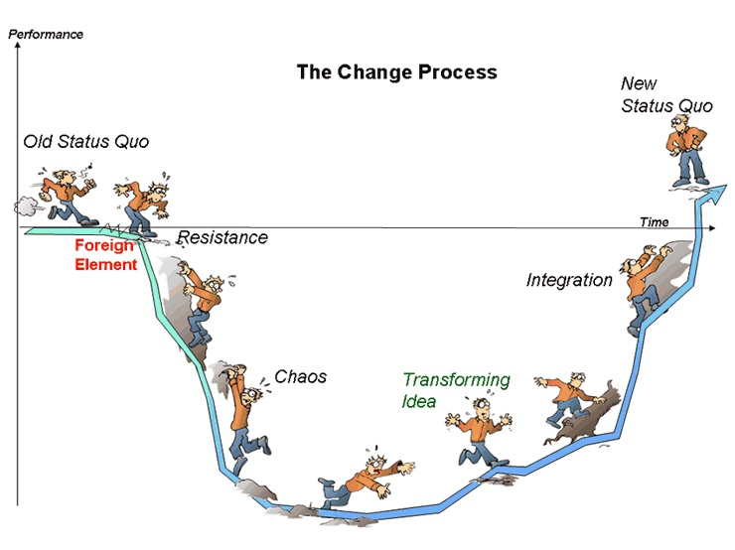
Introduction
The whole process of the change must be right understood.
It is necessary to work out a good plan of the change.
The resistence to the changes themselves belong
to the biggest
risks of the
process of changes.

Slide 4
Change management process

Slide 5
Planning of change
Bifurcation point (disintegration, separated point):
1. To implement a change, since a change is less dangerous in the future, or even more promising than an unchanging state.
2. Not to implement a change, because a change is risky at any given moment, while constancy represents certainty.

Slide 6
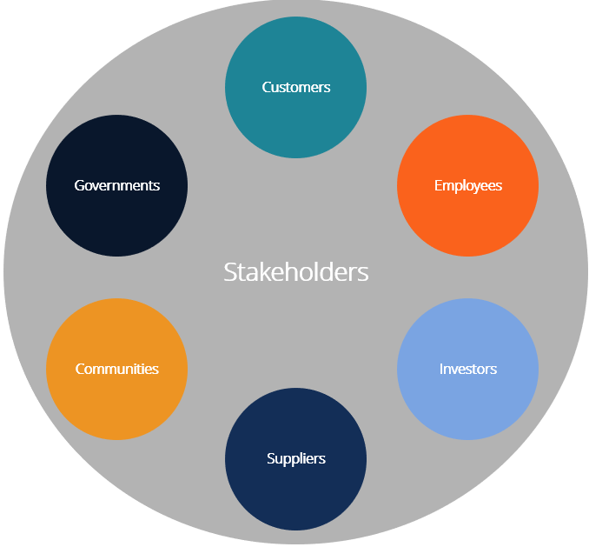
Planning of change
S – shared values
U – understand the organizations
C – cultural alingment
C – communication
E – experinced help where necessary
S – strong leadership
S – stakeholder buy-in

Slide 7
Planning of change

Slide 8
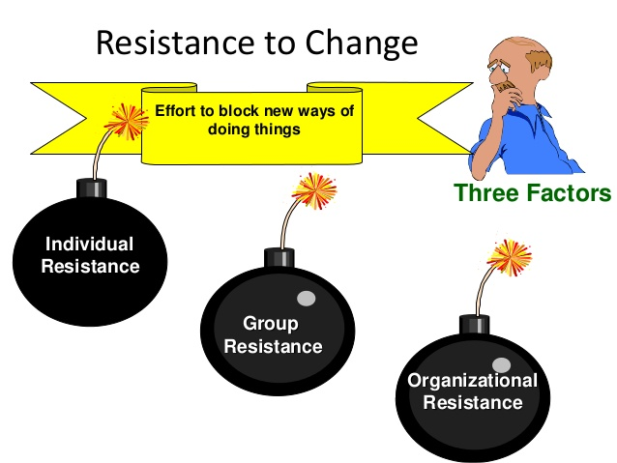
Resistence to change
own interests
uncertainty
lack of understanding and trust
different perception
lack of tolerance
unwillingness to give
up the existing
advantages
people are afraid of thinking over the presented changes

Slide 9
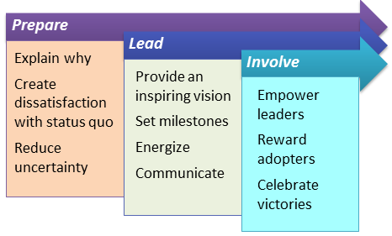
Overcoming resistence to change
Education and communication
Participation and involvement
Facilitation and support
Negotiation and agreement
Manipulation and cooptation
Explicit and implicit coercion

Slide 10
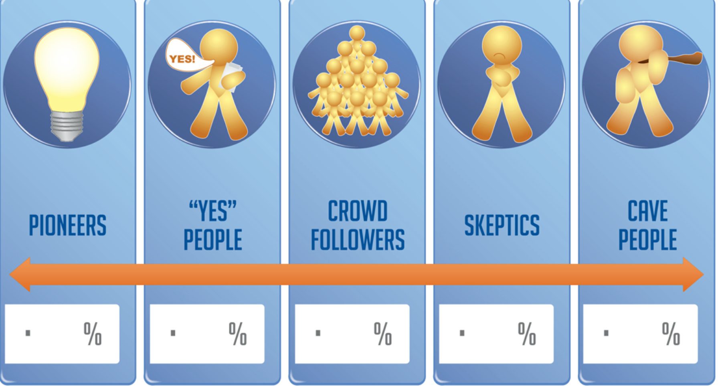
Participants in change process
Change initiator
Change analyst
Change realiser
Change user
Change investor
Supporters of the change
Opponents of the change
Uninvolved parties

Slide 11
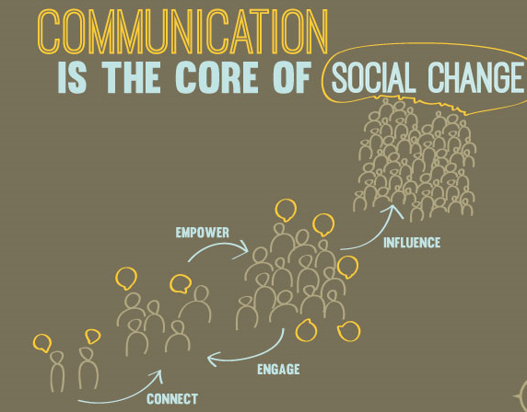
Communication of change
Who should be informed about a change?
When should they be informed?
What should the subject of the notification be?
Where should they be informed?
Who should manage the communication process?

Slide 12
Successful change
a clear, motivating, well communicable vision explaining the sense of the change,
sufficient time for the entire proces,
the people interested in the change,
concentration of strength on the change process,
use of positive and negative motivation of employees,
focus on communicating with the barriers of change.

Slide 13
Thank for
your attention!

