Slide 1
Reward systems
Rewarding employees by BSC and MBO, Remuneration of management, specialists and expatriates.

Slide 2
Rewarding employees by BSC and MBO
Remuneration according to MBO
(Management by Objectives)
It is a very widespread mode of remuneration mainly for reason of ease of implementation. It is a method based on the determination and mutual reconciliation of objectives and evaluation of the successfulness of their achievement. Designed by Peter F. Drucker. MBO places emphasis on the result rather than on the achievement method. The remuneration method based on MBO, i.e. according to the objectives, can be applied practically anywhere.

Slide 3
Rewarding employees by BSC and MBO
Remuneration according to MBO
(Management by Objectives)
The basis of the method comprises well-defined objectives that must be SMART (Specific, Measurable, Achievable, Realistic, Time Specific). The principle of causality, i.e. interdependence of objectives applies here. The objectives of the subordinate should build on the objectives of the superior, and these should in turn build on the objectives of the director. Types of objectives - company objective, departmental objective (department, division), individual objectives.

Slide 4
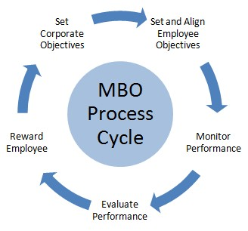
Rewarding employees by BSC and MBO
Remuneration according to MBO
(Management by Objectives)

Slide 5
Rewarding employees by BSC and MBO
Remuneration according to the Balanced Scorecard (BSC)
System of the balanced indicators of company performance, which was established in the USA in 1992. The basic idea is that the target of the enterprise is to satisfy not only its shareholders, but also other interest groups, such as employees, suppliers, distributors, customers and others.

Slide 6
Rewarding employees by BSC and MBO
BSC performance of the enterprise on the basis of four perspectives:
1. Financial (ROE, ROA, EVA, revenue growth rate…)
2. Customer (share of timely deliveries, share of key customers…)
3. Internal business processes (shortening of the manufacturing cycle, increase of productivity…)
4. Learning and growth (Improvement of the language knowledge of key employees, loyalty of the employees, fluctuation)

Slide 7
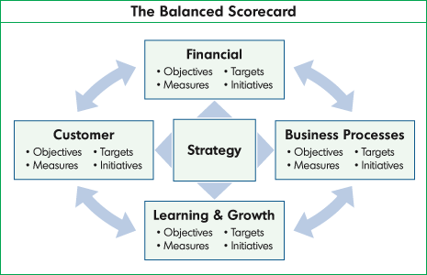
Rewarding employees by BSC and MBO

Slide 8
Rewarding employees by BSC and MBO
It is the most demanding of all the types of remuneration systems, but also one of the most transparent. The creation of this system starts with the definition of the strategic map, again on the basis of the mission, vision and values of the company. The application of the BSC method to practical remuneration requires a clear idea of the corporate strategy and translation of the strategy to the performance indicators of the company and its departments and setting of the target values of these performance indicators.

Slide 9
Rewarding employees by BSC and MBO
The strategic map contains the targets of the senior management that are further cascaded to the lower management levels, lower objectives.
Usually 3 to 5 levels (each with their own targets or criteria)
The following have their own targets in BSC
- senior management
- middle management
- individual departments
- individual work teams

Slide 10
Rewarding employees by BSC and MBO
Advantages:
- clear communication targets of the enterprise, their conversion to indicators and translation in the performance criteria of the individual organisational units.
- a balanced remuneration tool that besides financial targets also includes further evaluation criteria. (relationship to MBO)
Disadvantages:
- Variable remuneration through BSC requires stricter control of the causality of the objectives and their calibration
- The system is complicated and its function must be explained to the employees

Slide 11
Rewarding employees by BSC and MBO
Remuneration of management
A) By the Employment Agreement (so-called, management contract)
- commencement of the employment relationship
B) Transaction-management contract (earlier contract of mandate)
- an employment relationship is not established, he guarantees losses with all his assets (big risk)

Slide 12
Rewarding employees by BSC and MBO
Transaction-management contract
The agent undertakes to arrange and perform a certain act for the mandator for consideration (company management, CEO). The scope of his duties is stated in the contract. Just as applies to work on the basis of a trade licence.
Major characteristic features of the transaction-management contract:
- An employment relationship is not established
- He pays social security and health insurance contributions himself

Slide 13
Rewarding employees by BSC and MBO
Major characteristic features of the transaction-management contract:
- He is not obligated to be present at the workplace
- Possibility for quick termination - termination of the contract
- Guarantees losses with all his assets

Slide 14
Rewarding employees by BSC and MBO
Managerial Contract
The management contract should be constructed in compliance with the Labour Code and clearly regulate the responsibilities of the management employee for good organisation and operation of the company or the entrusted department and particularly for his good business results. The objective is to identify an ideal tool of managerial remuneration that motivates the managers to achieve long-term increase of the value of the company. An important role is played by the variable component of the wage (approx. 40% - 60% and above)

Slide 15
Rewarding employees by BSC and MBO
Wholesale
1. Basic wage (fixed wage component)
2. System of bonuses (variable wage components)
3. Employee benefits - up to 20 % of wage
An important role is played by the variable wage component, which should be tied to clear criteria (for instance, the profit growth rate, turnover growth rate, economy of value added, cash value added, etc. )

Slide 16
Rewarding employees by BSC and MBO
Management share options
The options are determined by the company’s board of directors. The options give their holders the right - but do not stipulate the obligation - to acquire the defined volume of shares in the company in a defined future period at a predefined price, usually the market price at the time of acquisition of the option (job start).

Slide 17
Rewarding employees by BSC and MBO
Application advantages
The manager whose annual bonus is based on the growth of the company profit may in an effort to achieve his performance targets postpone some company expenditure, for instance, in the areas of technical development or marketing, at the cost of restricting the long-term development potential of the company. On the contrary, the use of options allegedly motivates the managers to monitor the long-term interests of the company because the potential remunerations (higher value of the shares from which they profit) shall be reached only after a certain period.

Slide 18
Rewarding employees by BSC and MBO
Remuneration of expatriates
A significant component of international management of human resources are the expatriates, i.e. employees dispatched from the mother country to work for a limited period at the company’s branch in another country. Most of the organisations use expatriates only for higher management positions or as specialists in a very narrow area. Expatriates are very costly in terms of financing. For this reason, it does not seem to be economically reasonable to employ an expatriate in a position that can be occupied and performed easily by a local employee.

Slide 19
Rewarding employees by BSC and MBO
1) Remuneration according to the mother country (most often)
He gets the same pay as in the mother country plus an allowance for work abroad (i.e. spendable income)
2) Remuneration according to the host country
The expatriate has the same salary and benefits as the local employee in the host country. This approach helps maintain the equality of the expatriates with the employees in the host country.

Slide 20
Rewarding employees by BSC and MBO
3) Remuneration according to the selected country
The wage according to the mother country where the company has its seat and is adjusted according to the purchasing power of the host country.
4) Hybrid
The system consists of two components. One is the same for all employees abroad and the second depends on the lifestyle in the host country.

Slide 21
Rewarding employees by BSC and MBO
Allowances for expatriates
The allowance for expatriates is compensation for intervention in their lives. These allowance components include the allowance for higher living costs, moving bonus, allowances for deprivation, separation, housing or moving, work in a hazardous environment.

Slide 22
Thank you for your attention
Have a nice day

